Slide 1
Disclaimer
"The European Commission support for the production of this publication does not constitute an endorsement of the contents which reflects the views only of the authors, and the Commission cannot be held responsible for any use which may be made of the information contained therein."

Slide 2
POSITIVE BEHAVIOUR SUPPORT
Positive Behaviour Support (PBS) is an approach that is used to support behaviour change in a person with a learning disability.
The focus is not on ‘fixing’ the person or on the challenging behaviour itself
If you can teach someone a more effective and more acceptable behaviour than the challenging one, the challenging behaviour will reduce.
When is the challenging behaviour NOT happening?
Challenging behaviours are learned and open to being changed.
PBS helps people to get the life they wish by increasing the number of ways of achieving these things (i.e communication or learning new skills)
Notes:
PBS teaches alternative behaviour and changes the environment to support the person well
. There is nothing wrong with wanting attention, to escape from a difficult situation, wanting certain items, or displaying behaviours which just feel good. : for example, by developing communication skills. PBS helps people to learn new skills. For new skills to be used regularly, they have to be more effective than the challenging behaviour. We can make this happen by understanding the reasons people display challenging behaviour, and by making sure the new behaviours we want to teach are reinforced in the same way.

Slide 3
PBS PLAN
WHAT?
Document created to help understand and manage behaviour in people who have learning disabilities and display behaviour that others find challenging.
Provides step by step guide to making sure the person has a great quality of life
Enables people who work with the person to identify triggers and when they need to intervene to prevent an episode of challenging behaviour.
Positive Behaviour Support plan includes
PROACTIVE STRATEGIES
REACTIVE STRATEGIES
A good PBS plan has more proactive than reactive strategies
Notes:
is based on the results of a functional assessment and uses Positive Behaviour Support (PBS) approaches. The plan contains a range of strategies which not only focus on the challenging behaviour(s) but also include ways to ensure the person has access to things that are important to them. The strategies used are referred to as Proactive Strategies and Reactive Strategies. Proactive strategies are intended to make sure the person has got what they need and want on a day to day basis and also includes ways to teach the person appropriate communication and life skills. Reactive strategies are designed to keep the person and those around them safe from harm. They provide a way to react quickly in a situation where the person is distressed or anxious and more likely to display challenging behaviour. A good behaviour support plan has more Proactive strategies than Reactive ones. This helps to ensure that the focus of the plan is not just on the challenging behaviour but provides ways to support the person to have a good life, enabling the person to learn better, more effective ways of getting what they need.
Who?
A behaviour support plan is for individuals who regularly display challenging behaviour to the extent that it severely impacts on their life. For example, it may result in exclusion from places like schools, day centres and mainstream community activities e.g. swimming pool. A behaviour support plan can be developed and used at any age. The earlier challenging behaviour can be understood and strategies put in place to help reduce the behaviours, the better it is for the person and those caring for them.
Why?
To help effectively respond to challenging behaviour a good Behaviour Support Plan is vital. A Behaviour Support Plan aims to reduce the likelihood of challenging behaviour happening and if used consistently is very successful in supporting the person to find other ways to communicate their needs. The emphasis is on preventing the need for challenging behaviour, but also helps carers to identify when an individual may display challenging behaviour, giving them a chance to ~ 3 ~ intervene before the behaviour escalates. This can avoid a full blown incident of challenging behaviour. Everyone has different beliefs about what is right and wrong and how behaviour ‘should’ be managed, based on their own experiences and understanding. Using a Behaviour Support Plan means that everyone consistently uses the same techniques, rather than everybody ‘doing their own thing’ based on what they think is best.

Slide 4
PBS PLAN
WHO?
A behaviour support plan is for individuals who regularly display challenging behaviour to the extent that it severely impacts on their life.
WHY?
Reduce the likelihood of the challenging behaviour
Provide consistency
Promote participation and inclusion
ENHANCE QUALITY OF LIFE
Notes:
The emphasis is on preventing the need for challenging behaviour, but also helps carers to identify when an individual may display challenging behaviour, giving them a chance to ~ 3 ~ intervene before the behaviour escalates. This can avoid a full blown incident of challenging behaviour. Everyone has different beliefs about what is right and wrong and how behaviour ‘should’ be managed, based on their own experiences and understanding. Using a Behaviour Support Plan means that everyone consistently uses the same techniques, rather than everybody ‘doing their own thing’ based on what they think is best.

Slide 5
POSITIVE BEHAVIOUR SUPPORT
FUNCTIONS OF THE CHALLENGING BEHAVIOUR
Social attention - to get noticed or acknowledged by others
Escape/avoidance - to get away from a situation or task the person finds difficult
Tangible - to get something they want (e.g. food, activities, etc.)
Sensory - meet sensory needs
Check if the person is in pain, feeling unwell or trying to communicate!
Notes:
If the person is trying to get your Attention by hitting:
Teach the person how they can get your attention/the attention of others in a more appropriate way. This could be by teaching them a sign, a vocalisation or to gently tap your hand/arm
Make sure you notice when the person is trying to get your attention appropriately and respond as soon as you can. This will help to reinforce the behaviour you want
If the person goes to hit you, use a phrase such as “Gently” or “Hands down”. Teach the person what this means
Interact with the person regularly, giving them plenty of opportunity to get positive attention
Where possible ignore the hitting
If the person hits others to Escape/Avoid something or someone:
Give the person an effective way to stop something they don’t like; to remove them from a situation or person they don’t like. This could be a sign/word or photo card to say “Finish” or “Home”
Teach them to make choices and a way to say “yes” and “no”
Introduce them to a situation/activity gradually to help them become used to it
Use humour as a way to distract the person
Notice when they are displaying ‘early warning signs’ that they may be becoming unhappy or anxious
Change the way you ask them to do something
When the person hits others to get something Tangible:
Teach the person how to communicate they want a drink/toy/DVD etc.
Give them what they’ve asked for as soon as they’ve asked appropriately. Give lots of praise. Make sure they have regular access to what they need
Teach them how to get something for themselves where possible. Make sure the person knows where their magazines are kept or that juice is found in the fridge and make sure there is a cup in a cupboard they can easily reach
Make sure they are not left without food or drink for too long, or without something meaningful to do (offer these regularly)
As far as possible ignore the hitting
If the situation escalates and people are at risk give them what they want
Where a person hits to get their Sensory needs met:
Ask for a referral to a specialist Occupational Therapist (OT) who can do a sensory assessment to clarify specific sensory needs
Be creative! Get a drum, box, cushion or other thing that they could hit
Try out different objects to see which they prefer, then use these to create new activities
Use preferred items to help you engage with the person
Make sure the person can get their sensory needs met, but in a way that will not isolate them further or leave them engaging in a self-stimulatory behaviour for too long. If people have self-stimulatory activities that are very important to them, try and support them to have at least some meaningful routine/

Slide 6
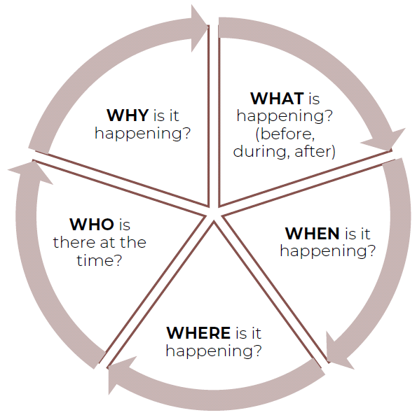
MONTESSORI: unmet needs
Behaviours of unmet needs
When is this not happening?
When needs are addressed and people are:
Engaged in their roles and activities
Given reassurance and attention
And have social contact

Slide 7
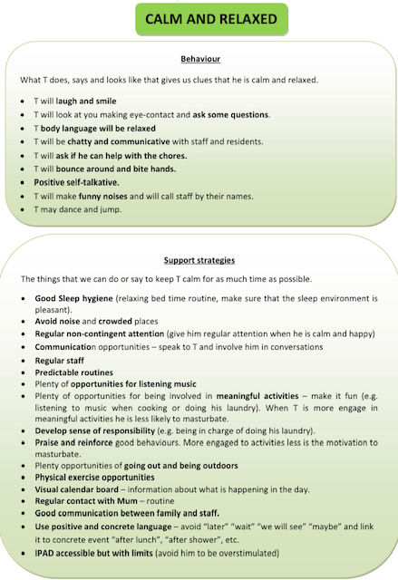
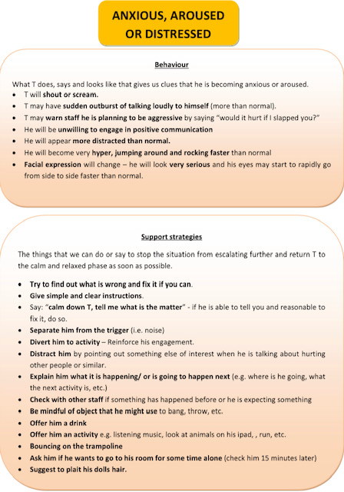
PBS: into practice

Slide 8
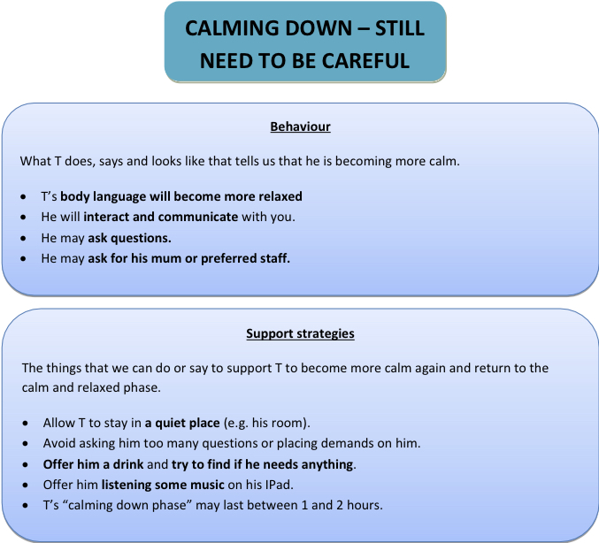
PBS: into practice

Slide 9
PBS: Dealing with problems
If someone refuses to do an activity
Check if it is a good time to do it.
Choice is important, avoid interrupting people when they are engaged in other activities
Give more support if needed.
Error free to avoid frustration
Check if the activity is too hard or insufficiently rewarding.
Be more encouraging and enthusiastic, make the activity enjoyable.
A person doesn’t seem to want to do anything
Keep it simple (small steps) and give a high level of support
Avoid nagging the person
Set up the activity so it is ready to do
Prompt and guide simple ways to participate
Reinforce the person immediately they begin to participate
Notes:
A person doesn’t seem to want to do anything - This is probably a case of the person not getting the support and encouragement to achieve things frequently enough in the past. It will take time to change. Asking a person whether they want to do something is not really giving him or her a choice if he or she does not have sufficient experience of doing any part of it successfully.

Slide 10
PBS: Dealing with problems
Getting a person to concentrate
Minimise distractions before supporting someone participate in an activity.
Give short, clear instructions, prompts or demonstrations.
Don’t fill the silences with chit-chat
Plan breaks carefully. Don’t
be tempted to carry on because everything is going so well.
Avoid setting the person up so that he or she has to be disruptive in order to stop participating.
A person starts to behave disruptively
Think if the person is exerting control.
Disruptive behaviour indicates that the person does not want to start the activity or to carry on with it.
Staff have to be sensitive and learn how to gauge the difficulty of tasks and the amount and type of support provided so that the person begins to experience success and enjoy the activity instead

Slide 11
PBS: What good PBS looks like?
Quality of life
Not PBS
Focus is on the behaviour, not the supported person
Good PBS
Improving quality of life is the main intervention an outcome
No concern about the supported person’s quality of life
A reduction in the number of incidents of behaviour of concern is the only desired intervention and outcome
A person-centred understanding of what matters to the supported person
An improvement in quality of life is evidenced
A reduction in the number of incidents of behaviour of concern is a side effect

Slide 12
PBS: What good PBS looks like?
Communication
Not PBS
Good PBS
Notes:
Exercise – Thinking about communication – what would Good PBS look like?
And what would it look like if we were not doing PBS?

Slide 13
PBS: What good PBS looks like?
Communication
Not PBS
Good PBS
Belief that people “understand everything we say” and so we don’t need to adapt our communication styles
Reliance on verbal communication people are considered ‘non-compliant’ when they don’t understand
Total or inclusive communication is not used (eg signs, gestures, photos, pictures)
Staff and other carers can describe the difficulties in understanding and communicating that supported people have and what they do to support this
Total or inclusive communication is seen being used regularly and frequently (eg signing, pictures, photos, gestures, facial expression)
Specific tools are used to support people’s communication and choice making (eg photos, pictures, drawing, high tech aids and iPads) routinely in most situations

Slide 14
PBS: What good PBS looks like?
Environment
Not PBS
Good PBS
Notes:
Exercise – thinking about the Environment ...what is good PBS? And what isn’t?

Slide 15
PBS: What good PBS looks like?
Environment
Not PBS
The supported person has to ‘fit’ the service provided
Good PBS
Institutionalised approach
No concern with changing the environment, or the support provided
Person-centred adaptations to the environment and support that fits the supported person’s needs
All twelve elements of capable environments are present
Team-based practice leaders coach colleagues to get the support right for each person
Notes:
For more information and other subject areas look at the bild.org Good PBS Screening Tool:
Key elements of PBS - how to spot them -Good_PBS_POB_SCREEN.pdf

Slide 16
PBS: What good PBS looks like?
An introduction to PBS (bild.org)
https://www.youtube.com/watch?v=epjud2Of610&t=29s

Slide 17
POSITIVE BEHAVIOUR ACTIVE SUPPORT
.
Every moment has potential
Little and often
Graded assistance
Maximising choice and control
‘The more you do for me, the more you steal from me’
Notes:
Active Support:
To achieve this Active Support focuses on the skills of staff in enabling engagement and on the capacity of the service to provide accessible opportunities in a structured and predictable fashion.
Active Support has been shown to be important in determining the quality of life of people with learning disabilities (Mansell and Beadle-Brown, 2012), and in particular in increasing people’s participation in daily life, social and community activities as well as increasing people’s skills, adaptive behaviour and choice. Research over many years also indicates that Active Support should be a vital component in the support of people with challenging The primary outcome of Active Support is engagement in meaningful activities and relationships but the way it looks in practice will vary depending on the individual requirements of the person being supported and the nature of activity or interaction they’re engaged in.
04 Every moment has potential: Utilising the activities that need to be done (such as housework,
shopping or gardening) and those that are available to do (such as visiting friends or relatives,
playing sport or adult education) as opportunities for supporting people to be engaged throughout
the day. These activities are often done by staff, with the people they serve acting only as nonparticipating
spectators, if they are present at all. Active Support reverses this condition, so that
people are involved in all the activities of daily living, even (or particularly) when the presence of
challenging behaviour might result in such opportunities being withdrawn.
Little and often: Thinking about activities and relationships as a series of steps so that staff can
identify those parts the person can do for themselves, those that staff can help them with and
those that staff will need to do for them in order for the person to experience success. As a result
staff can start small, enabling people to dip in and out and providing shorter opportunities for
engagement throughout the day rather than solely focusing on single lengthy events.
Graded assistance: Providing the right amount and type of support at the right time – too much
and the person will be ‘over-supported’ and hindered in their independence, control and status; too
little and they will fail. Staff develop the skills they need to ensure the amount and type of help they
provide is constantly adjusted to fit the particular activity, step or circumstance.
Maximising choice and control: Looking for opportunities for the person to express their
preferences and be listened to, recognising that choosing within activities and relationships is a
valuable opportunity for experiencing choice and control. Frequently responding to preferences this
way increases the likelihood that the person will learn that making choices makes sense, and will
make more of them

Slide 18
SUPPORTING PEOPLE’S STRENGTHS
What is a strength?
We
Recognise people’s strengths
Take action to build and maintain those strengths
Use those strengths to help us meet the person’s needs.
A change of language and culture
Professional identity is a strength throughout life
Notes:
What are the strengths of the people you have worked with who have disabilities?
How can we support people to develop their strengths further?
When supporting an elderly or retired person, their professional identity can still be a strength – a source of memories, habits, skills, pride and self esteem.

Slide 19
MEETING PEOPLE’S NEEDS
WHAT DO WE NEED TO DO?
Personalised support
Flexibility in our approach
Tailor the environment/tools to their needs
Find new ways of motivation and stimulation
Encourage and facilitate decision making
Increase proactive participation
HOW?
Get to know the person
Good practice research.
WORKING AS A TEAM
Attention to detail
Engagement into activities

Slide 20
IMPORTANCE OF FOLLOW UP
FEEDBACK ABOUT ACTIVITIES (DAILY LIVING ACTIVITIES INCLUDED).
Does the person like it?
Is the activity appropriate for the person?
PROPOSE NEW IDEAS AND GIVE
FEEDBACK!!
Is the activity meeting their needs?
Is the person motivated enough?
Is he/she participating in the decision making?

