Slide 1
PERSON CENTRED APPROACH
If you were moving into a care community today, what are 10 things you would like staff to know about you?

Slide 2
Disclaimer
"The European Commission support for the production of this publication does not constitute an endorsement of the contents which reflects the views only of the authors, and the Commission cannot be held responsible for any use which may be made of the information contained therein."

Slide 3
PERSON CENTRED APPROACH
Right support – right place - right time
Our approach
Diagrama improves lives through a person-centred approach.
We provide active support, so service users participate in meaningful activities and relationships to gain independence and autonomy, becoming integrated and valued members of their community and to achieve their goals.
We build on service users’ strengths and capabilities, irrespective of degree of disability.
We seek best practice to develop our service

Slide 4
PERSON CENTRED APPROACH
PERSON CENTRED APPROACH
SUPPORT INDEPENDENCE
HONOURS CHOICE
IMPROVES QUALITY OF LIFE
ENHANCE DIGNITY
EMPOWERMENT
PROMOTE POSITIVE WELLBEING

Slide 5
PERSON CENTRED APPROACH
PHYSICAL & EMOTIONAL WELLBEING – HEALTH
PERSONAL GROWTH
SOCIAL INCLUSION
INTERPERSONAL RELATIONSHIP
PHYSICAL ENVIRONMENT – Material resources
RIGHTS – CHOICES - EQUAL OPPORTUNITIES
Professional identity

Slide 6
PERSON CENTRED APPROACH
FAMILY
STAFF TEAM
CARE AND SUPPORT PLAN
RISK ASSESSMENTS
GOALS AND ASPIRATIONS
ADAPTED ENVIRONMENTS
MONITOR PROGRESS AND CHANGING NEEDS
MEANINGFUL OPPORTUNITIES AND RELATIONSHIPS
ADVOCATE
FRIENDS
PERSON
HEALTH PROFESSIONALS
SOCIAL SERVICES
COMMUNITY OPPORTUNITIES
COMMUNITY LINKS

Slide 7
PERSON CENTRED APPROACH
Diagrama’s principles of care:
People we support should be happy, healthy, safe from harm and able to develop, thrive and fulfil their potential.
Value and nurture each person as an individual with talents, strengths and capabilities.
Foster positive relationships, encouraging strong bond between people we support and staff in the home on the basis of joint activities, shared daily life routines.
Be ambitious, nurturing learning and ambitions for their future.
Be attentive to people’s needs and strengths, supporting emotional, mental and physical health needs and encouraging friendships.
Be outward facing, working with the wider system of professionals for each person, and their families.
Have high expectation of staff as committed members of a team, as decision makers and as activity leaders. Ensuring all staff and managers are engaged in on-going learning about their role and the people they work with.
Provide a safe and stimulating high quality environment, with spaces that support nurture and allow privacy as well as common spaces and spaces to be active.

Slide 8
PERSON CENTRED APPROACH
How we can promote health and wellbeing in a creative way?
Healthy eating
Active ageing
Engagement in the community
Positive risk taking
Sensory activities
Meaningful relationships
Personal growth

Slide 9
PERSON CENTRED APPROACH
Person centred support provides help to enable people to participate successfully in meaningful activities and relationship so that they gain more control over their lives and more independence.
Plan about:
Individuals’ strength
Possible direction and aspirations
Set realistic goals and achieve progress
Facilitation of choice
Decision making about present and future
Autonomy
Personal control

Slide 10
PERSON CENTRED APPROACH
WALKING IN THE PERSON’S SHOES...
Make a sandwich, peel a potato, make a phone call.
Observe ... what's going well? What can be adapted? Right tools? What is not working? Is there something we can do about it?

Slide 11
ACTIVE SUPPORT
I CAN’T DO IT I CAN DO IT
Active Support is designed to make sure that people who need support have the chance to be fully involved in their lives and receive the right range and level of support to be successful. Several research studies have shown that it is effective
Active Support has 3 components:
Interacting to Promote Participation. Right level of assistance so the person can do all the typical daily activities that arise in life
Activity Support Plans. Plan of activities which individuals need or want to do each day and to work out the availability of support so that activities can be accomplished successfully.
Keeping Track. Monitor development, improvements and/or
ACTIVE SUPPORT

Slide 12
ACTIVE SUPPORT
WHY IS ACTIVE SUPPORT IMPORTANT?
Participation and contribution are important to self-esteem
People with learning disabilities might need support to participate
Providing support bridges the gap between what people can and cannot do
Is a way to empower people to take control over their life
MONTESSORI IN CARE COMMUNITIES

Slide 13
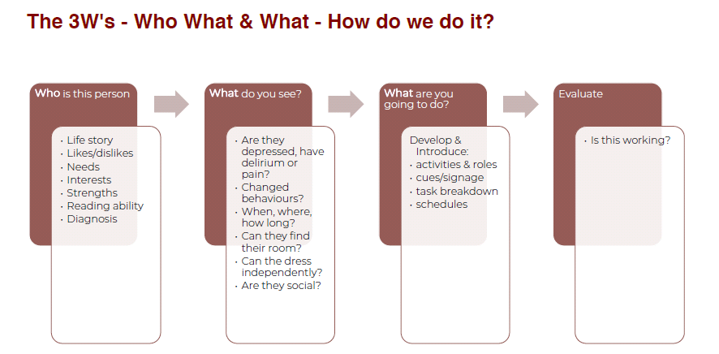
ACTIVE SUPPORT: The person

Slide 14
ACTIVE SUPPORT
.
ACTIVE SUPPORT aim to provide enough help to enable people to
participate successfully in meaningful activities and relationships
gain more control over their lives
develop more independence
become more included as a valued member of their community irrespective of degree of disability or presence of challenging behaviour
QUALITY OF LIFE
PARTICIPATION IN COMMUNITY
Notes:
Active Support:
To achieve this Active Support focuses on the skills of staff in enabling engagement and on the capacity of the service to provide
accessible opportunities in a structured and predictable fashion.
Active Support has been shown to be important in determining the quality of life of people with learning
disabilities (Mansell and Beadle-Brown, 2012), and in particular in increasing people’s participation in daily life,
social and community activities as well as increasing people’s skills, adaptive behaviour and choice (McGill &
Toogood, 1994; Jones et al, 2001; Stancliffe et al, 2007; Beadle-Brown et al, 2012; Felce et al, 1986; Mansell
et al, 2002; Mansell and Beadle-Brown, 2012). Research over many years also indicates that Active Support
should be a vital component in the support of people with challenging behaviour (McGill & Toogood, 1994;
Jones et al. 2013).
The primary outcome of Active Support is engagement in meaningful activities and relationships but the way
it looks in practice will vary depending on the individual requirements of the person being supported and the
nature of activity or interaction they’re engaged in.
04 Positive Behaviour Support and Active Support
1
2
3
4
Every moment has potential: Utilising the activities that need to be done (such as housework,
shopping or gardening) and those that are available to do (such as visiting friends or relatives,
playing sport or adult education) as opportunities for supporting people to be engaged throughout
the day. These activities are often done by staff, with the people they serve acting only as nonparticipating
spectators, if they are present at all. Active Support reverses this condition, so that
people are involved in all the activities of daily living, even (or particularly) when the presence of
challenging behaviour might result in such opportunities being withdrawn.
Little and often: Thinking about activities and relationships as a series of steps so that staff can
identify those parts the person can do for themselves, those that staff can help them with and
those that staff will need to do for them in order for the person to experience success. As a result
staff can start small, enabling people to dip in and out and providing shorter opportunities for
engagement throughout the day rather than solely focusing on single lengthy events.
Graded assistance: Providing the right amount and type of support at the right time – too much
and the person will be ‘over-supported’ and hindered in their independence, control and status; too
little and they will fail. Staff develop the skills they need to ensure the amount and type of help they
provide is constantly adjusted to fit the particular activity, step or circumstance.
Maximising choice and control: Looking for opportunities for the person to express their
preferences and be listened to, recognising that choosing within activities and relationships is a
valuable opportunity for experiencing choice and control. Frequently responding to preferences this
way increases the likelihood that the person will learn that making choices makes sense, and will
make more of them

Slide 15
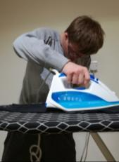
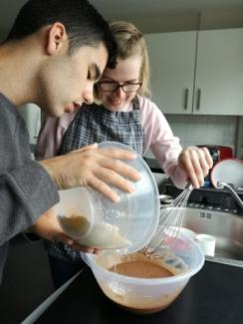
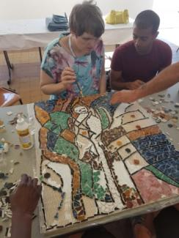
ACTIVE SUPPORT: into practice
Some examples…
Daily living activities
Personal care
Laundry
Cooking
Etc.
Occupational workshop
How to plan an activity
SUBTASK | TOOL | POINTS TO SHOW
1.
2.
3.
4.
5.
6.
The more they do it the better they get

Slide 16
ACTIVE SUPPORT: into practice
Mild disability
Activities that focus on the whole task
Moderate disability
Activities that focus on the individual steps of the activity
Severe disability
Activities that focus on the sensory part of the activity
ADAPT AN ACTIVITY: Baking a cake
Notes:
Example: 2 versions of the steps involved in making toast
Fewer, larger steps More, smaller steps
1. Get bread out 1. Open bread bin
2. Pick up packet of bread
3. Put bread on table
4. Open packet and take out 1 slice
2. Put bread in toaster 5. Put bread into toaster
3. Swith toaster on and set dial 6. Switch toaster on and set dial
4. Start toaster 7. Press lever down on toaster
5. Get Plate 8. Open cupboard
6. Get butter and jam
9. Pick up plate out of cupboard
10. Close cupboard door
11. Put plate on table
12. Open fridge
13. Pick up butter and put on table
14. Pick up jam and put on table
15. Close fridge
7. Get knife and spoon 16. Open drawer
17. Pick up knife and put on table
18. Pick up spoon and put on table
19. Close drawer
TOAST IS READY AND POPS UP
8. Put toast on plate 20. Take toast out
21. Put on plate on table
9. Spread butter on toast 22. Open butter dish
23. Pick up knife
24. Scrape up a lump of butter
25. Spread butter on toast
26. Put knife down
10. Spead jam on toast 27. Open lid of jam jar
28. Pick up spoon and put in jam
29. Take a spoonful of jam
30. Put jam on toast
31. Put spoon down
32. Pick up knife
33. Spread jam with knife

Slide 17
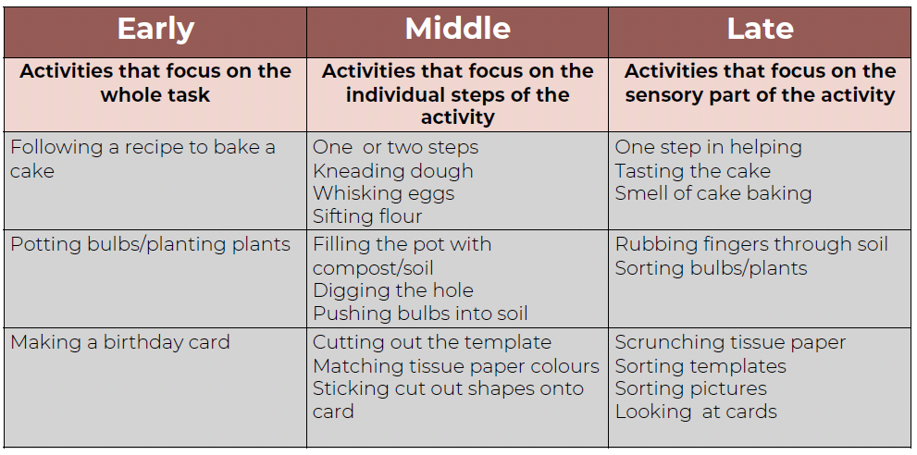
ACTIVE SUPPORT: into practice

