Slide 1


Slide 2

Disclaimer
"The European Commission support for the production of this publication does not constitute an endorsement of the contents which reflects the views only of the authors, and the Commission cannot be held responsible for any use which may be made of the information contained therein."

Slide 3

A Person-Centred Approach - Key Statements
Every person craves meaning in their lives – meaningful roles meet our human needs for community and purpose.
Every person has the right to make their own choices – whether wise or otherwise.
A Person Centred Approach recognises people’s individual strengths, honours choices, supports independence and integration in the community.

Slide 4
Overview and summary of module
Diagrama UK model
Montessori principles
Person centred approach
Active support
Positive behaviour support
Integration into the community
Montessori roles and activities
Prepared environment
Learning and reflection

Slide 5
A Person-Centred Approach
Right support – right place - right time
Key Principles:
Support independence
Honour choices
Enhance dignity
Empowerment
Promote positive wellbeing
Improve quality of life
Based on people’s strengths and capabilities - irrespective of degree of disability.

Slide 6
What do we mean by a Person-Centred Approach?
Person centred active support provides help to enable people to participate successfully in meaningful activities and relationships so that they gain more control over their lives and more independence.
Plan possible direction and aspirations
Set realistic goals and achieve progress
Focus on individual strengths
Facilitation of choice
Decision making about present and future
Autonomy
Personal control

Slide 7
Montessori – the history
          Dr Maria Montessori
          Maria Montessori (1870-1952) was the first female Physician in Italy. She worked with underprivileged children who were labelled “unteachable” and who were called “mental defectives”. Her goal in working with these children was to improve their quality of life.
          Montessori’s philosophy (vision) makes a perfect mission statement for aged care: To enable persons to be as independent as possible, to have a meaningful place in their community, to have high self-esteem, and to have the chance to make choices and meaningful contributions to their community.
          Montessori Environments can be created wherever older people, particularly those living with dementia can be found. Anyone who has been trained can create a Montessori Environment.

Slide 8
Person-centred approach
Focus on autonomy and independence
Maintain or further develop skills
Expanding their horizons
Why Montessori?

Slide 9
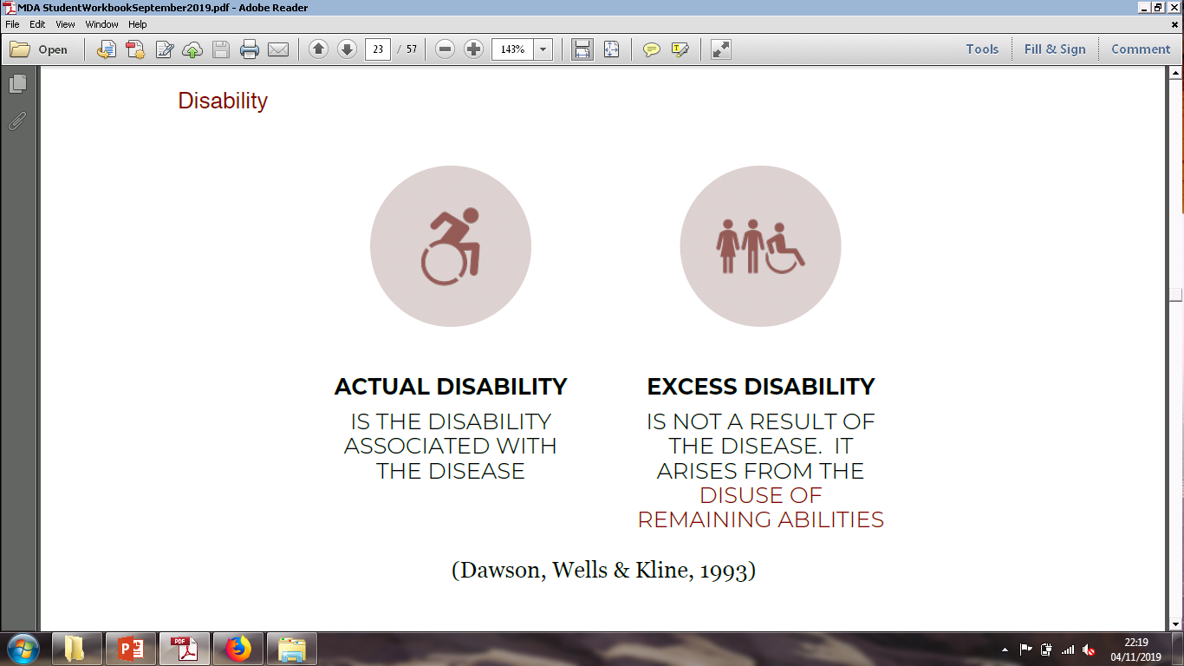
Montessori: the model
Goal = Prevention of excess disability
When we focus on strengths, needs, interests and abilities we are better able to:
Offer a range of appropriate activities
Find roles that the person is able to fill and develop a routine and schedule.
Focus on Activities of Daily Living (ADL) needs to promote or maintain independence.
Ensure activities are provided when needed to minimise or prevent behaviours of unmet needs.
.

Slide 10
Montessori: the methodology
The importance of Activities
Doing, to most people, is synonymous with being alive.
Everything we do from the moment we open our eyes in the morning till we close them again at night is an activity.
They are far more than what we see on an activity program.
Success, failure or lack of activity in our lives influences our mental health, self-esteem and mood.
Activities need to be available 24/7.
Activities or lack of them define us.
Activities reduce or help minimise responsive behaviours and depression.
Activities are as important as clinical care.
All staff are accountable for what happens to people 24 hours a day.
Montessori Activities
Follow a set of principles
Provide repetition
Provide opportunity for self-initiated activities
Match strengths and personal history

Slide 11
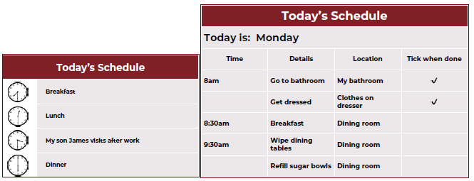
The prepared environment
Roles
Roles are activities and tasks that are part of daily life and contribute to a person’s community.
Task Breakdown
Enables people to complete a task.
Sequencing is important – a prepared environment ends in success.
Make your own flow chart even using real pictures that they may recognise.
Visual cues
Support memory by using signage, cue cards, colour coding, planners, memory books, name badges, etc.
Scheduling and routines

Slide 12
Active Support
ACTIVE SUPPORT
I CAN’T DO IT I CAN DO IT
Active Support is designed to make sure that people who need support have the chance to be fully involved in their lives and receive the right range and level of support to be successful. Several research studies have shown that it is effective
Why is Active Support important?
Participation and contribution are important to self-esteem
People with learning disabilities might need support to participate
Providing support bridges the gap between what people can and cannot do
Is a way to empower people to take control over their life

Slide 13
Integration into the community
A strengths based approach
Personal strengths?
Community strengths?
Support Network strengths?
Working in partnership with other organisations

