Slide 1

Disclaimer
"The European Commission support for the production of this publication does not constitute an endorsement of the contents which reflects the views only of the authors, and the Commission cannot be held responsible for any use which may be made of the information contained therein."

Slide 2

INTEGRATION INTO COMMUNITY
HOW?
By working within a person-centred approach, providing active support and positive behaviour support to support individuals to gain control and become integrated and valued members of their communities.
Paid job Volunteering Club members Education centres

Slide 3
INTEGRATION INTO COMMUNITY
STRENGTHS BASED APPROACH
Personal strengths?
Community strengths?
Support Network strengths?
Working alongside other organisations

Slide 4
INTEGRATION INTO COMMUNITY
Diagrama model includes the following
Training staff in active support and positive behaviour support
Work within person centred support framework
Adapting environment, communication and ways of working to the capabilities and preferences of the people we support
Risk assessment and planning to support people to achive their goals
Regular reviews
Tailored timetables in line with their goals, preferences
Promoting choices and decision making
Supporting positive risk taking

Slide 5
INTEGRATION INTO COMMUNITY
POSITIVE RISK TAKING
Dignity of risk
Allow people to take some risks
Stop hiding behind Health &Safety or guidelines as excuses as to why to keep things the same
People have the right to make unwise decisions
Case study: travel training
‘Life itself is a risk. We cannot eliminate risk without eliminating the person’

Slide 6
INTEGRATION INTO COMMUNITY
GOALS
Strengths
Realistic? Achivable?
RESOURCES
Community
Other organisations
LINKS
Making contacts
Matching needs and strengths with work opportunities
COACHING
Support needed
Adaptations?
WORK/ACTIVITY
Engagement and motivation
SUPERVISION
Monitor changes/development
Adapt support

Slide 7
INTEGRATION INTO COMMUNITY
EXAMPLES IN THE LOCAL COMMUNITY
  Paid jobs at pub, restaurants, parking, shops, etc.
  Volunteering at local gym, charity shops, quality checkers
  Members of the gym, art and craft groups, speak uo groups, allotments
  Educational opportunities
  Keep fit programmes
EXAMPLES AT ORGANISATIONAL LEVELS
  Support staff with monitoring health and safety
  Part of inductions (eg H&S briefing)
  Minor repairs
  Recruitment process
EXAMPLES AT HOME
  Recycling lead
  Cooking
  Ironing
  Trolley pusher
  Laundry
  Shopping list

Slide 8
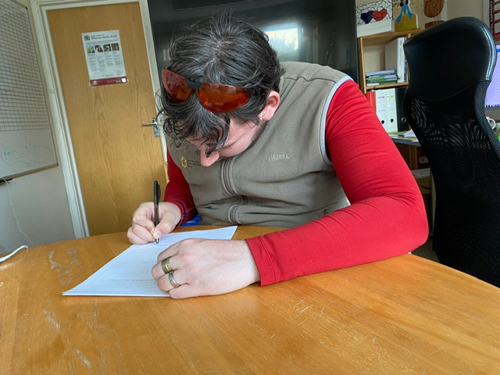
JJ’S JOURNEY
My name is Julian but I like to be called JJ
I was born in west Yorkshire
I am 31 years old
I live in a supported living home with other 3 housemates
I have a paid job and I volunteer in a recue centre

Slide 9
How I found my job…
WISH TO HAVE A PAID JOB
TRAINEE MARSHALL
COMBAT LASER GAMES
I told my key worker I wanted to have a paid job.
Key worker found out what things I like
I explained that I like gaming outdoors, my Xbox and Health & Safety
Support worker got in touch with external organisation (Mencap)
Mencap introduced me to Combat Laser Games
I had a face-to-face meeting and met the boss of the company.
I got a job offered at Combat Laser games
I completed my Marshall training

Slide 10
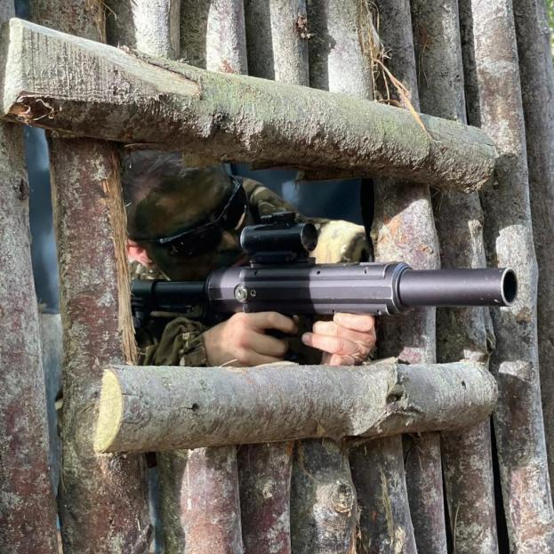
COMBAT LASER GAMES
I keep players in order to play the games and missions to make sure there are no injuries or accidents during their sessions and birthday parties in order to keep them safe and make sure they don’t wander off anywhere they cannot go in the field boundaries
I have been working there for over 2 and a half years now!

Slide 11
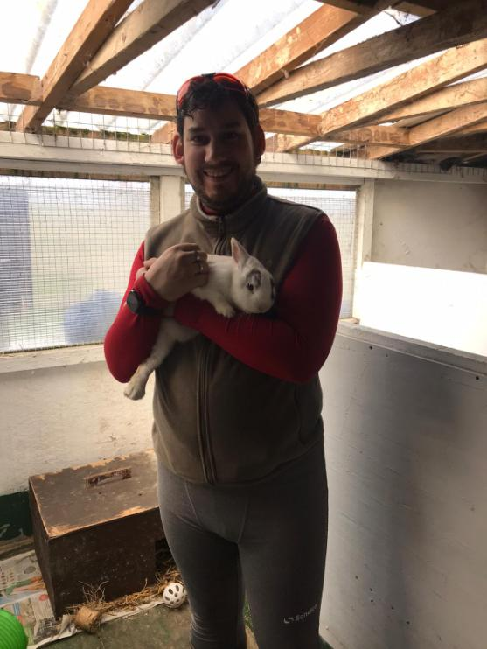
ANIMAL SANCTUARY
I keep the bunnies loved up by giving them my attention by holding and feeding them, including cleaning their pens and preparing their healthy food and water
I have been making a difference for these bunnies for the last 6 months

Slide 12


ROLES IN DIAGRAMA
Health &
Safety
Recruitment
I make sure my home is safe to prevent further structural damage either to walls, doors and ceilings even windows if the damage gets any worse please report it to the manager to sort it.
I am part of the interviewing panel.
I select the staff I would like to work in my home.
I like to ask about Health & Safety and epilepsy
I like staff to be reliable and on time and kind.

Slide 13
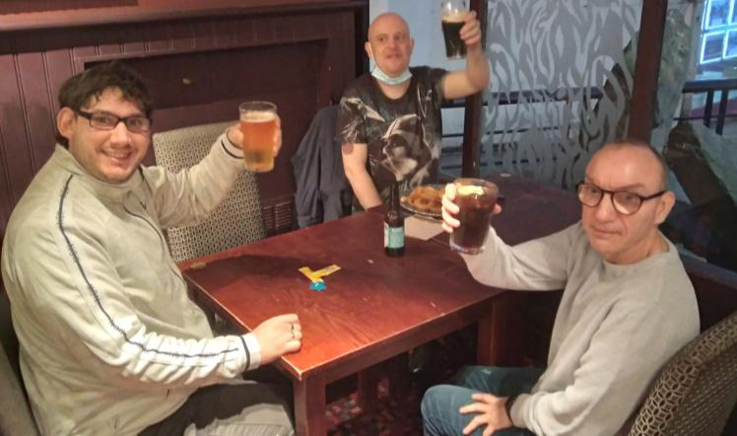
INTEGRATION INTO COMMUNITY
Every person needs to feel they contribute to their community
Promotes independence, meaningful relationships, maintains skills
Builds self esteem and confidence
Changes the perceptions of the wider public - Professional identity
Notes:
Case study – Supporting E and J in Work and Volunteering
All our staff understand the importance to our service users of having meaningful relationships and meaningful roles in their lives – to build confidence, skills and self esteem, promoting their wellbeing.
We took over our supported living services in Bromley during the pandemic which meant that service users were not going out and were losing confidence and skills. We worked with service users to help them regain their confidence. As part of this we worked with them to understand who would be interested in exploring work or volunteering roles. Staff, supported by coordinators, took practical steps to identify possible opportunities, including through discussions with local businesses and shops. 5 out of 30 of our support users currently volunteer and we continue to seek meaningful roles for all who would benefit.
In one house in particular we supported E and J to return to previous paid roles, and they wanted to expand their opportunities too. E wanted to take on another paid job. He is action orientated, adventurous, confident and perseveres at tasks. He needs clear guidance about tasks and needs reminders of what is and is not appropriate. We worked with the Mencap employment advice service to find him a new paid role, being responsible for keeping a car park tidy. We supported with him with the risk assessment and with travel training. E’s independence is important to him and he does not want to use a mobile phone. Our risk assessment takes this into account with staff having a good knowledge of his routine, E understanding how to access help if he does get lost, and the Herbert Protocol is in place for all service users in the event that they are lost and information needs to be shared quickly.
Both E and J wanted to take on new volunteering roles. In a house meeting for the people we support, our staff asked our service users about what they liked doing. Both said they liked animals and would be interested in working for a rescue centre. A staff member worked with the two service users to research different local organisations on the internet and to make contact with them. They found one that was willing to take on volunteers. One of our service coordinators met with the staff at the animal rescue centre and they talked through how the volunteering would work, and how J and E would best be supported in possible roles. Our support worker then accompanied J and E on a visit to the rescue centre where they met staff and animals, tried out different activities and thought about which animals they might prefer to work with. Roles were agreed and, with the support of the registered manager, a risk assessment and plan to volunteer once a week was put in place for each service user, in line with their strengths and needs. For the first visits, the service users were each supported with travel training until they were confident in carrying out the journey with a travel buddy. They have both now been volunteering for over a year: J works with rabbits and E enjoys working with pigs.
For both E and J, the new opportunities have enhanced their independence and control over their own money and lives and we will continue to support them in their roles.

Slide 14
INTEGRATION INTO THE COMMUNITY
https://www.youtube.com/watch?v=72wGb95EAuM

Slide 15
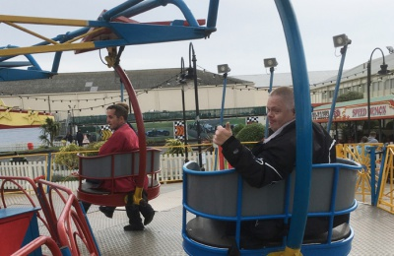
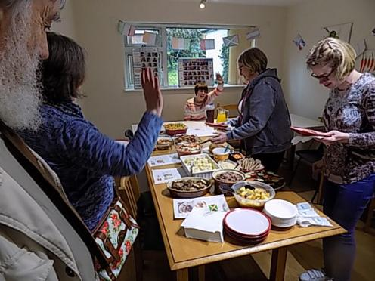
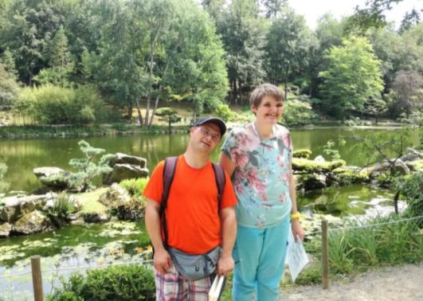
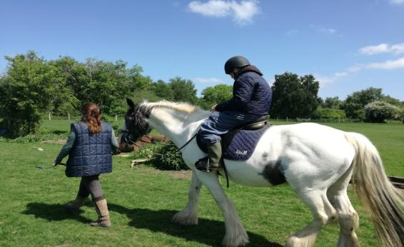
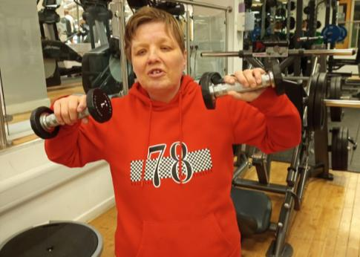
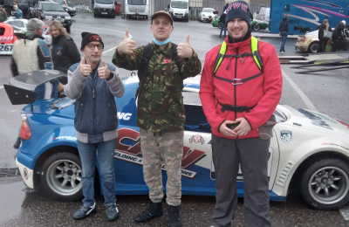
INTEGRATION INTO THE COMMUNITY

Slide 16
MONTESSORI: roles and activities
Roles
Roles are activities and task that are part of daily life and contribute to a person’s community.
Example of roles: Set the table, orientation board updated, hand out aprons, pour drinks, feeding fish, cutely sorter, etc.
Roles build on people’s strengths.
Roles need to be put into a routine so they an be done daily or more often.
Easy read schedules support the person to remember their role.

Slide 17
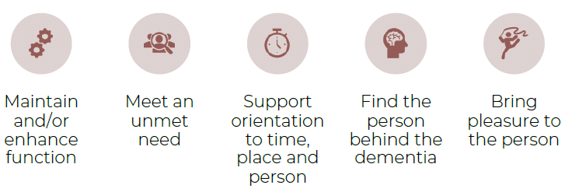
MONTESSORI: roles and activities
Consider if the activity will:
Classes of Montessori Activities :
Social and cultural: extending greeting, shaking hands, helping others, etc.
Sensory Activities: discrimination of colour, shape, sound, touch, size, etc.
Practical life: buttoning, folding, personal care, pouring, cleaning, etc.
Cognitive: reading, categorising, using a template, detecting same/different, etc.

Slide 18
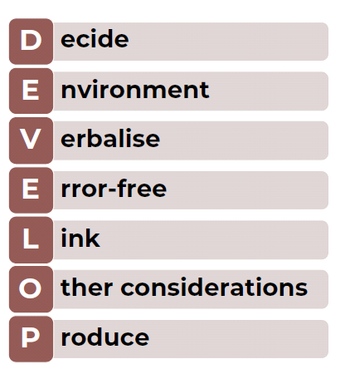
MONTESSORI: develop an activity
Decide what role/activity you are going to develop – taking into account the needs,
interests and abilities of person
Environment – where might the role/activity occur, any changes needed to the
environment, i.e., signage, work boards, etc. What other resources might you need?
Verbalise the purpose and expected outcomes – ensure all are involved in the
process of development
Error free – think the role/activity through, ensure the resident/client has the
physical ability to carry it out – do modifications need to be made?
Link to the persons schedule or routine, if they have one, find out the best time of
day for them and work from that
Other considerations – has the resident/client had a disturbed night or lots of
visitors? Have they the right glasses on? Hearing aid in? Anything else?
Produce – templates, manipulatives, signs, etc.
• Remove unnecessary markings/backgrounds
• Materials used are recognisable by the resident/client – colourful, selfcontained
(baskets/boards/trays), attractive, adult themed
• Use pictures the resident/client will recognise and have meaning for the, etc.

Slide 19
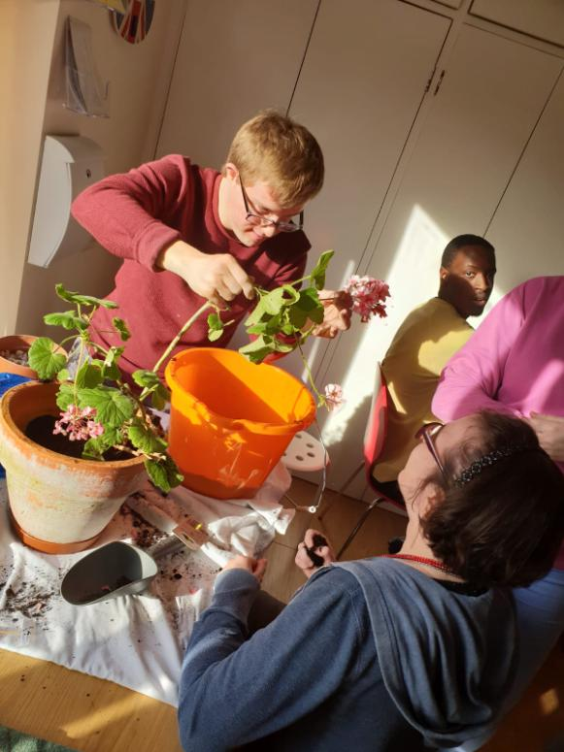
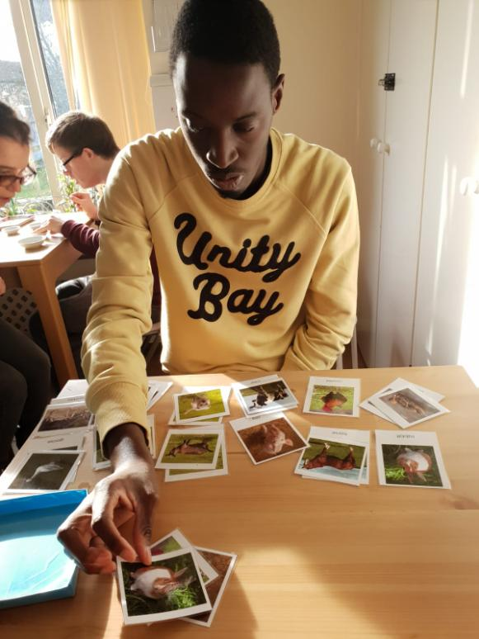
MONTESSORI: insights

Slide 20
MONTESSORI: roles and activities
https://www.youtube.com/watch?v=WkJc2Rk6IgA&t=2s

Slide 21

INSIGHTS:
SHOWING & DEVELOPMENT
PRESENTATION IS CRUCIAL
    movement OR language
    slow, clear movements
    broken down
ENGAGE AND FADE
THIS IS THEIR ACTIVITY:
LET THEM DO!!
** Learning only by experience
DO NOT CORRECT!
OBSERVE. NOTE. BE SURPRISED.

Slide 22
INSIGHTS:
STEPPING IN
  Am I allowing time for finding own way?
  THEY DO AS MUCH AS THEY CAN→
  I DO THE LEAST AMOUNT
      Each time
      Each day
  Emotional support.
  APPROACH EACH PERSON
  OBSERVE:
      Tools suitable?
      Environment suitable?
      Where exactly is the difficulty?
      Problem-solving

Slide 23
INSIGHTS:
INDEPENDENCE
PRESENTATION
    Clear
    Movement- show, not tell!
    1 difficulty at a time
    Adapt
PROMPT AND FADE
OBSERVE
    NOTE → Support plan
    Learn
    Openness- be surprised!
PERSON DOES MAXIMUM
    Tools and environment
    Think SUBTASKS
    Problem solve
    Make own choices
    Find own way
    Make mistakes encouraged!

Slide 24
MONTESSORI: prepared environment
Task break down
Scheduling and routines
Activity areas
Interactive wall spaces
Roles
Visual cues
Dinning choice
The aim of the prepared environment is to support the person to be as independent as possible, supporting them to be the best they can be
The more disability, the more important the prepared environment is

Slide 25
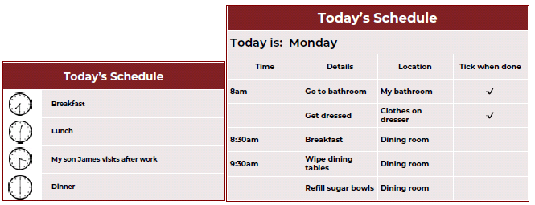
MONTESSORI: prepared environment
Dining experience
Mealtimes are an opportunity to bring people together in social groups. It is an important part of the day.
Choice should be offered – bain maries
People should be encouraged to choose and serve themselves if they are able.
Visual cues
Support memory loss by using signage, cue cards, colour coding, planners, memory books, name badges, etc.
Task Breakdown
Enables people to complete tasks such as cleaning teeth, dressing and going to the toilet independently.
Sequencing is important – a prepared environment ends in success.
Make your own flow chart even using real pictures that they may recognise – this type of flow chart can be used for any task – baking a cake, making sandwiches, making a cup of tea – you can number the steps.
Scheduling and routines

Slide 26
MONTESSORI: prepared environment
Activity areas.
Creating activity areas or workstations is a way of creating activity alternatives for individuals. These areas can be anywhere and can contain anything that may be of interest to the clients.
Interactive Wall Spaces.
Interactive wall space makes use of wall areas to provide activity. This is particularly useful in units where space for tables and other activity areas is limited.
Often residents can be encouraged to self-initiate and they provide activities that family and staff are able to use at any time.

Slide 27
MONTESSORI: prepared environment
https://www.youtube.com/watch?v=dYN7I87bXeY

Slide 28
Bringing it all together
Diagrama is on a journey - our key lessons
Culture change takes time
Staff are key – staff need to be kind, have emotional intelligence, able to connect with people.
Progress is different in each service
  Elder care: changed the environment; still more to do on activities
  Cabrini: full programme of activities, but can do more to tailor these to individuals
  Supported living: starting the journey, but building on very motivated staff who know their clients very well
  In all settings – we still underestimate what people can do for themselves
  Want to do more to get people roles in the community

Slide 29
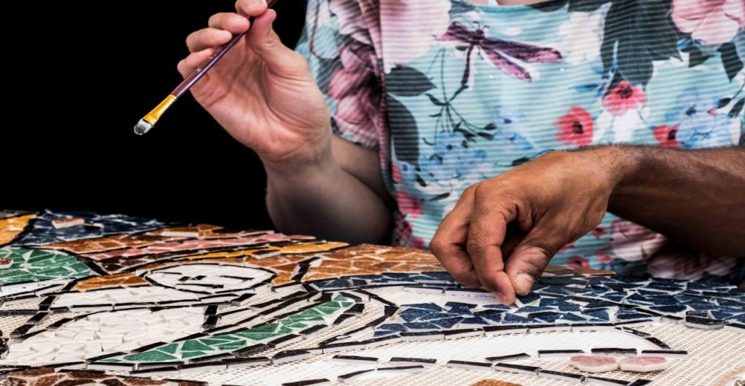
DIAGRAMA UK METHODOLOGY
WE SUPPORT PEOPLE TO LIVE THEIR BEST LIFE

