Slide 1


DIAGRAMA UK METHODOLOGY
We support people to live their best life

Slide 2

Disclaimer
"The European Commission support for the production of this publication does not constitute an endorsement of the contents which reflects the views only of the authors, and the Commission cannot be held responsible for any use which may be made of the information contained therein."

Slide 3
PROGRAMME
Diagrama UK model
Montessori principles
Person centred approach
Active support
Positive behaviour support
Integration into the community
Montessori roles and activities
Prepared environment
Learning and reflection

Slide 4
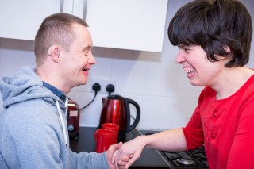
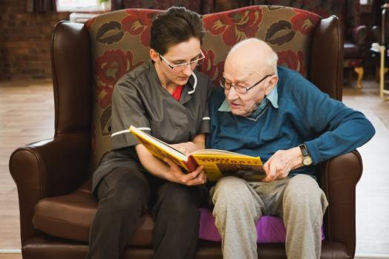
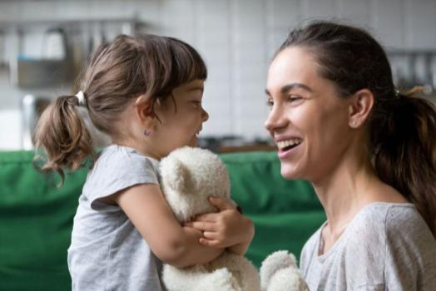
DIAGRAMA UK SERVICES
LEARNING DISABILITY SUPPORT
SENIOR &
DEMENTIA CARE
FOSTERING &
ADOPTION

Slide 5
DIAGRAMA UK MODEL
WHAT DO WE WANT TO ACHIEVE?
Diagrama supports vulnerable children and adults to live their best life.
We achieve this by:
Finding secure and nurturing families to care for traumatised children through our adoption and fostering services
Ensuring vulnerable elderly have the opportunity to live life to the full at our nursing and dementia care home, Edensor
Promoting the development of core skills for adults with learning disabilities at our residential service Cabrini House so that they can lead independent lives, integrated within their community
Enabling vulnerable people to develop the skills and confidence in their own and shared homes so they can lead independent, fulfilled lives, through our supported living service.
      PERSON CENTRED APPROACH
      ACTIVE SUPPORT
      POSITIVE BEHAVIOUR SUPPORT
      GOLD STANDARDS FRAMEWORK
MONTESSORI

Slide 6
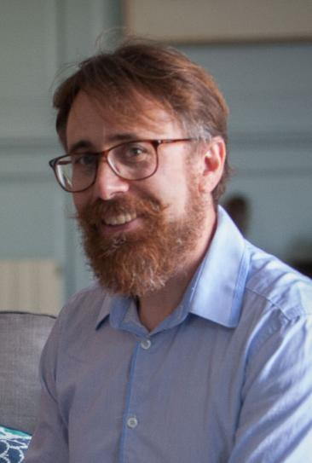
THE NEED FOR CHANGE
PERSONAL JOURNEY
  DIAGRAMA SPAIN VS UK MODEL
  SECURE ESTABLISHMENTS
  CHILDREN´S HOMES
  MISTAKES
  ANALYSE
  START AGAIN
TEAM
  VISION
  CULTURE CHANGE
  EXPERIMENT
    STAFF PROFILE
    MONTESSORI THE EXTERNAL FRIEND/FAMILY
RESULTS
  MISTAKES
  ANALYSE
  CONTINUE LEARNING

Slide 7
Why Montessori
Person-centered approach
Focus on autonomy and independence
Maintain or develop skills further
Expanding People’s horizons

Slide 8
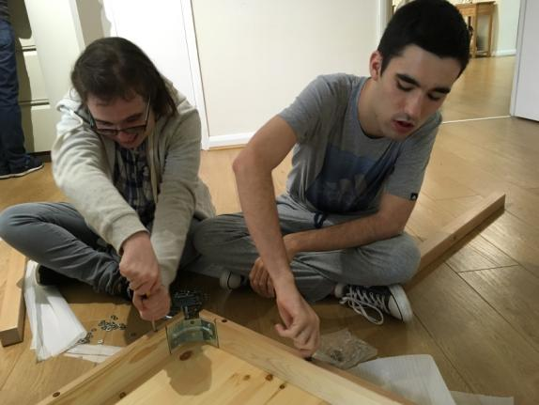
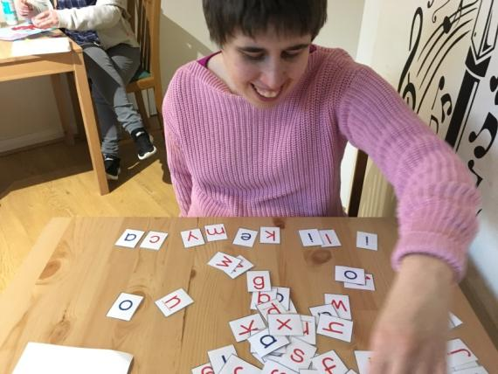
IN COLLABORATION WITH MONTESSORI

Slide 9
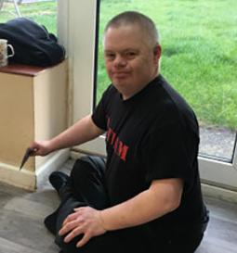
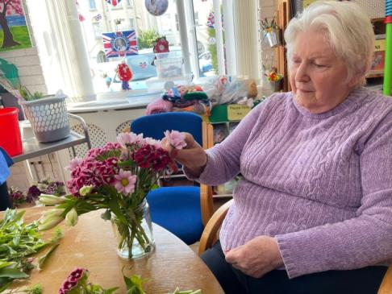
IN COLLABORATION WITH MONTESSORI
DIAGRAMA JOURNEY WORKING IN COLLABORATION WITH AMI
PILOT PROGRAMME
Cabrini
Nati Beltran (Montessori guide)
MONTESSORI FOR AGED & DEMENTIA CARE TRAINING
LD and senior care & dementia services
Anne Kelly (Montessori consulting Director)
SUPPORTING CHILDREN WITH TRAUMA - MONTESSORI TRAINING
Fostering and adoption
AMI (Association Montessori Internationale)
IN PROGRESS

Slide 10

THE NEED FOR CHANGE
Why do we need to change what we do when we already:
have a good reputation
meet the required standards
have families/people using the service who are happy and don’t complain.
Low staff turn over
We do need to change what we do if:
we lock the rooms and environment of the people we support
people we support are woken in the morning
tepid and repetitive food is served
spend most of the time in their rooms than engaging
people we support are into night attire before the evening meal
Choices of food or activities are not given
Team members are behind closed doors
Team members do things for people we support that they can do for themselves
People we support are in bed by 6pm
Large dining tables/rooms and plastic crockery and glasses, etc.
If language used is condescending, childish, or patronising – such as – ‘Good boy” or “Good morning sweetheart"
Team members are focused on the task rather than the person and their needs
If you’re running a hospital rather than a home (medical model)

Slide 11
MONTESSORI: The History
          Dr Maria Montessori.
          Maria Montessori (1870-1952) was the first female Physician in Italy. She worked with underprivileged children who were labelled “unteachable” and who were called “mental defectives”. Her goal in working with these children was to improve their quality of life.
          Montessori’s philosophy (vision) makes a perfect mission statement for aged care: To enable persons to be as independent as possible, to have a meaningful place in their community, to have high self-esteem, and to have the chance to make choices and meaningful contributions to their community.
          Montessori Environments can be created wherever older people, particularly those living with dementia can be found. Anyone who has been trained can create a Montessori Environment.

Slide 12
MONTESSORI: The Model
  The culture
  The person
  The prepared environment
  The methodology
  Developing Montessori Environments means the following for:
  The Person
  • appropriate roles that are built into regular routines are identified for each person.
  • meaningful activities are developed to fill their day
  The Environment
  Cue cards, task breakdown and signage are used to support the person in everyday
ADAPTING MONTESSORI TO EACH CARE SETTINGS

Slide 13
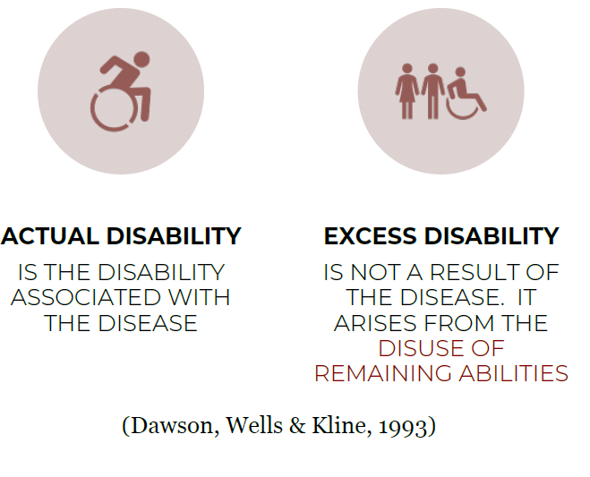
MONTESSORI: The Model
Goal = Prevention of excess disability
When we focus on strengths, needs, interests and abilities we are better able to:
Offer a range of appropriate activities
Find roles that the person is able to fill and develop a routine and schedule.
Focus on Daily Life Activities needs to promote or maintain in
dependence.
Ensure activities are provided when needed to minimise or prevent behaviours of unmet needs.

Slide 14
MONTESSORI: The methodology
The importance of Activities
Doing, to most people, is synonymous with being alive.
Everything we do from the moment we open our eyes in the morning till we close them again at night is an activity.
They are far more than what we see on an activity program.
Success, failure or lack of activity in our lives influences our mental health, self-esteem and mood.
Activities need to be available 24/7.
Activities or lack of them define us.
Activities reduce help minimise responsive behaviours and depression.
Activities are as important as clinical care.
All staff are accountable for what happens to people 24 hours a day.
Montessori Activities
Follow a set of principles
Provide repetition
Provide opportunity for self-initiated activities
Match strengths and personal history

Slide 15
MONTESSORI: The person
History
Diagnosis – cognitive ability
Lifestyle Diversity
Memory
Assessment
Behaviours of unmet needs
Culture
Who is this person?
Social profile, history, diagnosis, culture, lifestyle diversity, cognitive ability, behaviours of unmet needs, memory books, strengths, interests, needs, etc.
Always remember that there is a person behind the dementia/diagnosis.
Memory books and other cueing systems are important and should be available for people receiving care services.

Slide 16
MONTESSORI: The Model
Montessori in Aged Care – Overview:
https://www.youtube.com/watch?v=OqbJTX-ChNA

