Slide 2
Disclaimer
"The European Commission support for the production of this publication does not constitute an endorsement of the contents which reflects the views only of the authors, and the Commission cannot be held responsible for any use which may be made of the information contained therein."

Slide 3
VISUAL DESIGN
INCLUDES
Photography and Video
Look and feel
Brand strategy
corporate identity

Slide 4
Visual communication is in our human nature.
If we make more and smarter use of this,
we will communicate more fun, faster and better.

Slide 5
VISUAL DESIGN
Visual Design makes your organisation stronger.
We understand it faster but also remember it longer
It creates trust and interest
It fits the identity of your target group
It ensures usability and accessibility of your service

Slide 6
HOW DO YOU START
How do tart
‘It starts with the values ​​you propagate.’
Making people stronger also makes us stronger. We want to show our clients, employees and volunteers in a respectful, warm way. We want to put their talents/possibilities in the spotlight.

Slide 7
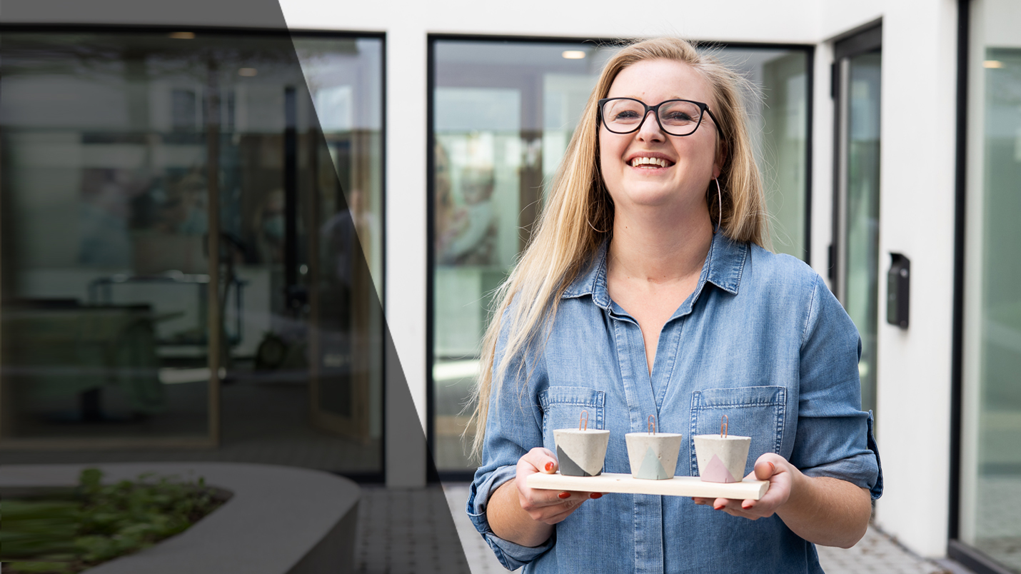
“How you relate to the clients will influence the images you make!”

Slide 8
TO GREAT GOOD VISUALS YOU NEED
Preparation
It tells the story
Be social
Less is more
Details
Experiment
Edits
…

Slide 9
PREPARATION
Prepare yourself as much as possible.
What’s the goal? What do we need? Discuss it with the team.
Social media, Flyer, magazine, video, campaign image...
Find the right people and places. Know the story.
The story or goal has to be in your head.

Slide 10
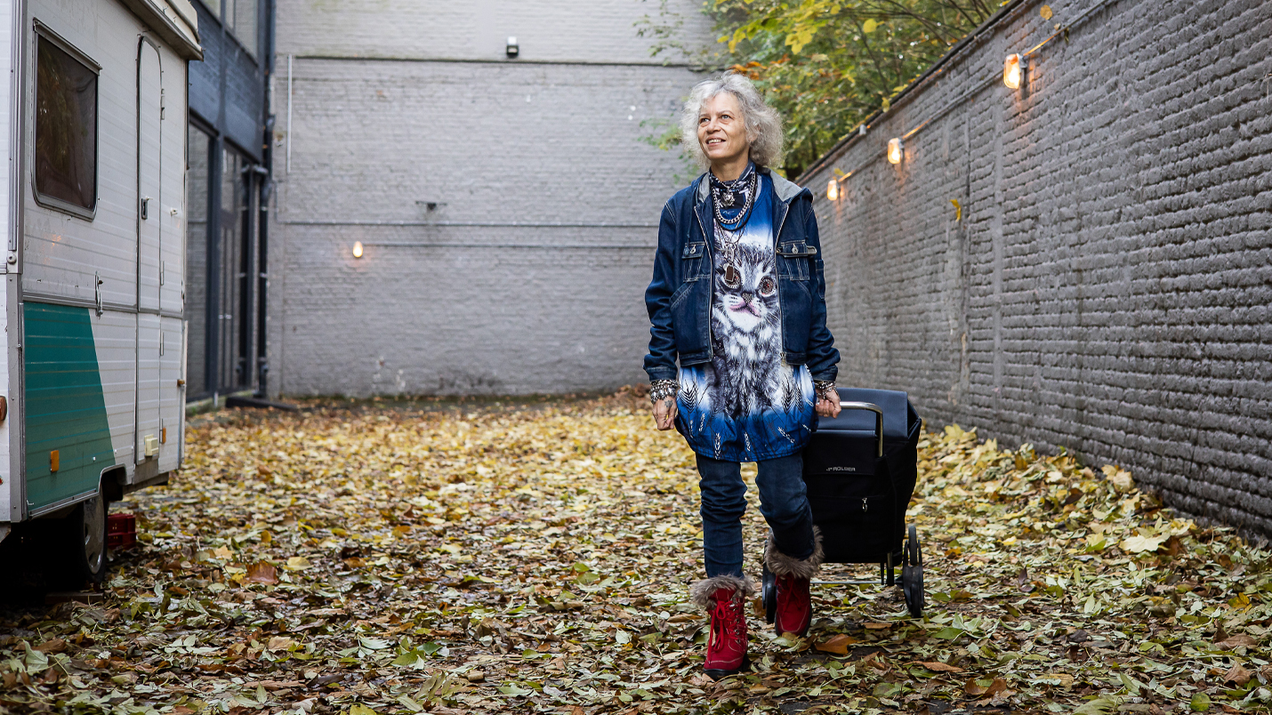

Slide 11
IT TELLS A STORY
Your photos our visuals are only successful if they fit the story.
Don’t miss it.

Slide 12
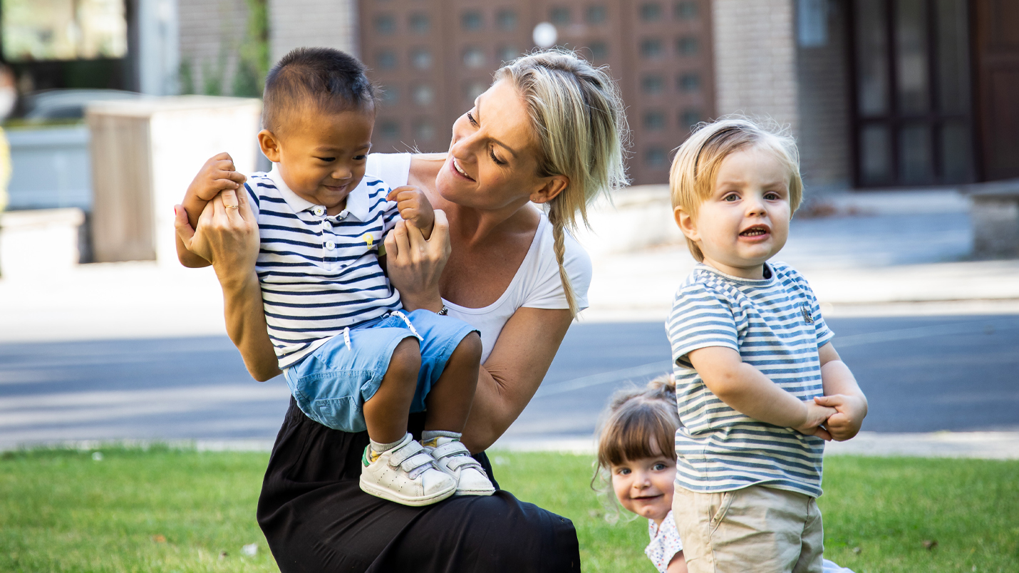

Slide 13
BE SOCIAL
Talk to your people while you shooting. Make them feel good.
Be social, use some smalltalk, don't place yourself above them but on the same level.
It will make your models comfortabel what will reflect in the pictures you make.
(don’t be just a photographer, be yourself)

Slide 14
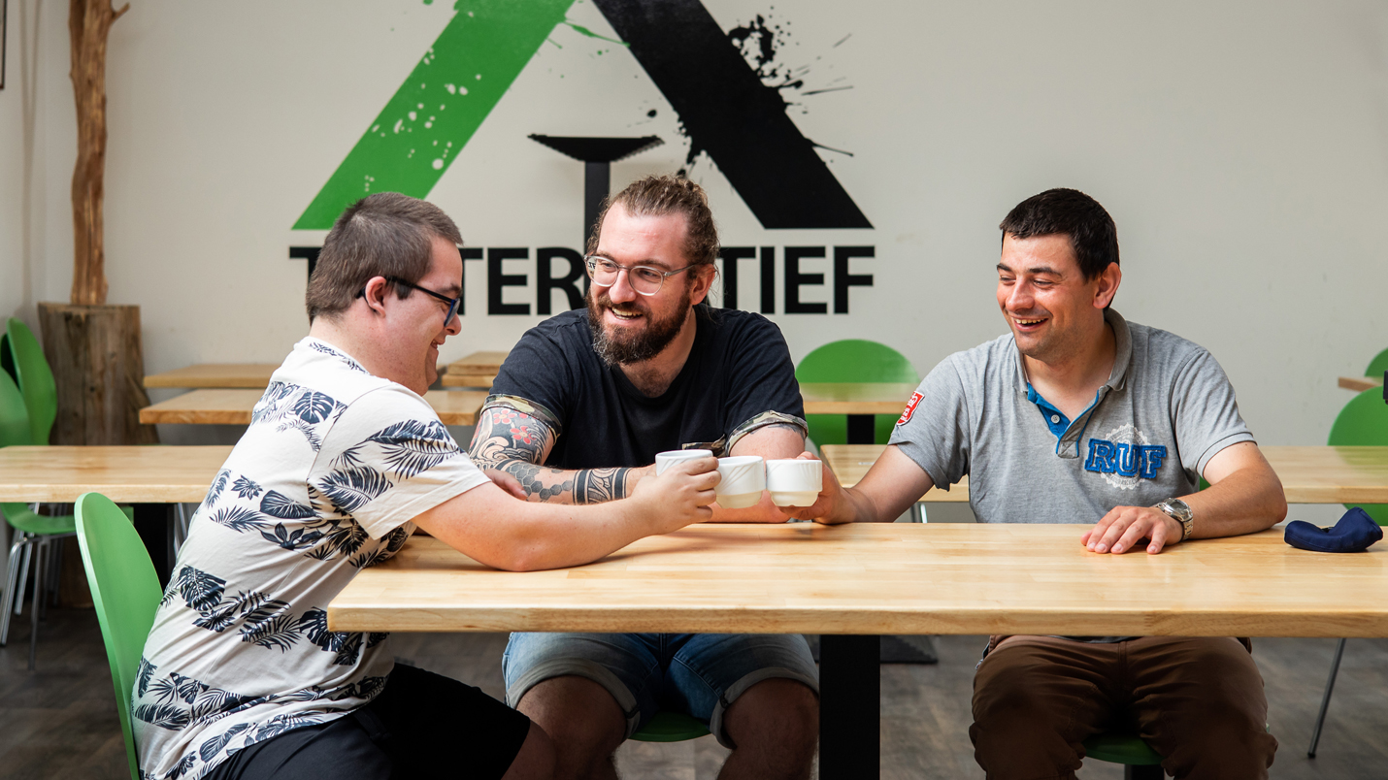

Slide 15
LESS IS MORE
Try to capture the essence.
When there are too many subjects in a photo, the viewer gets confused; what exactly does the photographer want to say with a photo?
Be ready at the right time. Certainly the moment when your subject forgets that you are there, is the moment when you have to be ready to shoot. Feel the connection.

Slide 16
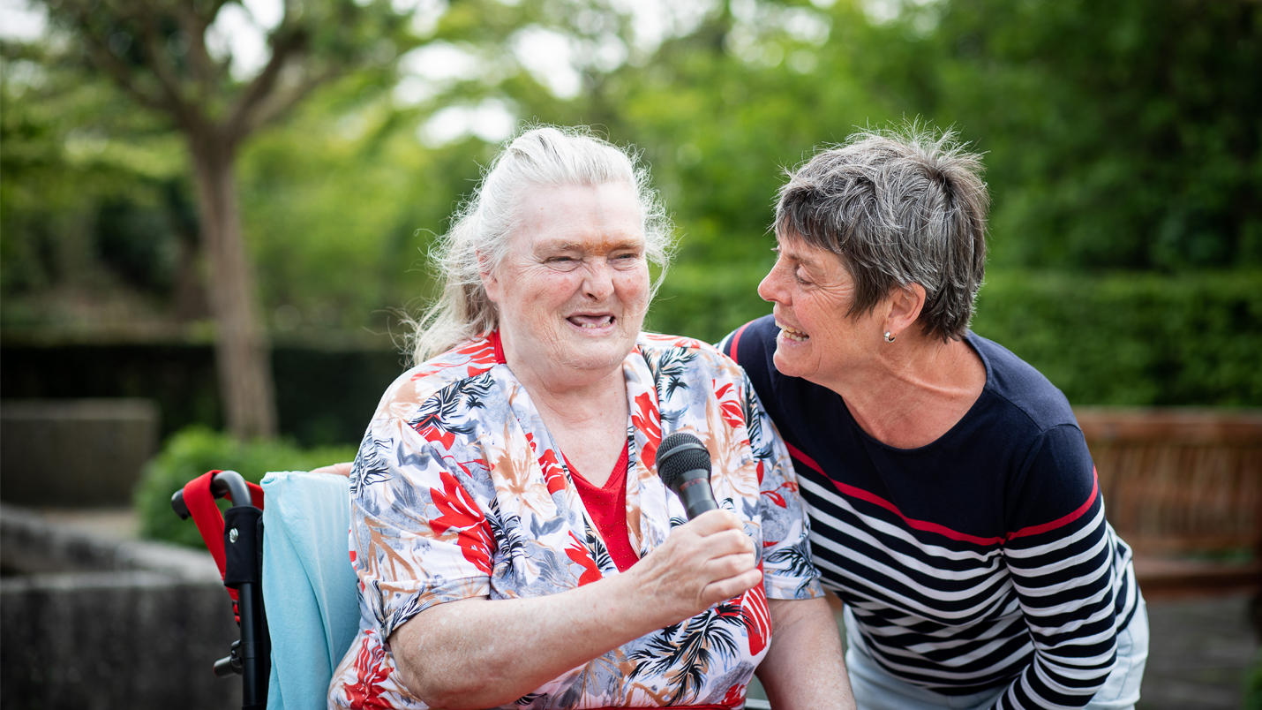

Slide 17
DETAILS
Detailed photos can tell more than you expected. They can bring variety and a more emotional impact on your visuals and stories.
So go close, photograph hands, subjects, interaction with the environment and the
environment itself. The story does not only have to consist of 'portrait photos', but can also be over-shoulder photos or a photo from the back.

Slide 18
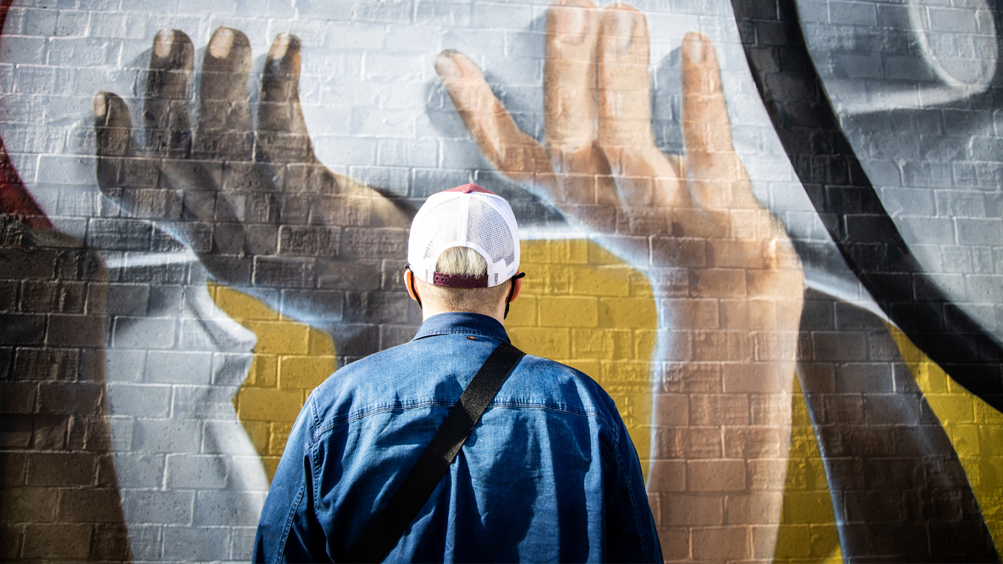

Slide 20
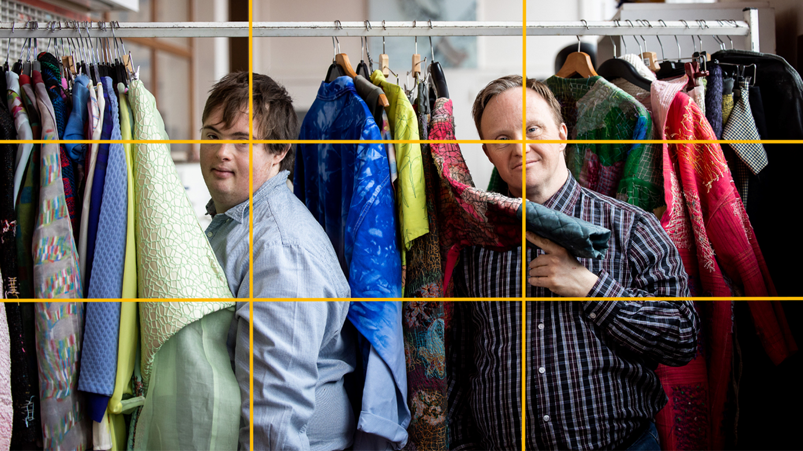
EXPERIMENT
With
The rule of thirds:
With the help of a grid you can make
photos more striking or interesting.
Your subject gets more attention.
(you can use it also on your phone)

Slide 21
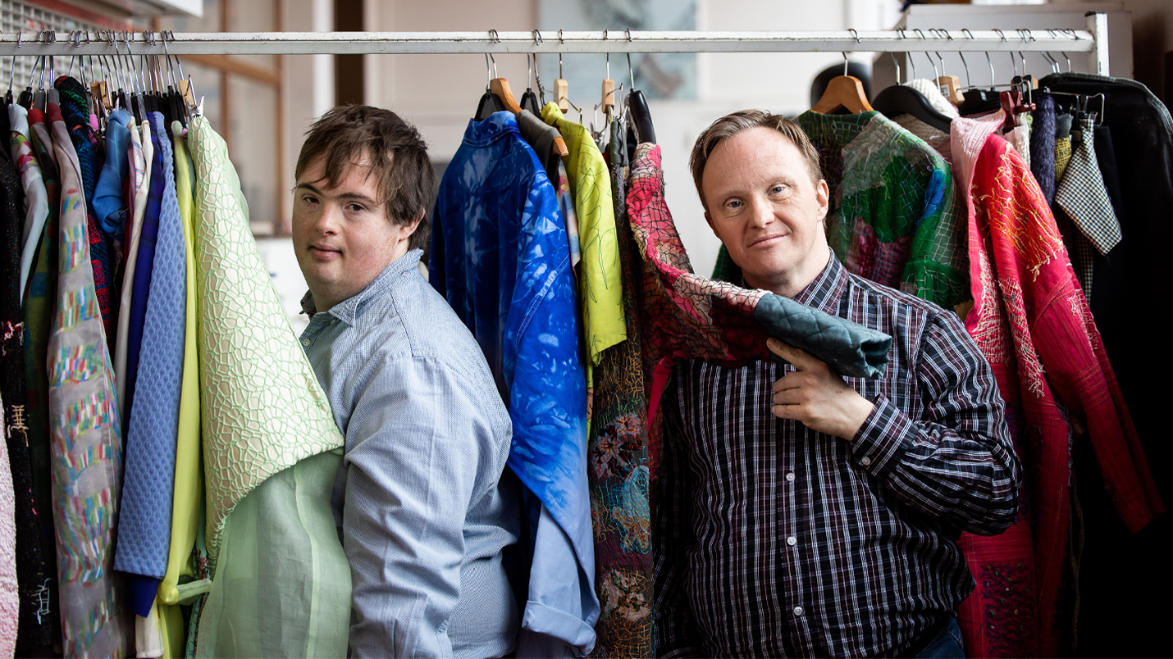

Slide 22
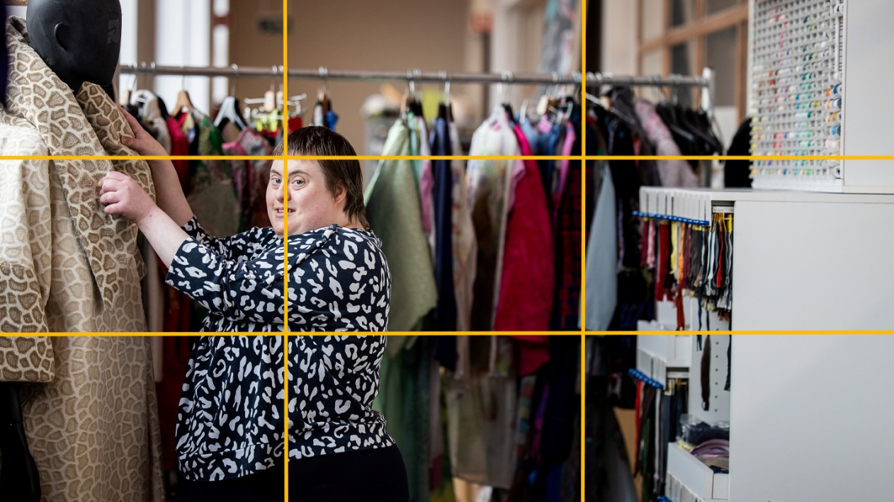

Slide 23
EXPERIMENT
Horizontal – vertical
Perspective
Lens - phone
Space
…

Slide 24
EDITS
Choose an edit that suits your photos.
It’s very important because the look and feel were made of it.

