Slide 2
Disclaimer
"The European Commission support for the production of this publication does not constitute an endorsement of the contents which reflects the views only of the authors, and the Commission cannot be held responsible for any use which may be made of the information contained therein."

Slide 3
Let’s start with a little game

Slide 4
THE STORY OF ROY
Roy is a fan of Lionel Messi, the famous football player. On his birthday, he gets the best present of his life: he can go to Barcelona with his father. There, they go to a football match with Lionel Messi. Roy makes a big banner that he can show on the stands. It says 'Hi Lionel'. When the players enter the field, Roy holds up his banner. Messi looks up and waves. “He has seen it," Roy shouts to his father, jumping up and down full of excitement. This is his best birthday ever!

Slide 5
Each story you read is an interpretation
Notes:
If I tell you a story, or you or you, you will all remind you different things about the story. That’s why it’s important that you say the right things, and that your core message is obvious.

Slide 6
Stories motivate people in ways that statistics never will
Notes:
Once upon a time … If we think about it, we tell stories all the time. It’s proven that people retain 70% of the information in story form, while we only capture 5 to 10% through data or statistics. That’s the power of storytelling!

Slide 7
HOW TO WRITE A STORY?
1 core message
WHAT IS THE MESSAGE I WANT TO SHARE WITH THEM?
WHO IS MY AUDIENCE?
Notes:
Keep your audience in mind, you wouldn’t tell something about your job to your mother as you say it to a colleague at work. Your tone of voice is different if you write for a potential client, for his or her parents or for health professionals.

Slide 8
HOW TO WRITE A STORY?
WHAT IS THE MESSAGE I WANT TO SHARE WITH THEM?
WHO IS MY AUDIENCE?
Notes:
Not every story you tell has to be a surprising, edge-of-your-seat epic. Some of the most successful and memorable stories are relatively simple and straightforward. Also if you write the texts, the most difficult thing is to translate a tekst with a lot of difficult words into an easy-reading simple tekst without losing your content.

Slide 9
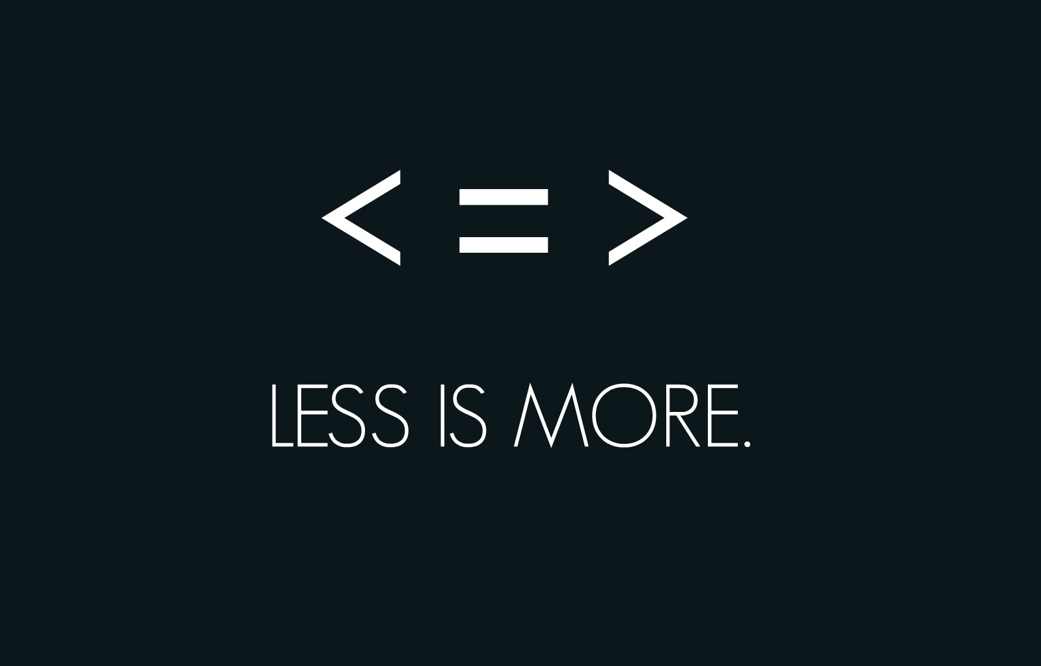
HOW TO WRITE A STORY?
WHAT IS THE MESSAGE I WANT TO SHARE WITH THEM?
WHO IS MY AUDIENCE?
Notes:
Don’t let needless details to detract from your core message. Work from the principle that “less is more.” One of the biggest mistakes you can make is “putting in too much detail of the wrong kind” Don’t tell your audience what day of the week it was, for instance, or what shoes you were wearing if it doesn’t advance the story in an artful way. But transporting your audience with a few interesting, well-placed details — how you felt, the expression on a face, the humble beginnings of a now-great company — can help immerse your listeners and drive home your message.

Slide 10
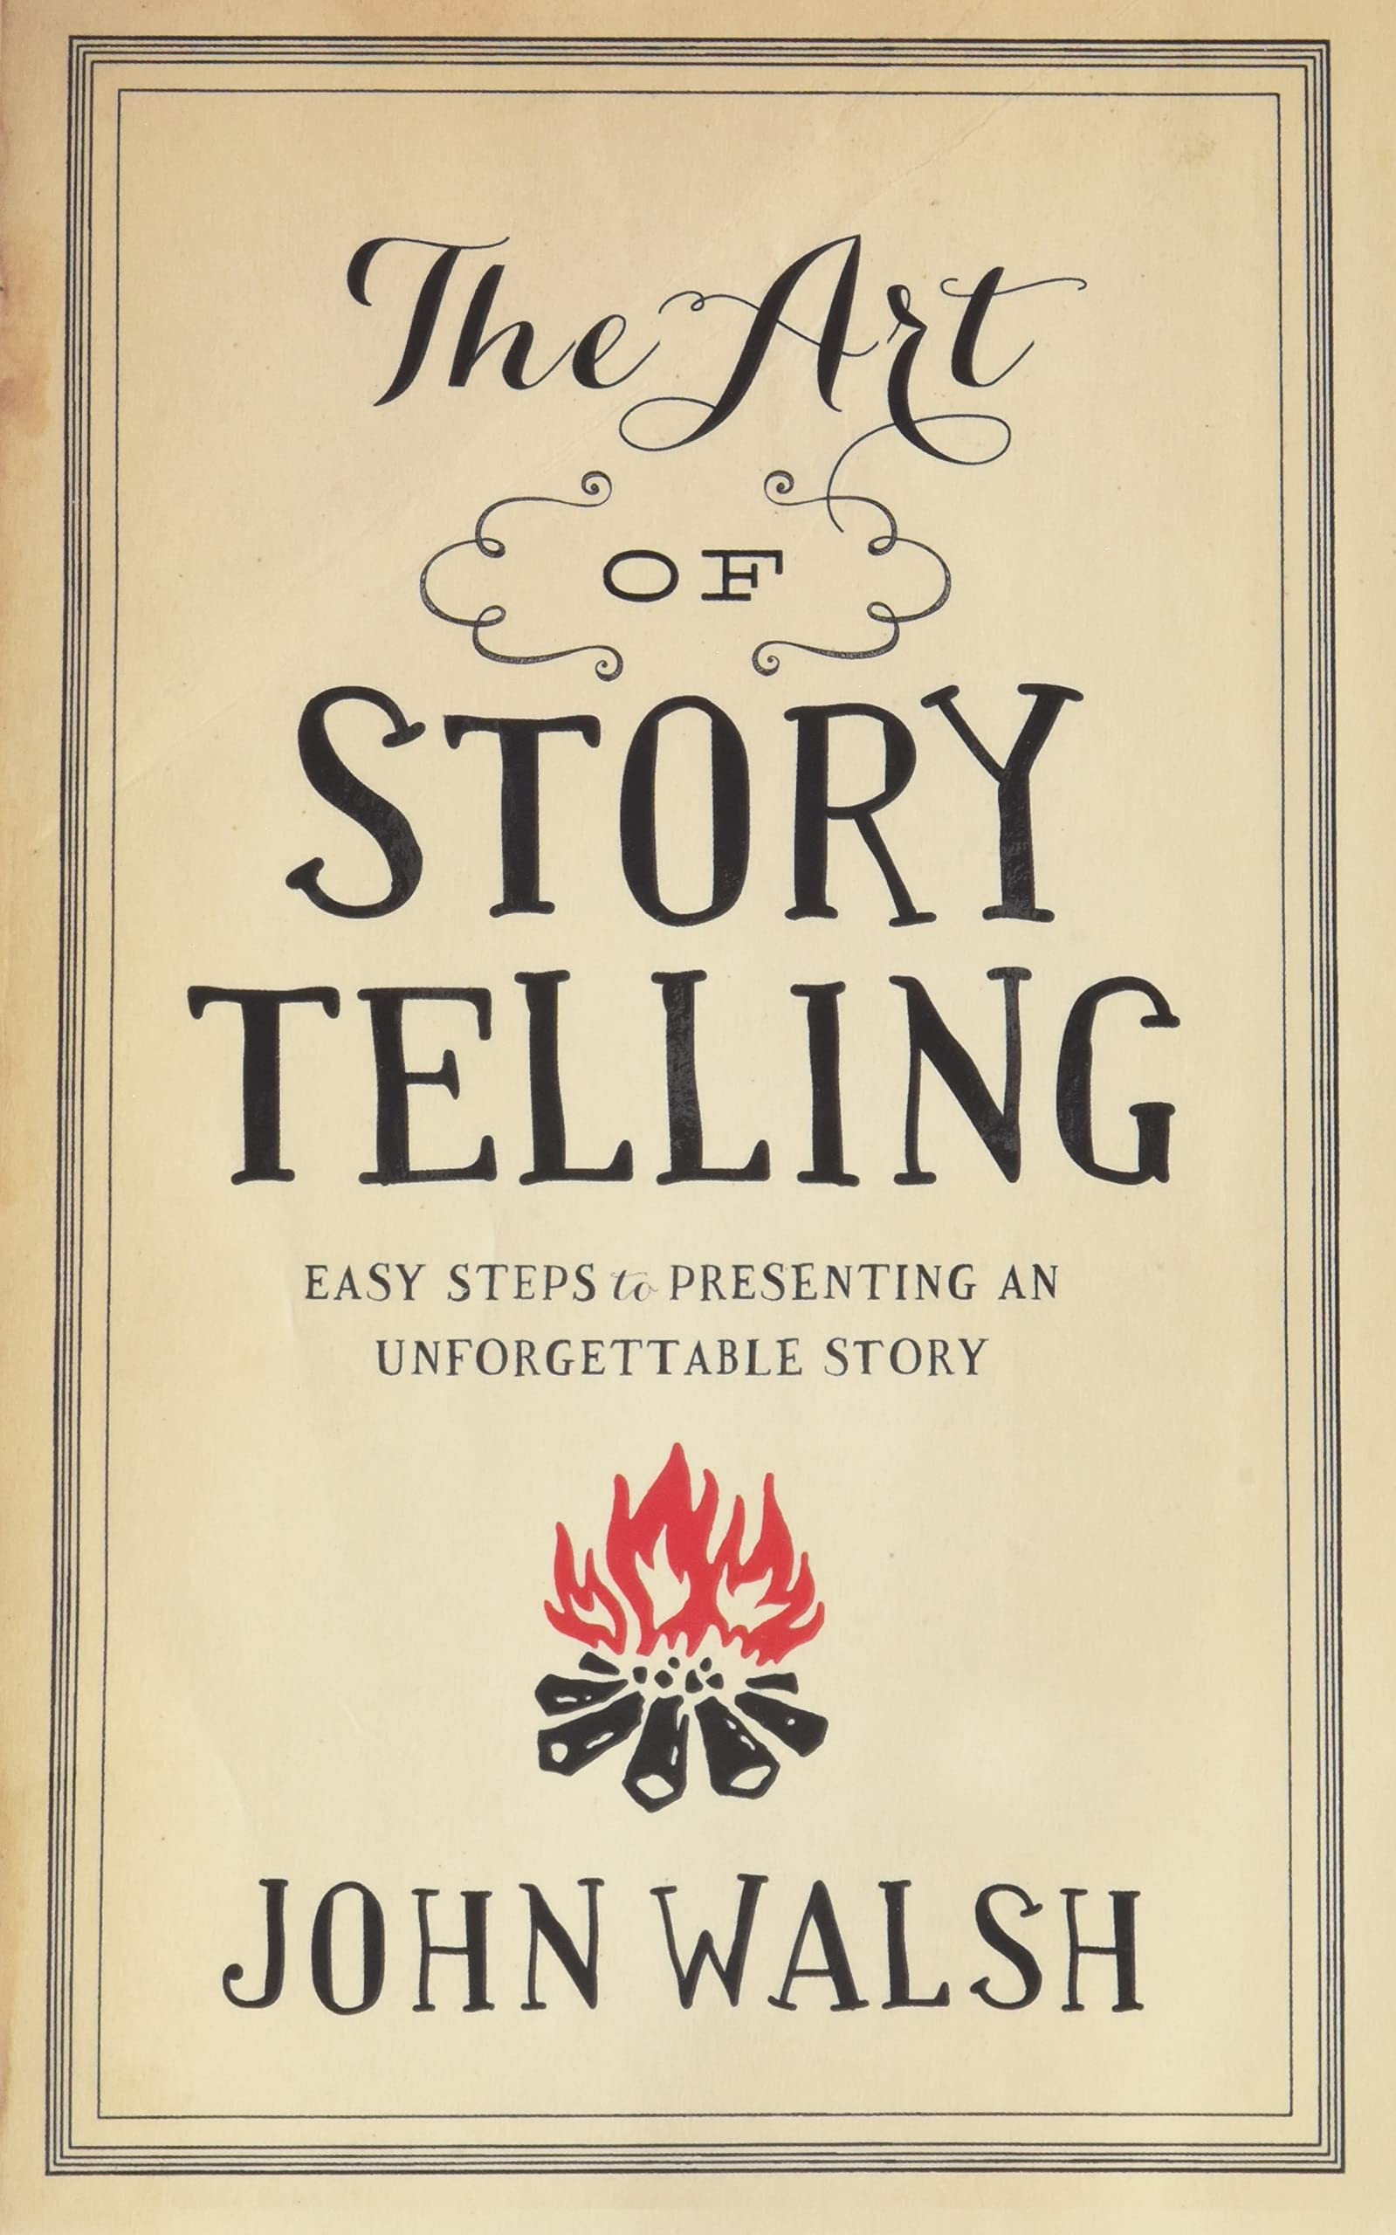
Storytelling = an art
Notes:
The main thing I would like you to keep in mind, is: write it the way you would tell it to your neighbour. Don’t use antiquated language, but use spoken language.

Slide 11
HOW TO WRITE A STORY?
SETUP describe the situation, particulars about the setting, the mood and the main character
RISING ACTION reveal the conflict or obstacles to be overcome
CLIMAX the turning point, when the main character becomes a hero (‘gets your appreciation’)
RESOLUTION the conclusion, where obstacles are overcome / the end of the story reveals the main point or essential lesson
CTA what do you want your readers to do after reading?
Notes:
Authenticity is very important. Don’t lie.
CTA: subscribe to a newsletter, buy a product, ask information about your services, …?

Slide 12
Set the stage
Use dialogues
One take-away
Notes:
Storytelling is a bit like telling a fairy tale to little children. You have to catch their attention, they have to hang on your every word and afterwards they must have an emotional, good feeling about your story.
Set the stage: create mental image with time and location – who is your character, where does he live, where does he work, …
Be very specific: use dialogues, this places the listener into action – a butcher says something in a different way than a teacher would do, a child doesn’t talk like an adult, a person with a disability doesn’t talk like our general manager talks, but we as writers we sometimes give them some extra power
What’s the moral of the story? One take-away you want them to keep in mind

Slide 14
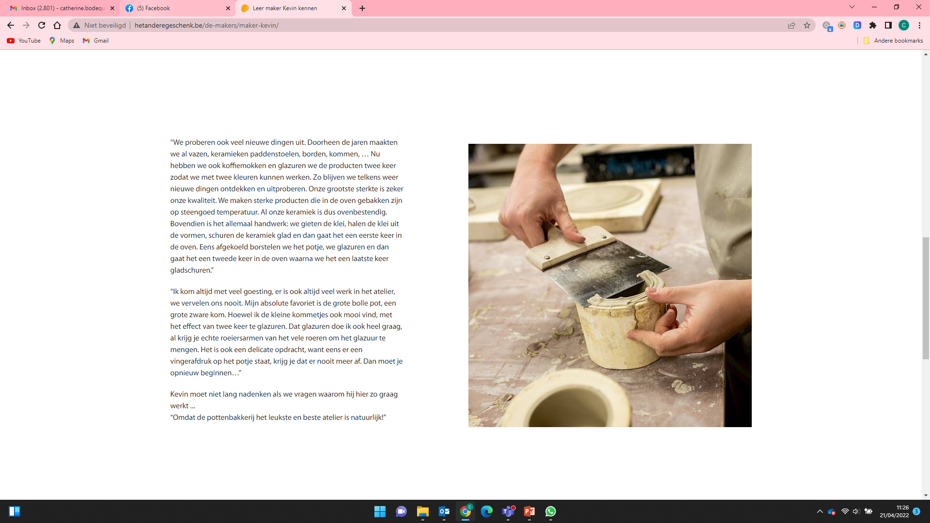
Notes:
handicraft

Slide 15
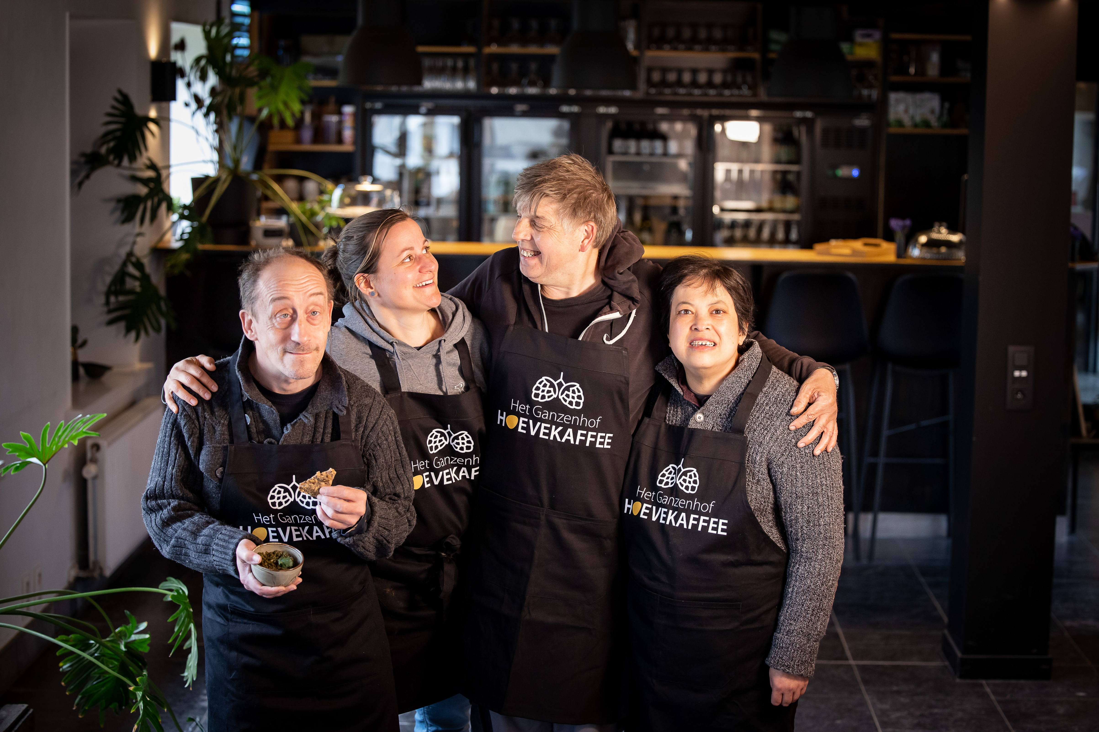
Notes:
Everyone has a story. The story is about people just like them who have problems just like they do. Then it shows how your brand solved them – and in the process how it can solve theirs too. This approach builds trust and confidence in the brand while remaining authentic. If you want to motivate, persuade or be remembered, start with a story of human struggle and eventual triumph. It will capture people’s hearts, by first attracting their brains.

Slide 16
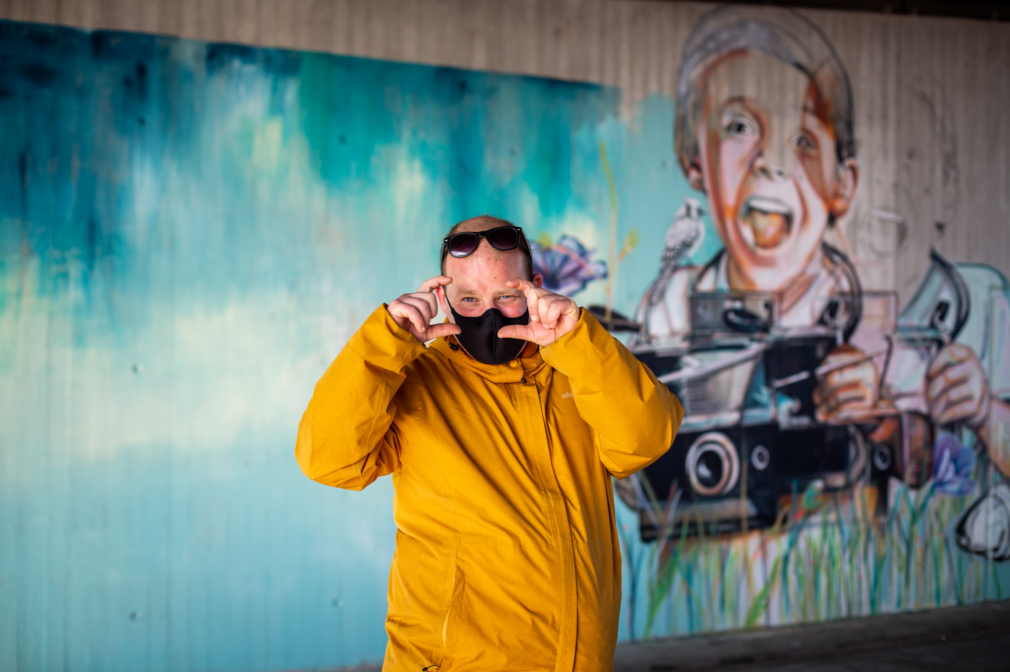
Stay curious
Notes:
Stay curious and you will have plenty of stories to tell! Listen to people in your organization, keep your eyes and ears open, create a setting where colleagues know they can share beautiful stories with you / the communication department. Even if it is a subject you’re unfamiliar with, you’re curious and ready to absorb everything there is to know about it. This copywriter skill is something that tends to come naturally, but before you think you’re not curious enough, consider just asking yourself questions. Anytime you have a topic or assignment, start asking the Who, What, When, Where, Why, and How. You can trick yourself into being curious by answering those six essentials.
You may start an interview with a certain idea, and arrive back in your office with a whole other idea about the story, because you really listened to the other person, and you kept asking further.

Slide 17
COPYWRITING
ACTIVE VS. PASSIVE VOICE
In a sentence written in the active voice, the subject of sentence performs the action.
In a sentence written in the passive voice, the subject receives the action.
e.g.
Active: Researchers earlier showed that high stress can cause heart attacks. Passive: It was earlier demonstrated that heart attacks can be caused by high stress.
Active: The dog bit the man. Passive: The man was bitten by the dog.
Notes:
You can convert every sentence to active voice. It replaces the reader more into the place of the main character, they look through the same eyes. You don’t have to do it everywhere, but as much as possible.

Slide 18
COPYWRITING
You need to master grammar, your language, punctuation, spelling, adjectives, and have a vast vocabulary to pull from when you write.
Notes:
Copywriting is not something that can be done by a robot. A writer always puts his own feelings and emotions into a text. Certainly in care organizations it’s really important that the writer himself cares about the stories and the organization.

Slide 19
COPYWRITING
THE SHORTER THE BETTER
True or false?
Notes:
False! If you take people into your story, they keep reading, even on the internet. What they don’t read are boring stories.

Slide 20
COPYWRITING
You are not a robot,
you are a human being
with feelings and empathy.
Notes:
Copywriting is not something that can be done by a robot. A writer always puts his own feelings and emotions into a text. Certainly in care organizations it’s really important that the writer himself cares about the stories and the organization. To write something that sells, you need to touch a reader on an emotional level.
You explore their feelings of happiness, sadness, failure, fears, and beliefs.
By using the power of empathy, you prime the reader for your sales pitch, and may increase the likelihood they will follow your call-to-action at the end.

Slide 21
COPYWRITING
The Ability To Create Something New, Even If It’s Old
Notes:
As a communication officer working in one organization you will often be asked to tell the same message in a different way. You have to stay creative and repackage your message over and over again.

Slide 22
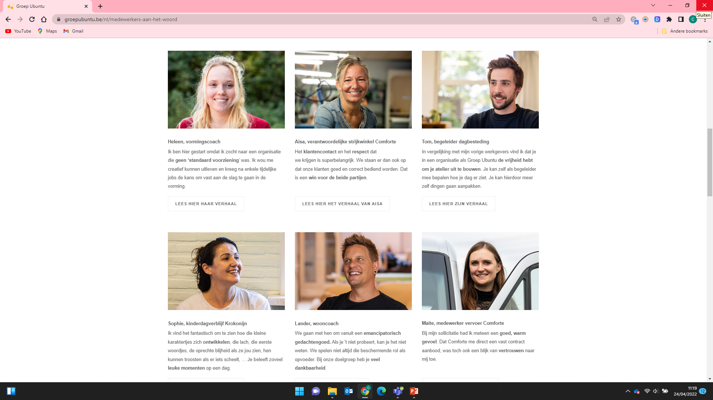

Slide 23
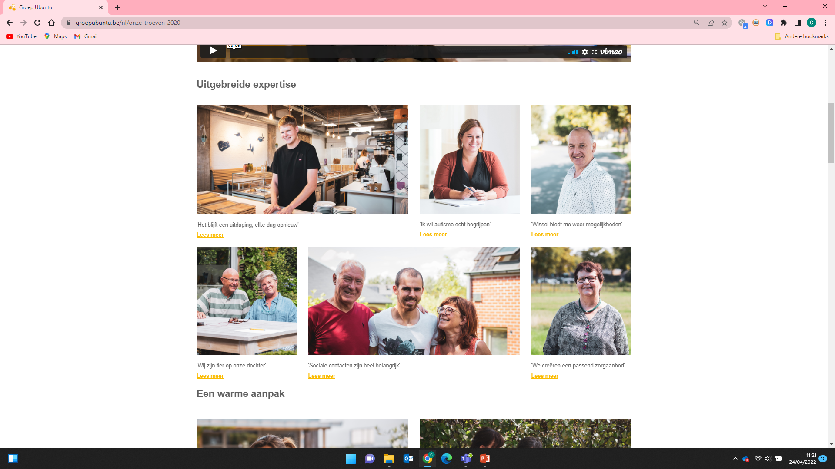

Slide 24
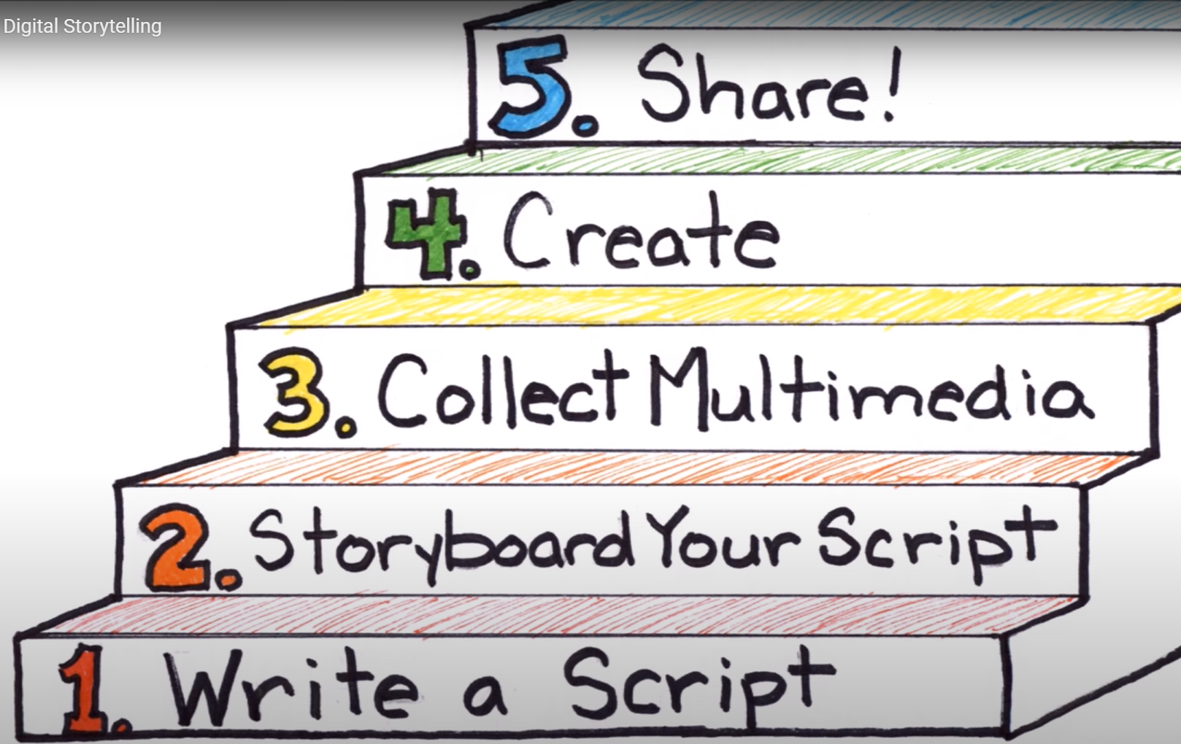

Slide 26
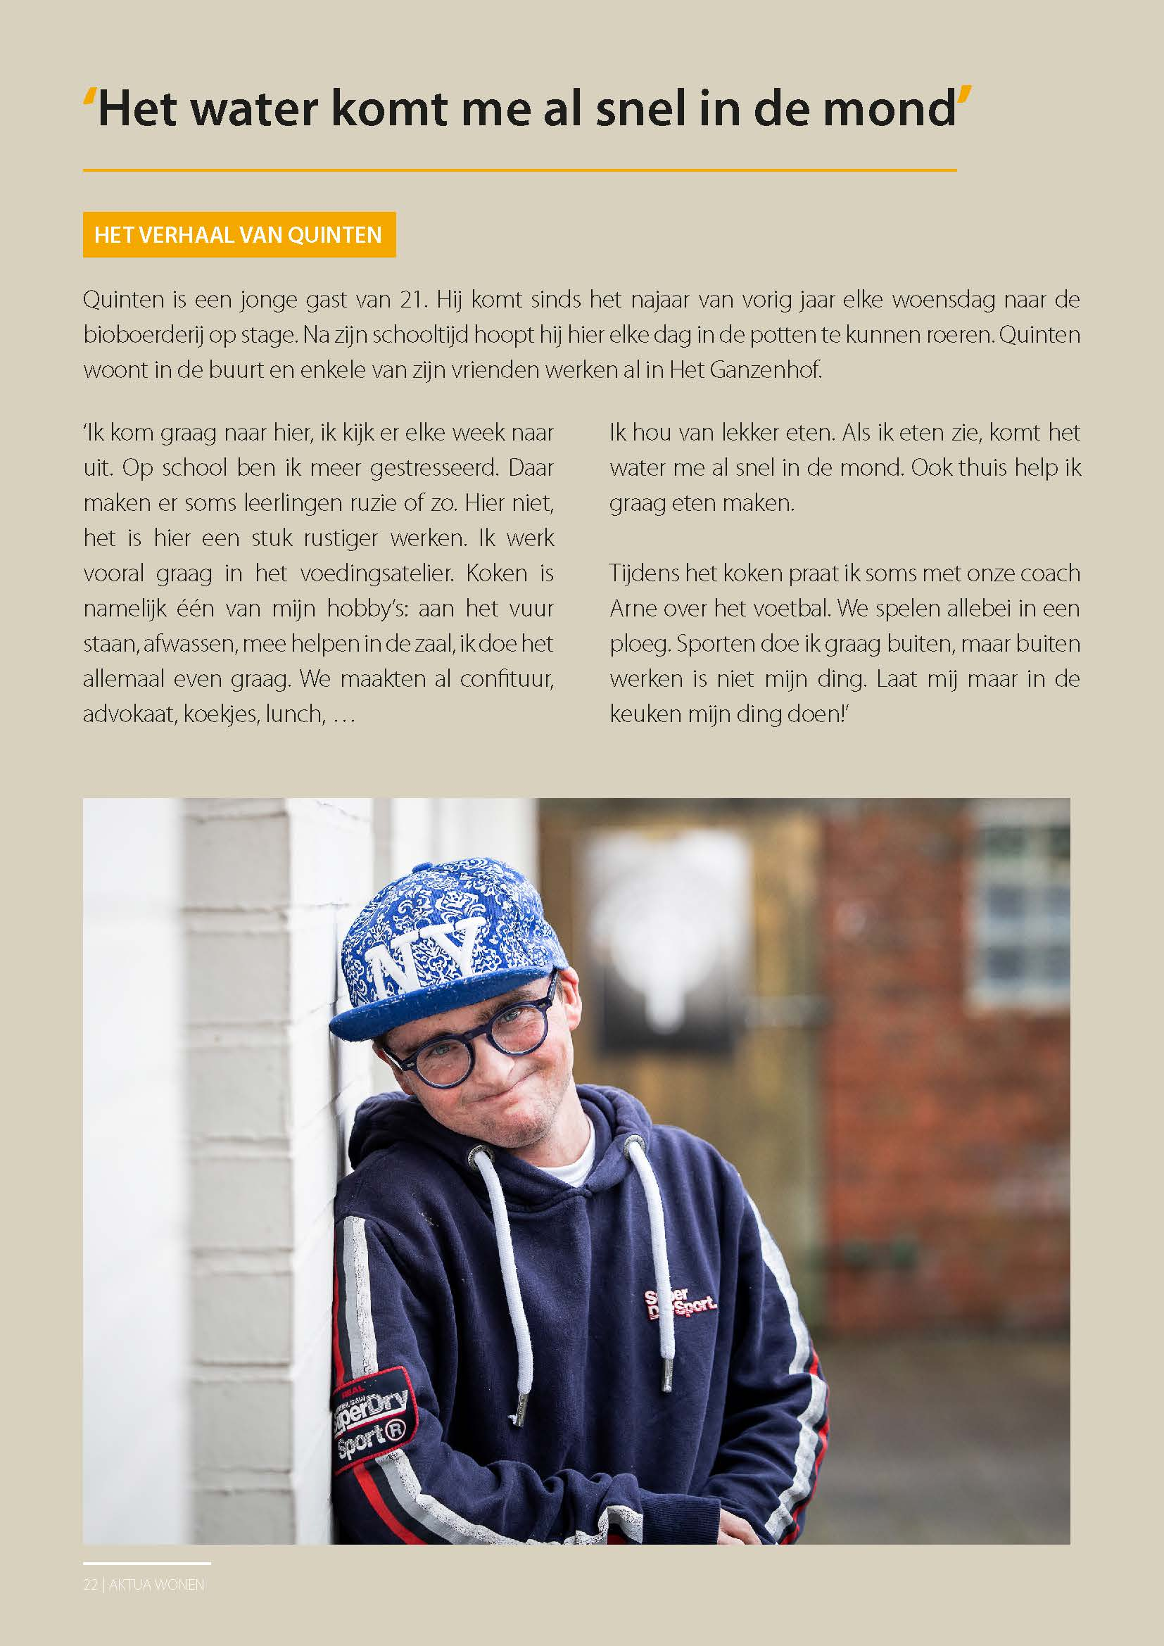
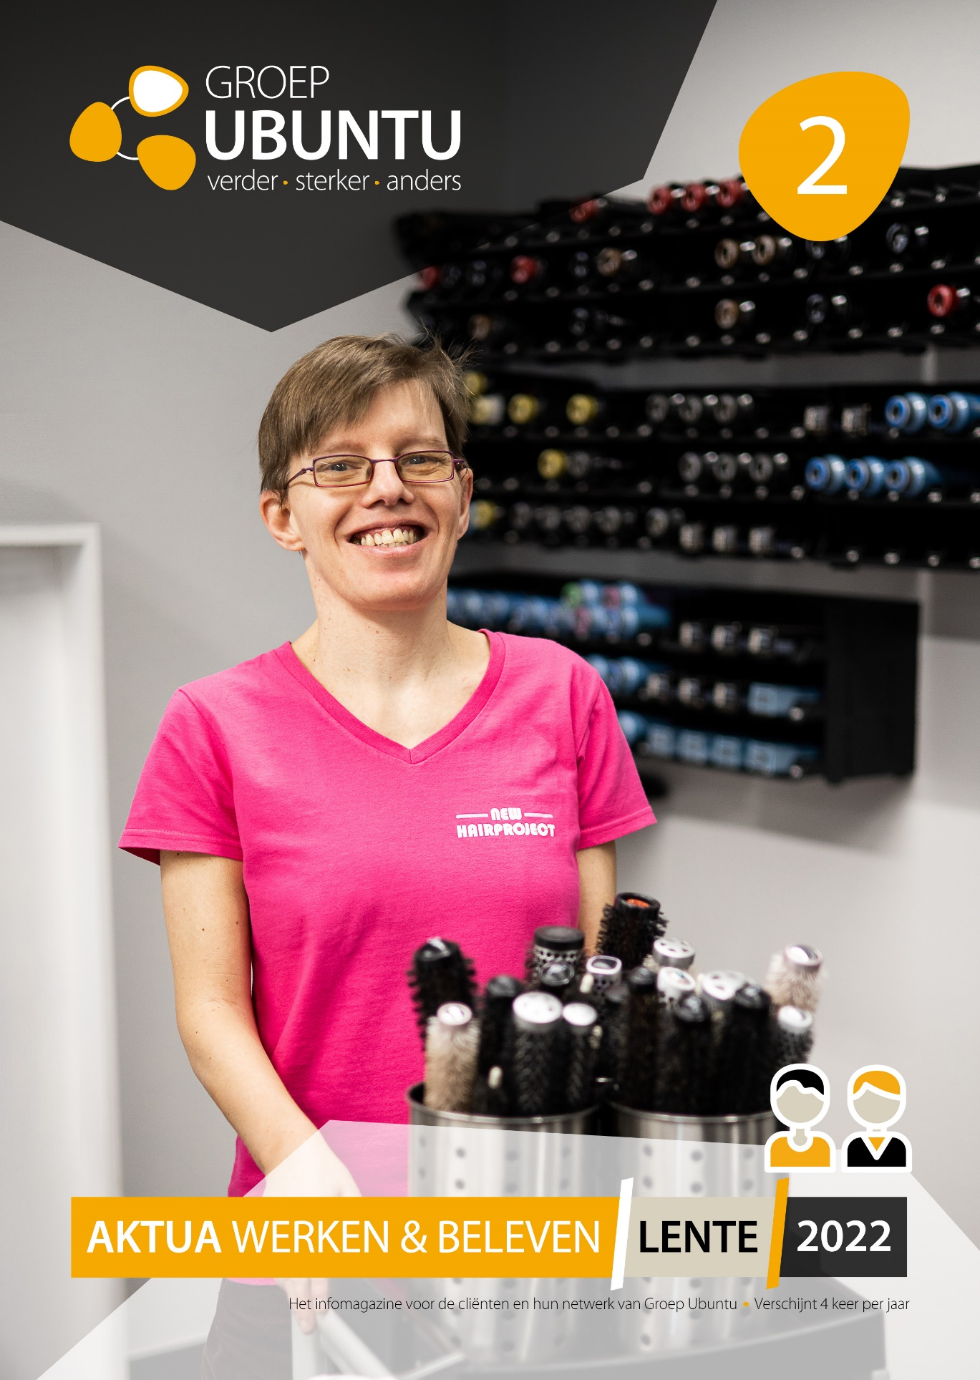

Slide 27
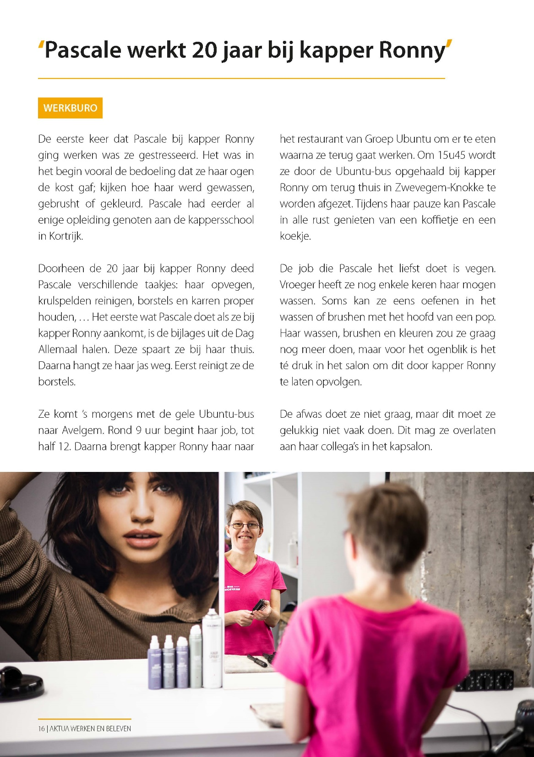
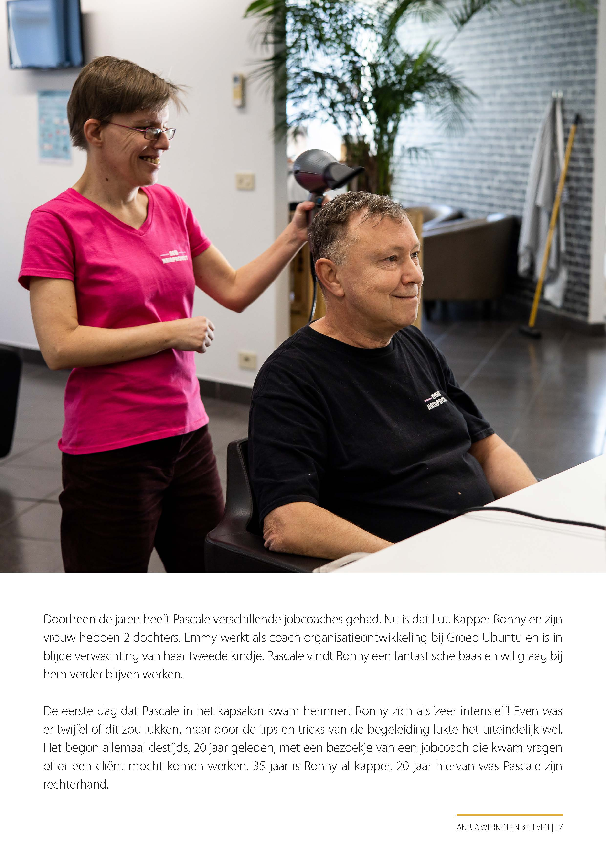

Slide 28
VISUAL DESIGN
INCLUDES
Photography and Video
Look and feel
Brand strategy
Corporate identity

Slide 29
Visual communication is in our human nature.
If we make more and smarter use of this,
we will communicate more fun, faster and better.

Slide 30
VISUAL DESIGN
Visual Design makes your organisation stronger.
We understand it faster but also remember it longer
It creates trust and interest
It fits the identity of your target group
It ensures usability and accessibility of your service

Slide 31
HOW DO YOU START
How do tart
‘It starts with the values ​​you propagate.’
Making people stronger also makes us stronger. We want to show our clients, employees and volunteers in a respectful, warm way. We want to put their talents/possibilities in the spotlight.

Slide 32
“How you relate to the clients will influence the images you make!”

Slide 33
TO CREATE MAKE GOOD VISUALS YOU NEED
Preparation
It tells the story
Be social
Less is more
Details
Experiment
Edits
…

Slide 34
PREPARATION
Prepare yourself as much as possible.
What’s the goal? What do we need? Discuss it with the team.
Social media, Flyer, magazine, video, campaign image...
Find the right people and places. Know the story.
The story or goal has to be in your head.

Slide 35
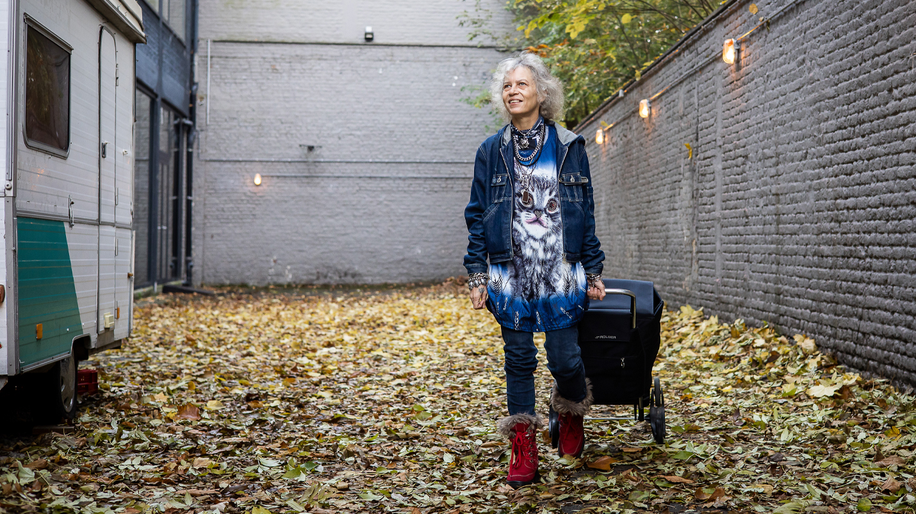

Slide 36
IT TELLS A STORY
Your photos or visuals are only successful if they fit the story.
Don’t miss it.

Slide 38
BE SOCIAL
Talk to your people while you are shooting. Make them feel good.
Be social, use some smalltalk, don't place yourself above them but on the same level.
It will make your models comfortable what will reflect in the pictures you make.
(don’t be just a photographer, be yourself)

Slide 39
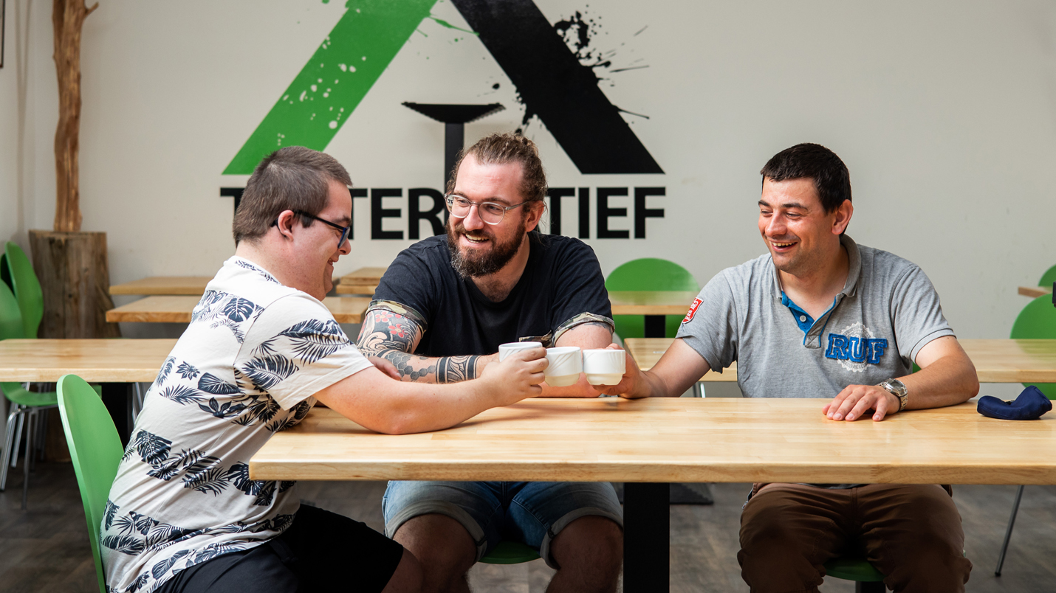

Slide 40
LESS IS MORE
Try to capture the essence.
When there are too many subjects in a photo, the viewer gets confused; what exactly does the photographer want to say with a photo?
Be ready at the right time. Certainly the moment when your subject forgets that you are there, is the moment when you have to be ready to shoot. Feel the connection.

Slide 41
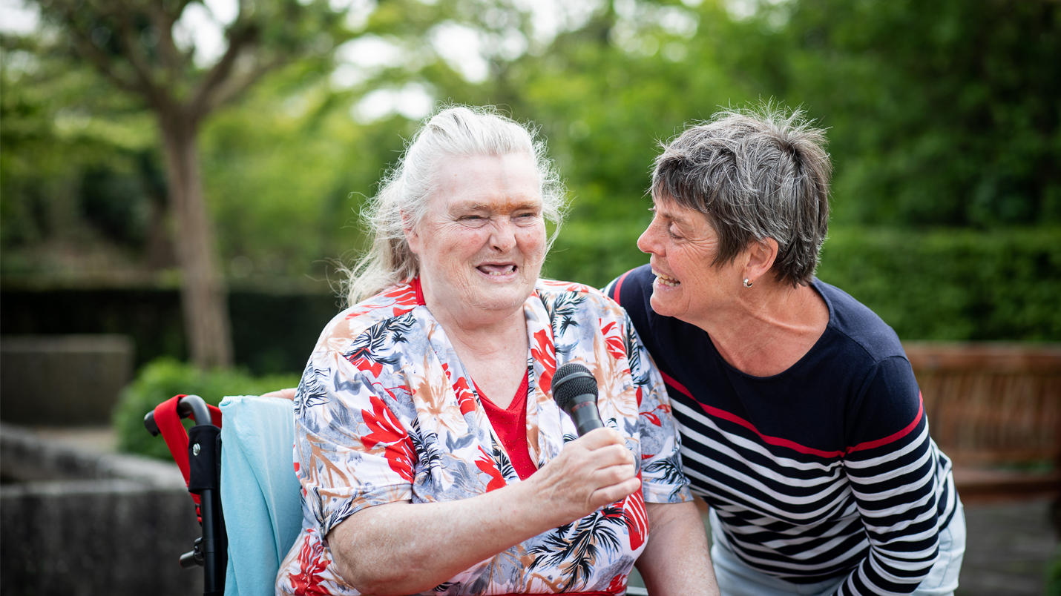

Slide 42
DETAILS
Detailed photos can tell more than you expected. They can bring variety and a more emotional impact on your visuals and stories.
So go close, photograph hands, subjects, interaction with the environment and the
environment itself. The story does not only have to consist of 'portrait photos', but can also be over-shoulder photos or a photo from the back.

Slide 43
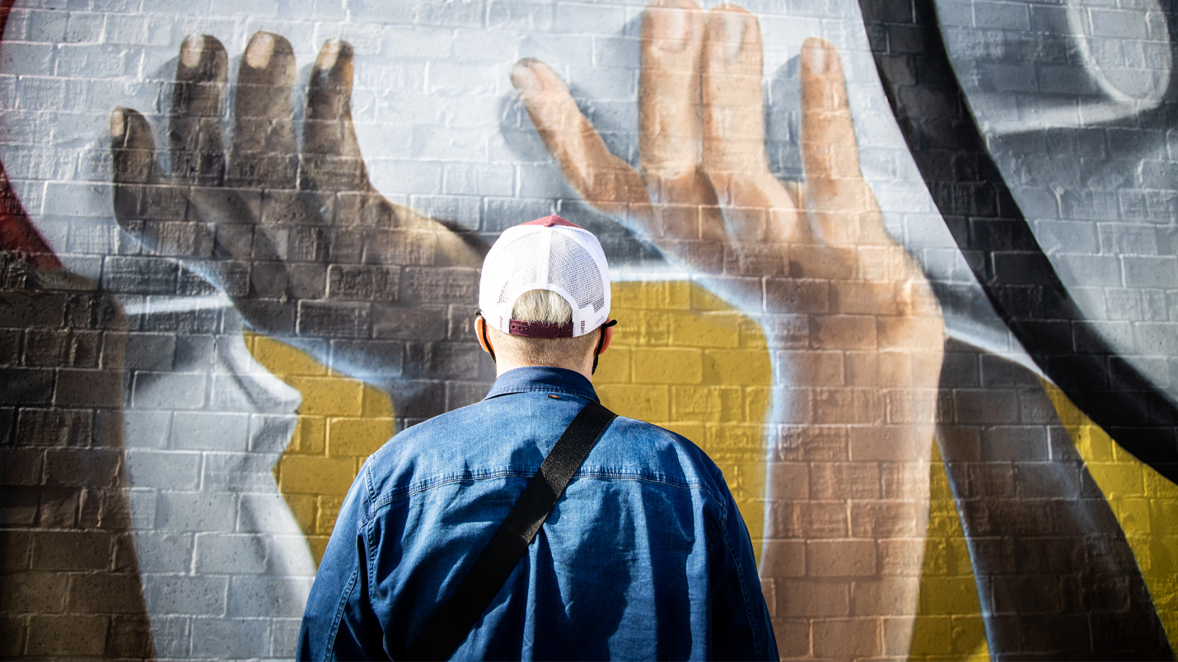

Slide 45
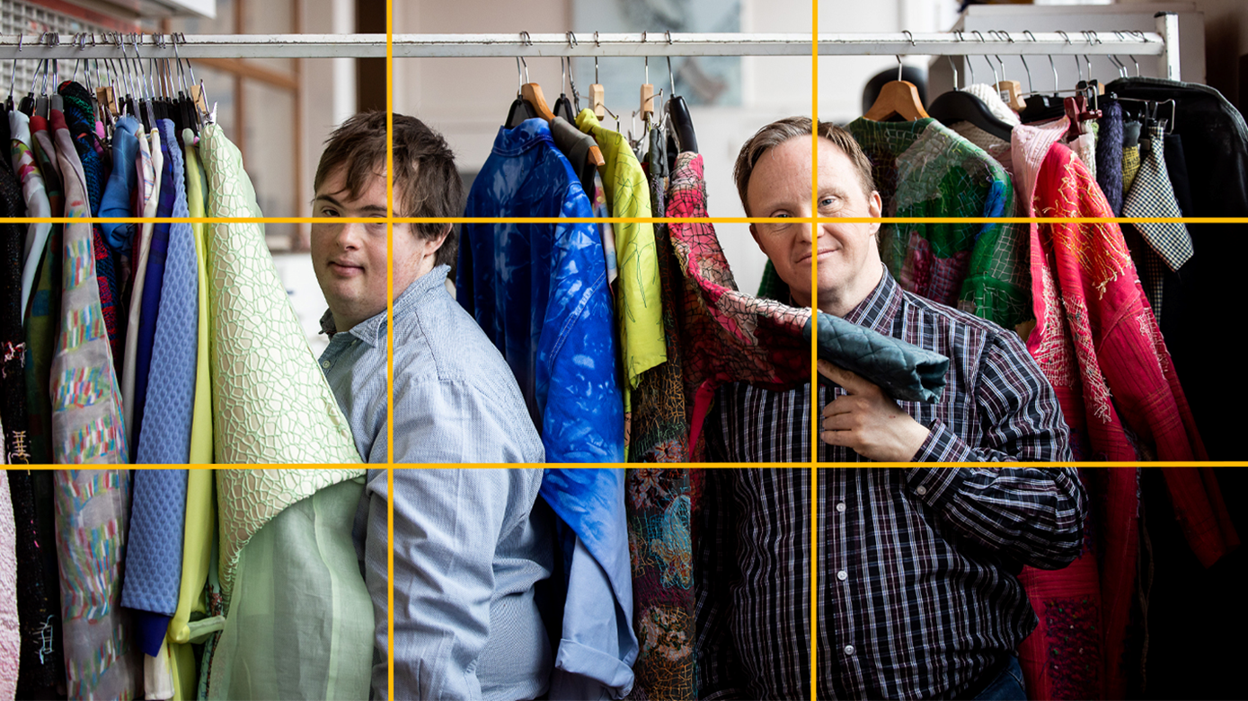
EXPERIMENT
With
The rule of thirds:
With the help of a grid you can make
photos more striking or interesting.
Your subject gets more attention.
(you can use it also on your phone)

Slide 46
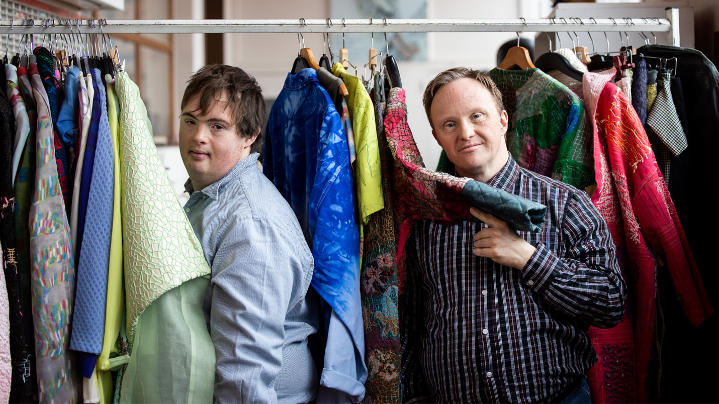

Slide 47
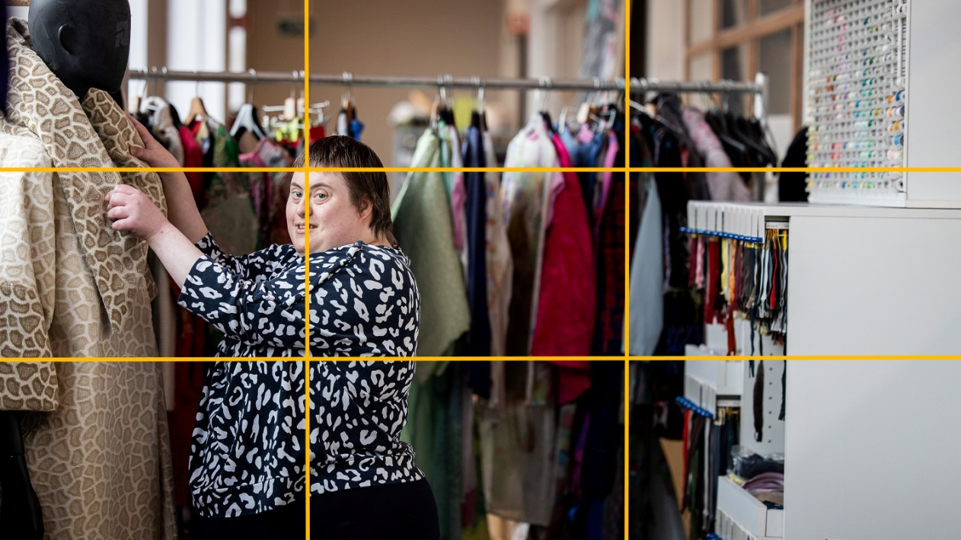

Slide 48
EXPERIMENT
Horizontal – vertical
Perspective
Lens - phone
Space
…

Slide 49
EDITS
Choose an edit that suits your photos.
It’s very important because the look and feel were made of it.

Slide 50
PROFESSIONAL IDENTITY
Image and identity = point of view of the organisation
Reputation = point of view external stakeholder
GOAL = reputation strokes with the image and identity
Notes:
Image and identity is seen from the point of view of the organisation and the reputation is how external stakeholders look at the organisation. The goal is that both match with eachother. We try to keep one direction for all communication. Certain things are cristal clear for our organisation, but the key is that external stakeholders look at us the same way.

Slide 51
CREATOR
Not just an activity
Responsable for quality
Proud
PI also makes the products sell
Notes:
Clients are our creators in the different workplaces. They do a job and the take responsibility. It isn’t just an activity, but really a serious job. The are responsable for the product and thus the quality of it. This is also what makes them proud to be a ceramist, baker, cook… We capture their story. The fact that they’re proud en responsable also makes the product sell. They share the things that they love, as does eveybody.

Slide 52
WE BRING ONE STORY USING DIFFERENT MEDIA
Intranet
Website
Newsletters
Facebook
Instagram
Magazines (Aktua, Sporen, employee magazine)
...
Notes:
To bring a story across, we use different kind of media: printed media (magazines, flyers, cards…), social media such as Facebook, Instagram, LinkedIn but our website and newsletters are also an important way to reach different stakeholders. You always have to keep in mind that the story you bring is fit or adjusted depending on what medium you use. I will give some examples to make my point.

Slide 53
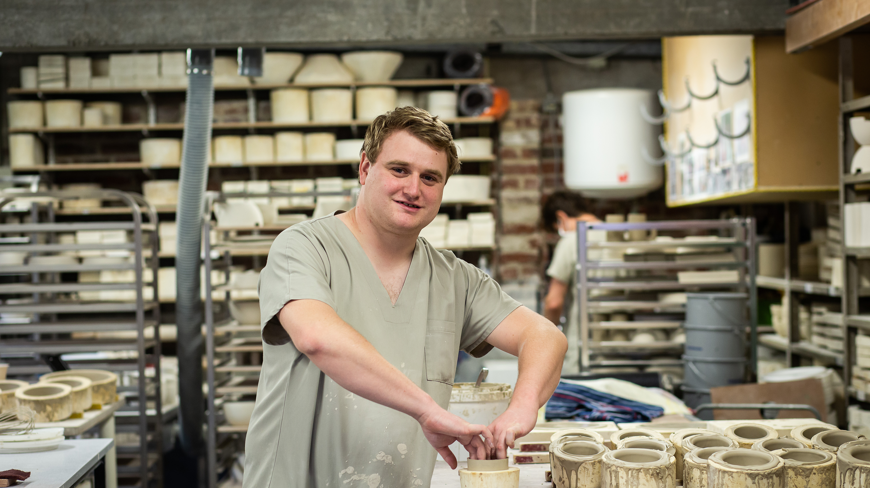

Slide 54
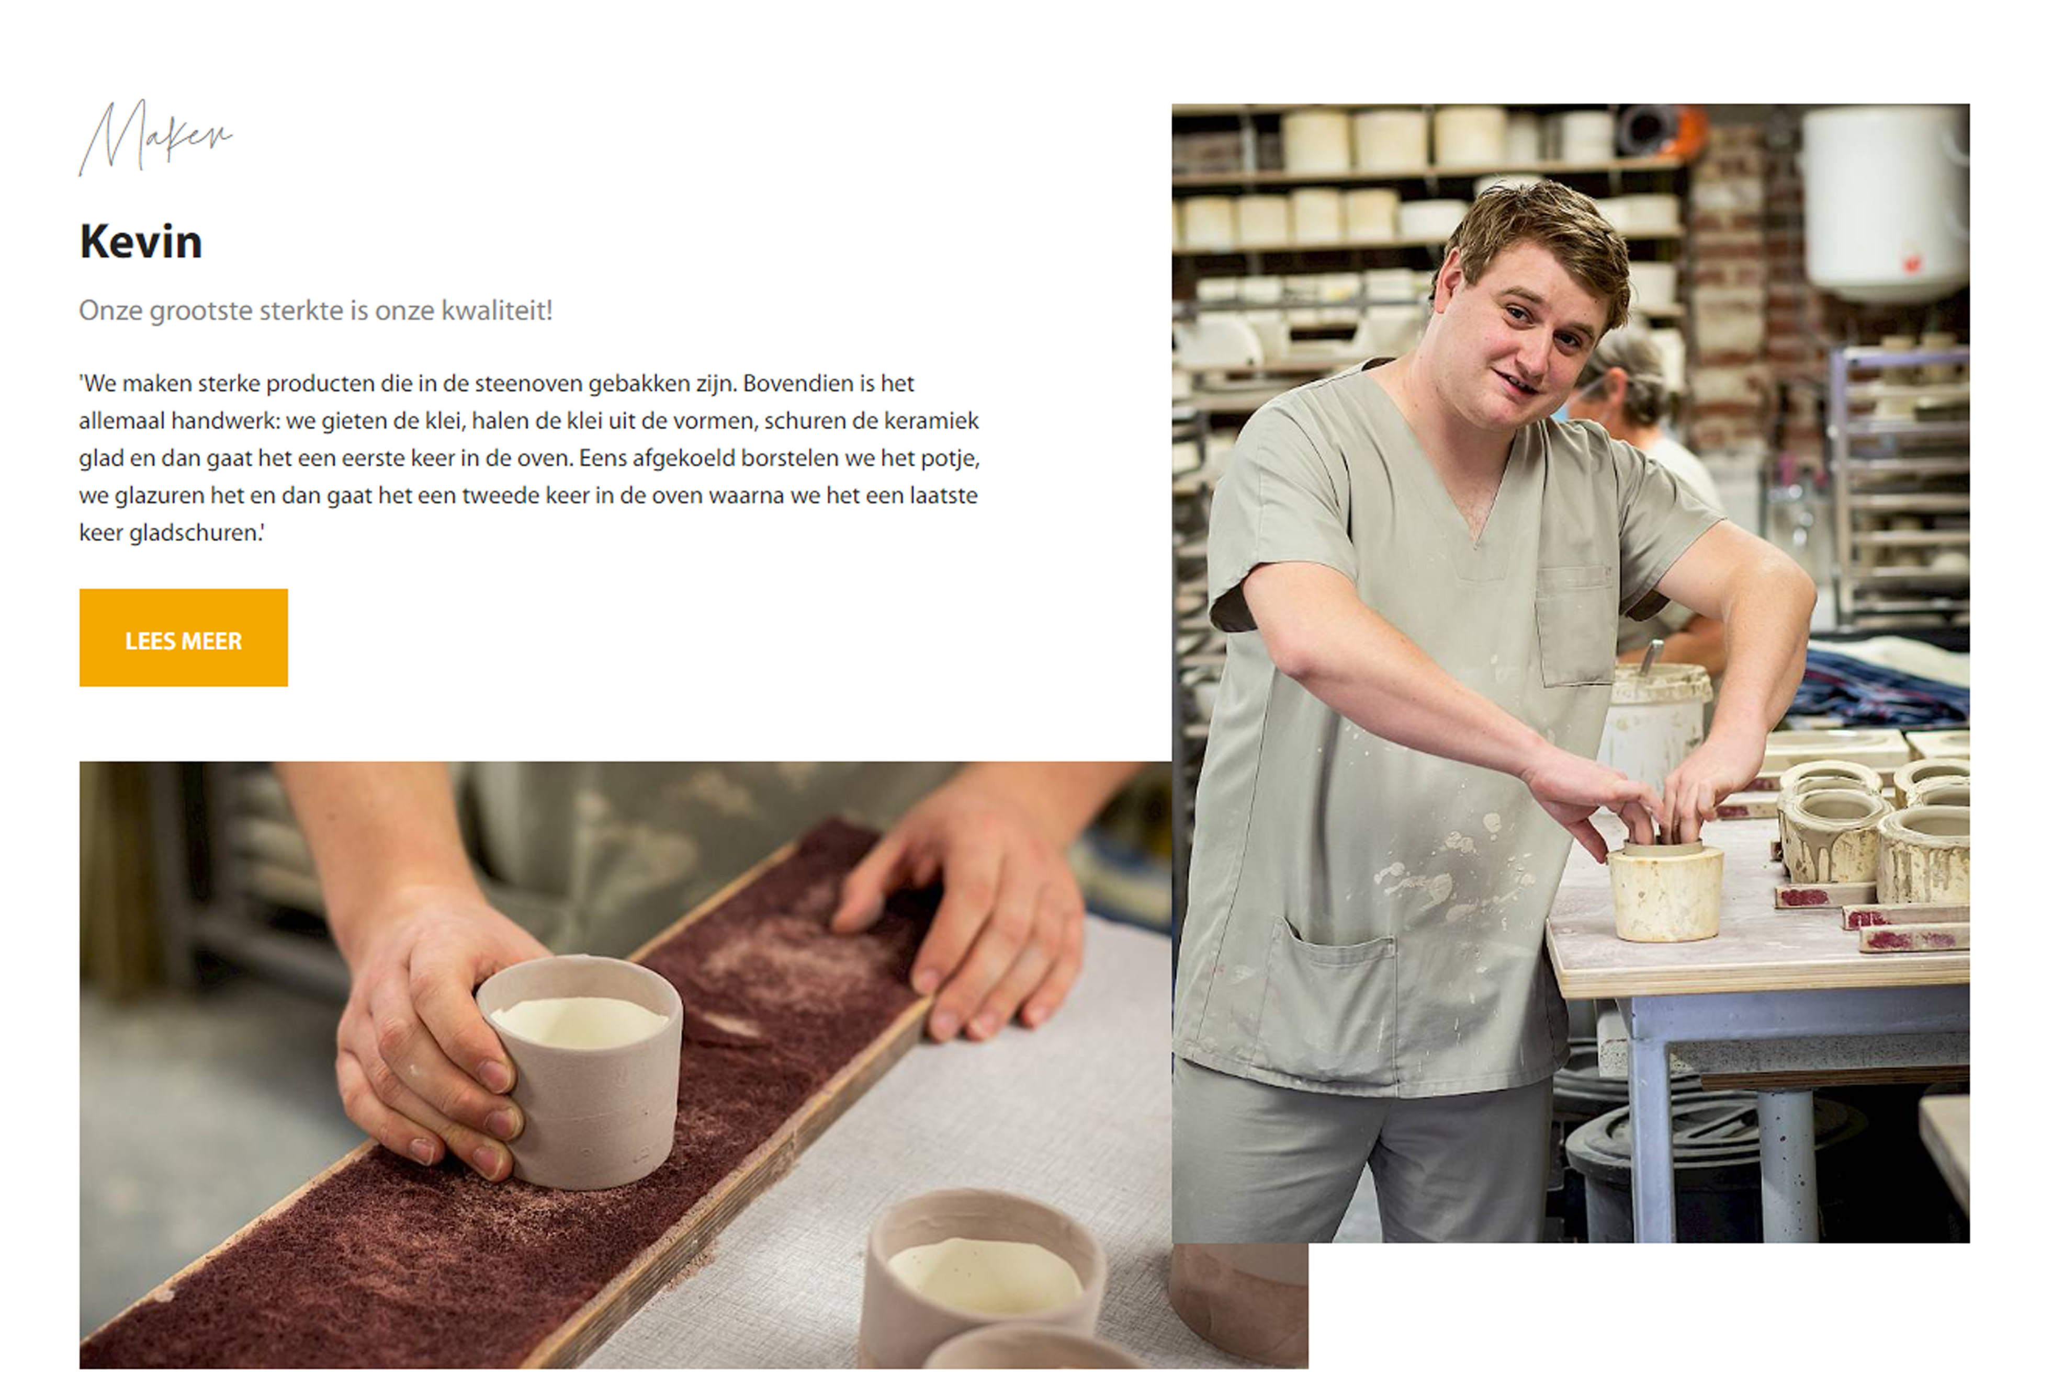
STORYTELLING = BASE OF ALL COMMUNICATION
WEBSHOP
www.hetanderegeschenk.be
Triggering introduction
Notes:
At the end of 2020 we launched a webshop to sell our products. The logo was designed keeping in mind that it should match with the logo of Groep Ubuntu. Het andere Geschenk is a selection of products that we sell online but also in our shops. We want to make sure that the products are seen as ‘real’. We don’t want people to buy them out of compassion. Our clients have a job and they make good products. It is very important that their stories are told online. We especially made a section were creators tell their story. We trigger the visitor with the introduction of the creator, so that they want to know the whole story.

Slide 55
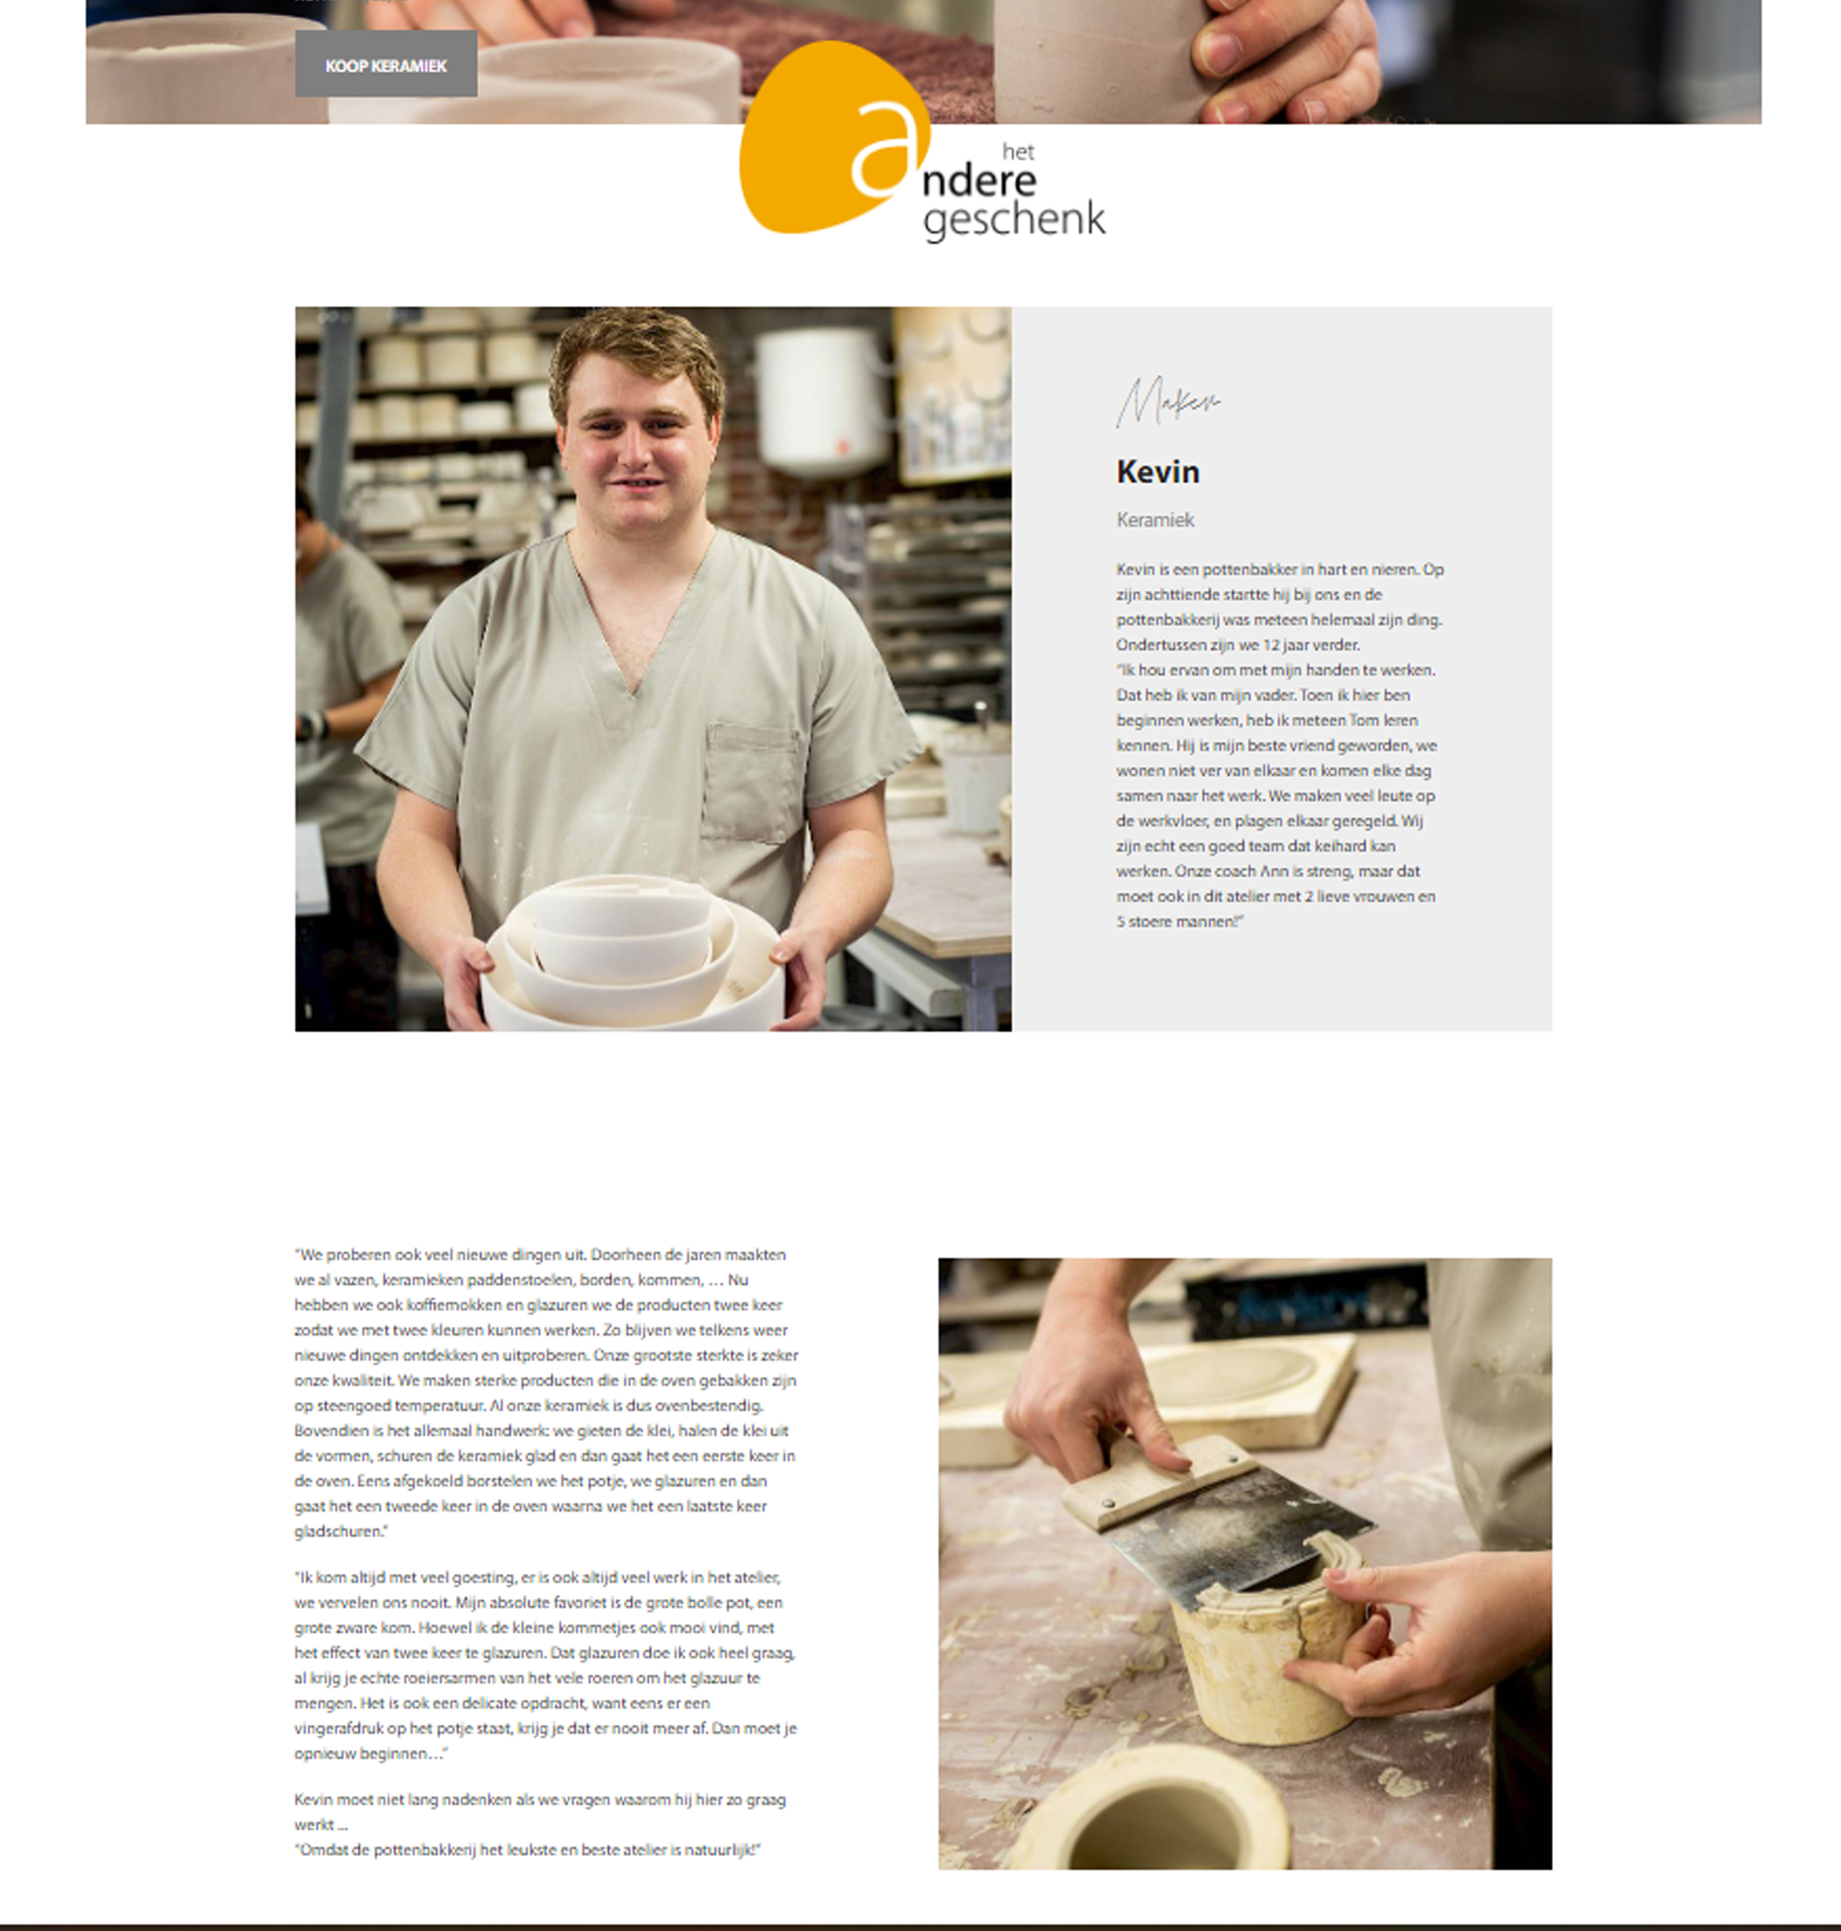
Full story + strong images
People behind the product
Notes:
Visitors/ customers get to know the people behind the product.

Slide 56
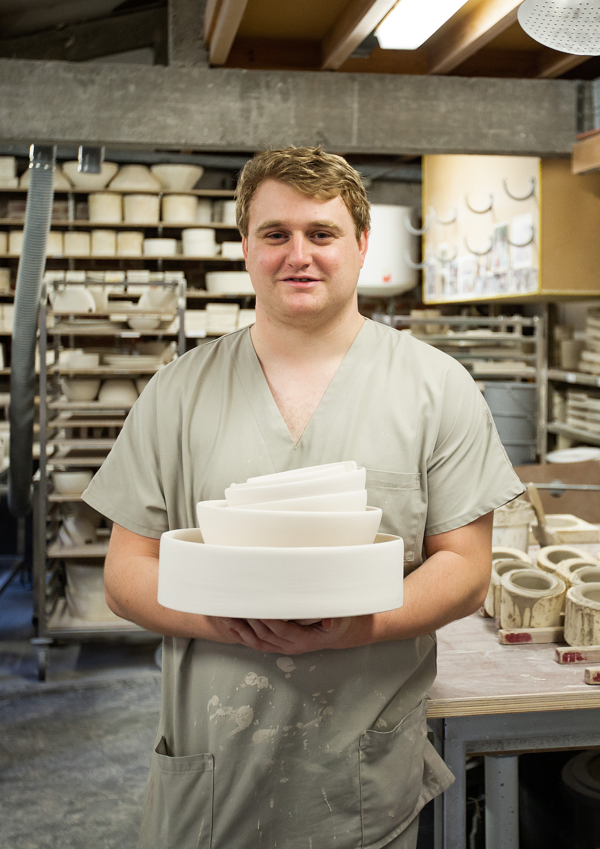
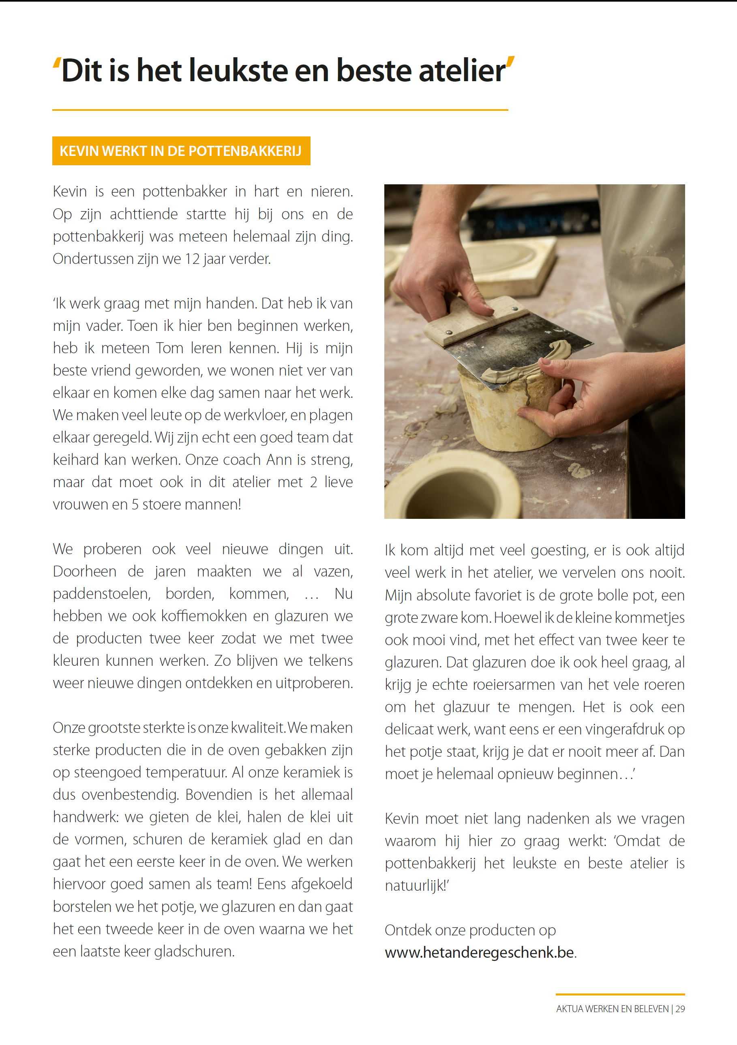
Notes:
Storytelling is also used in our own magazines such as Aktua (= magazine that is made by and for clients). The story is alsways flanked by good pictures (also details).

Slide 57
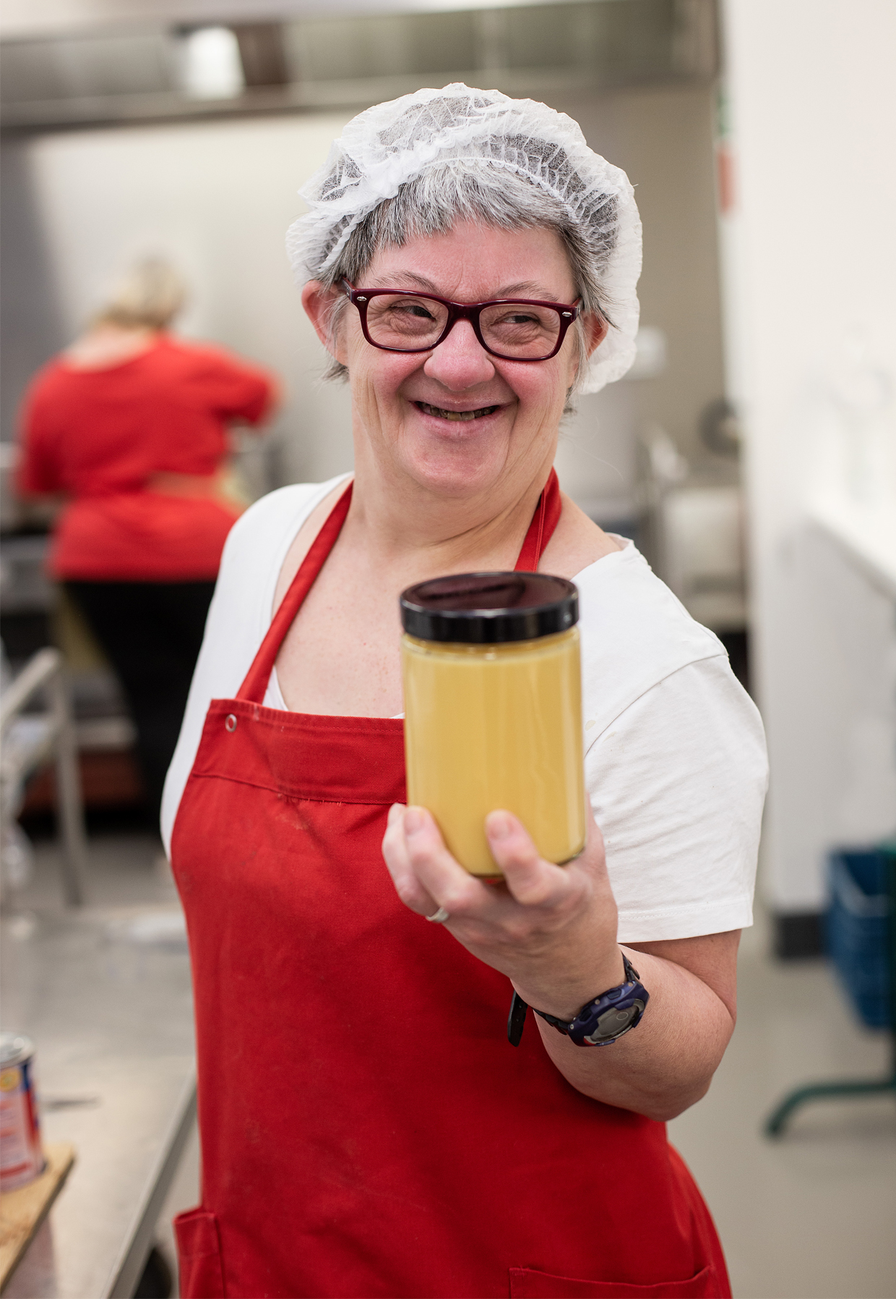
Front
Back
POSTAL CARDS
Same style returns
Recognition
Notes:
We make sure the same style returns in everuthing we do and publish. This is an example of the postal cards we put with the online orders. The packing is also in the same style as the rest of the site.

Slide 59
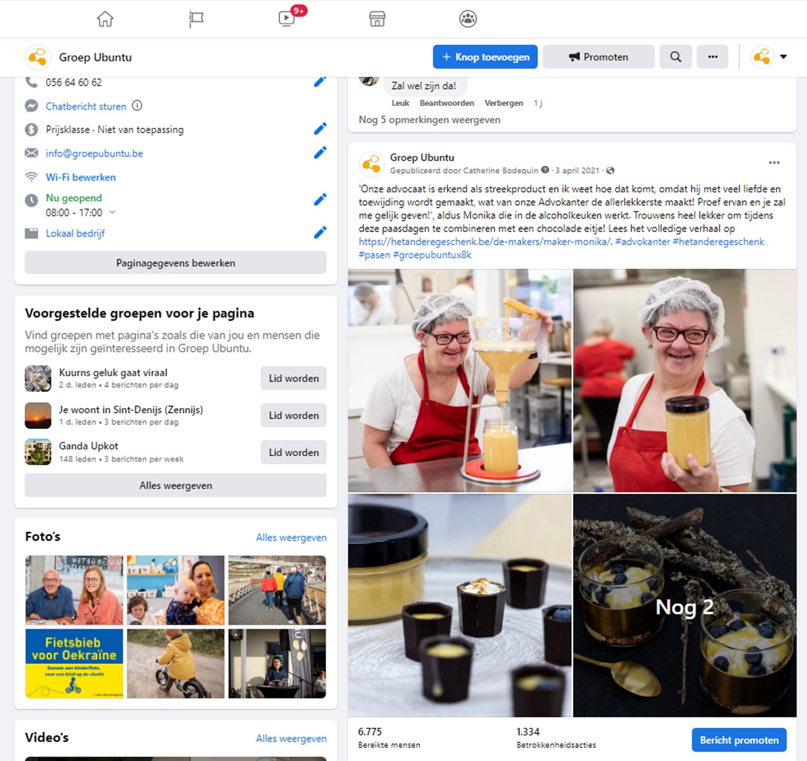
FACEBOOK
SOCIAL MEDIA
Pictures of client + products
Short version of the story
CTA
Link to the webshop
# are important!
Notes:
Social Media is an important part of all communication. Through social media you can reach a bunch of people that you can’t reach by just using printed media and your website. It is important you feed it well and this goes for and Facebook and Instagram. Facebook is not the same as IG.

Slide 60
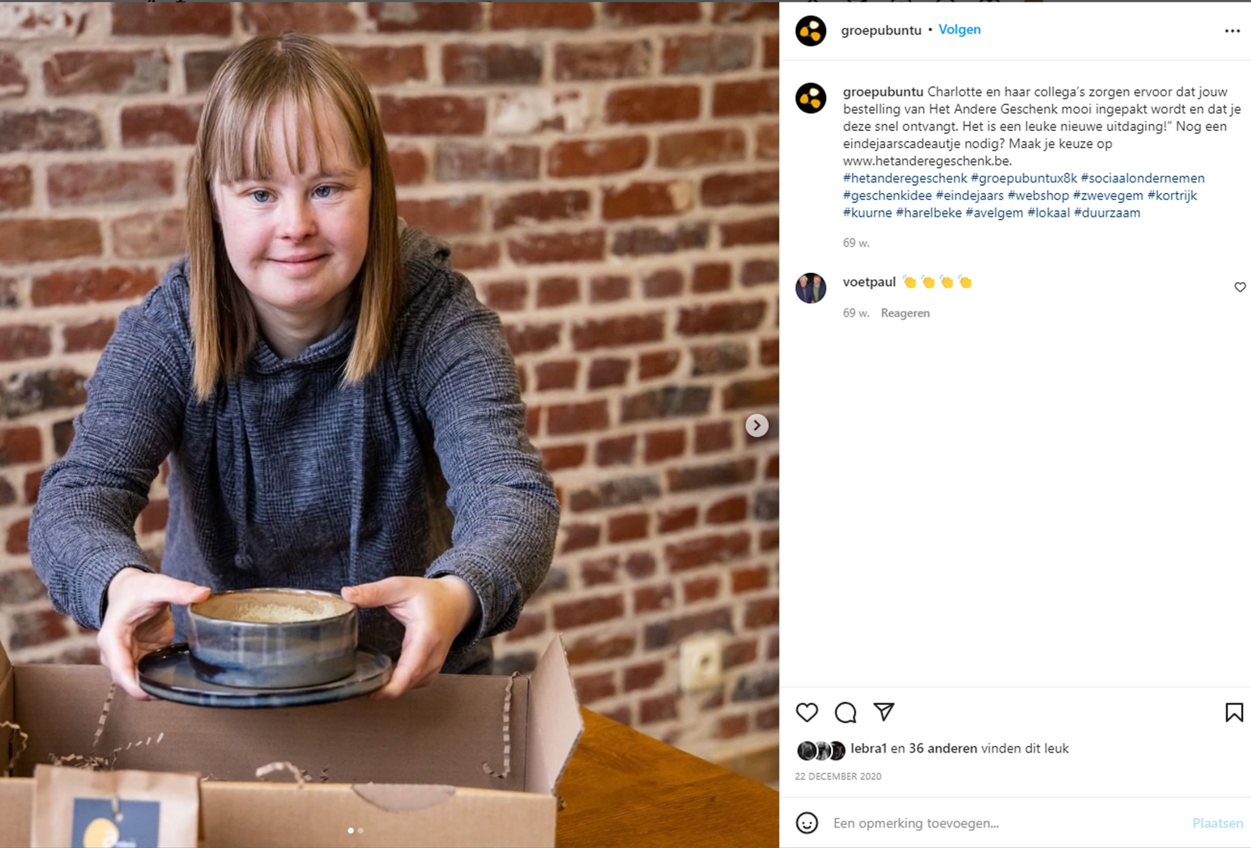
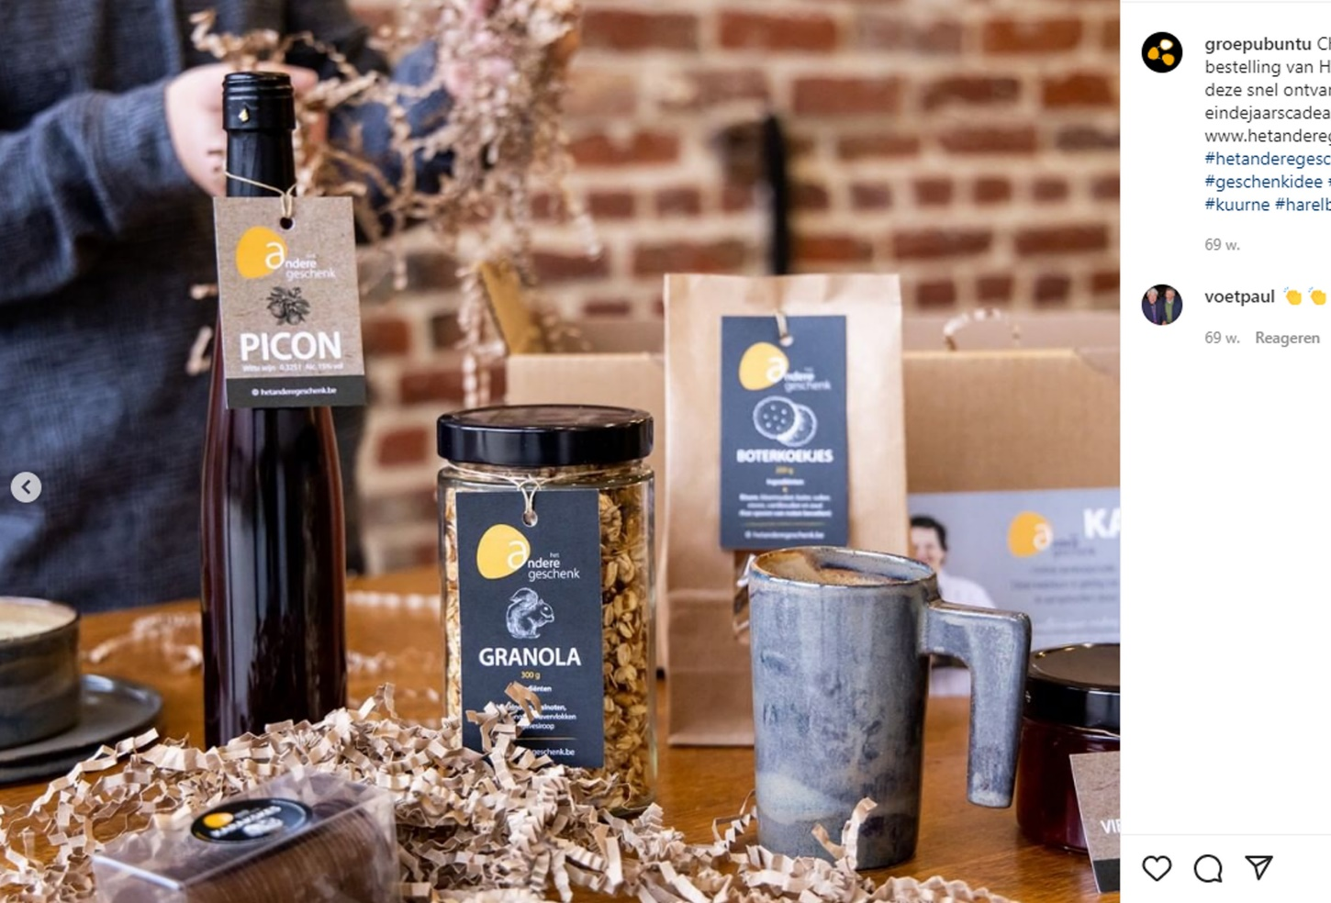
INSTAGRAM
Notes:
IG is a newer platform were images and pictures are even more important. Here we use the highlights of our story to trigger people. Our ultimate goal is that they look further than that message, that they have a look at the website, subscribe to our newsletter…

Slide 61
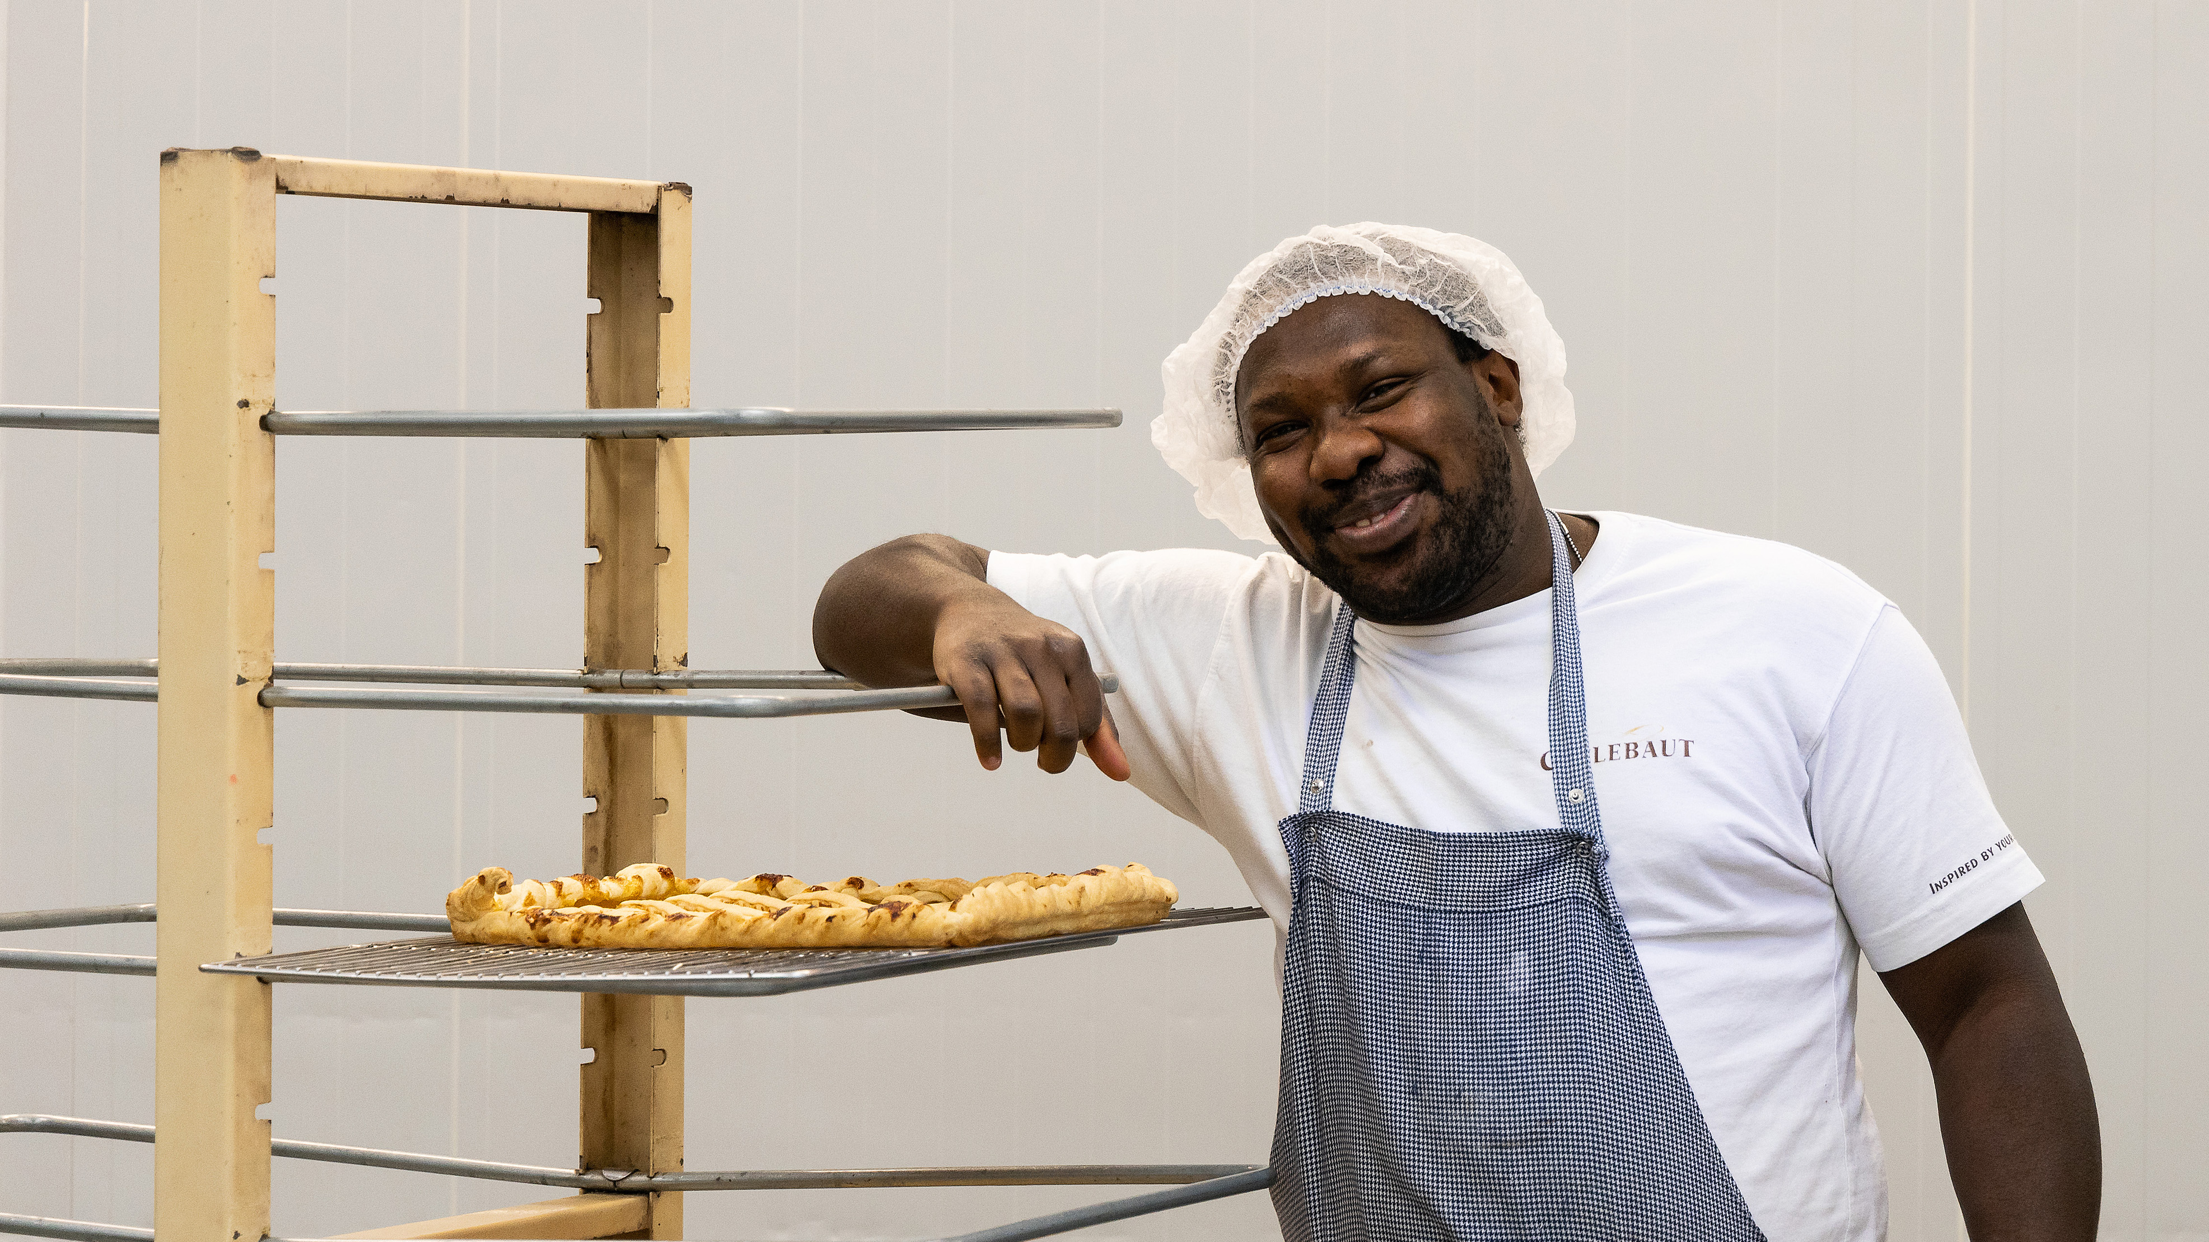

Slide 62
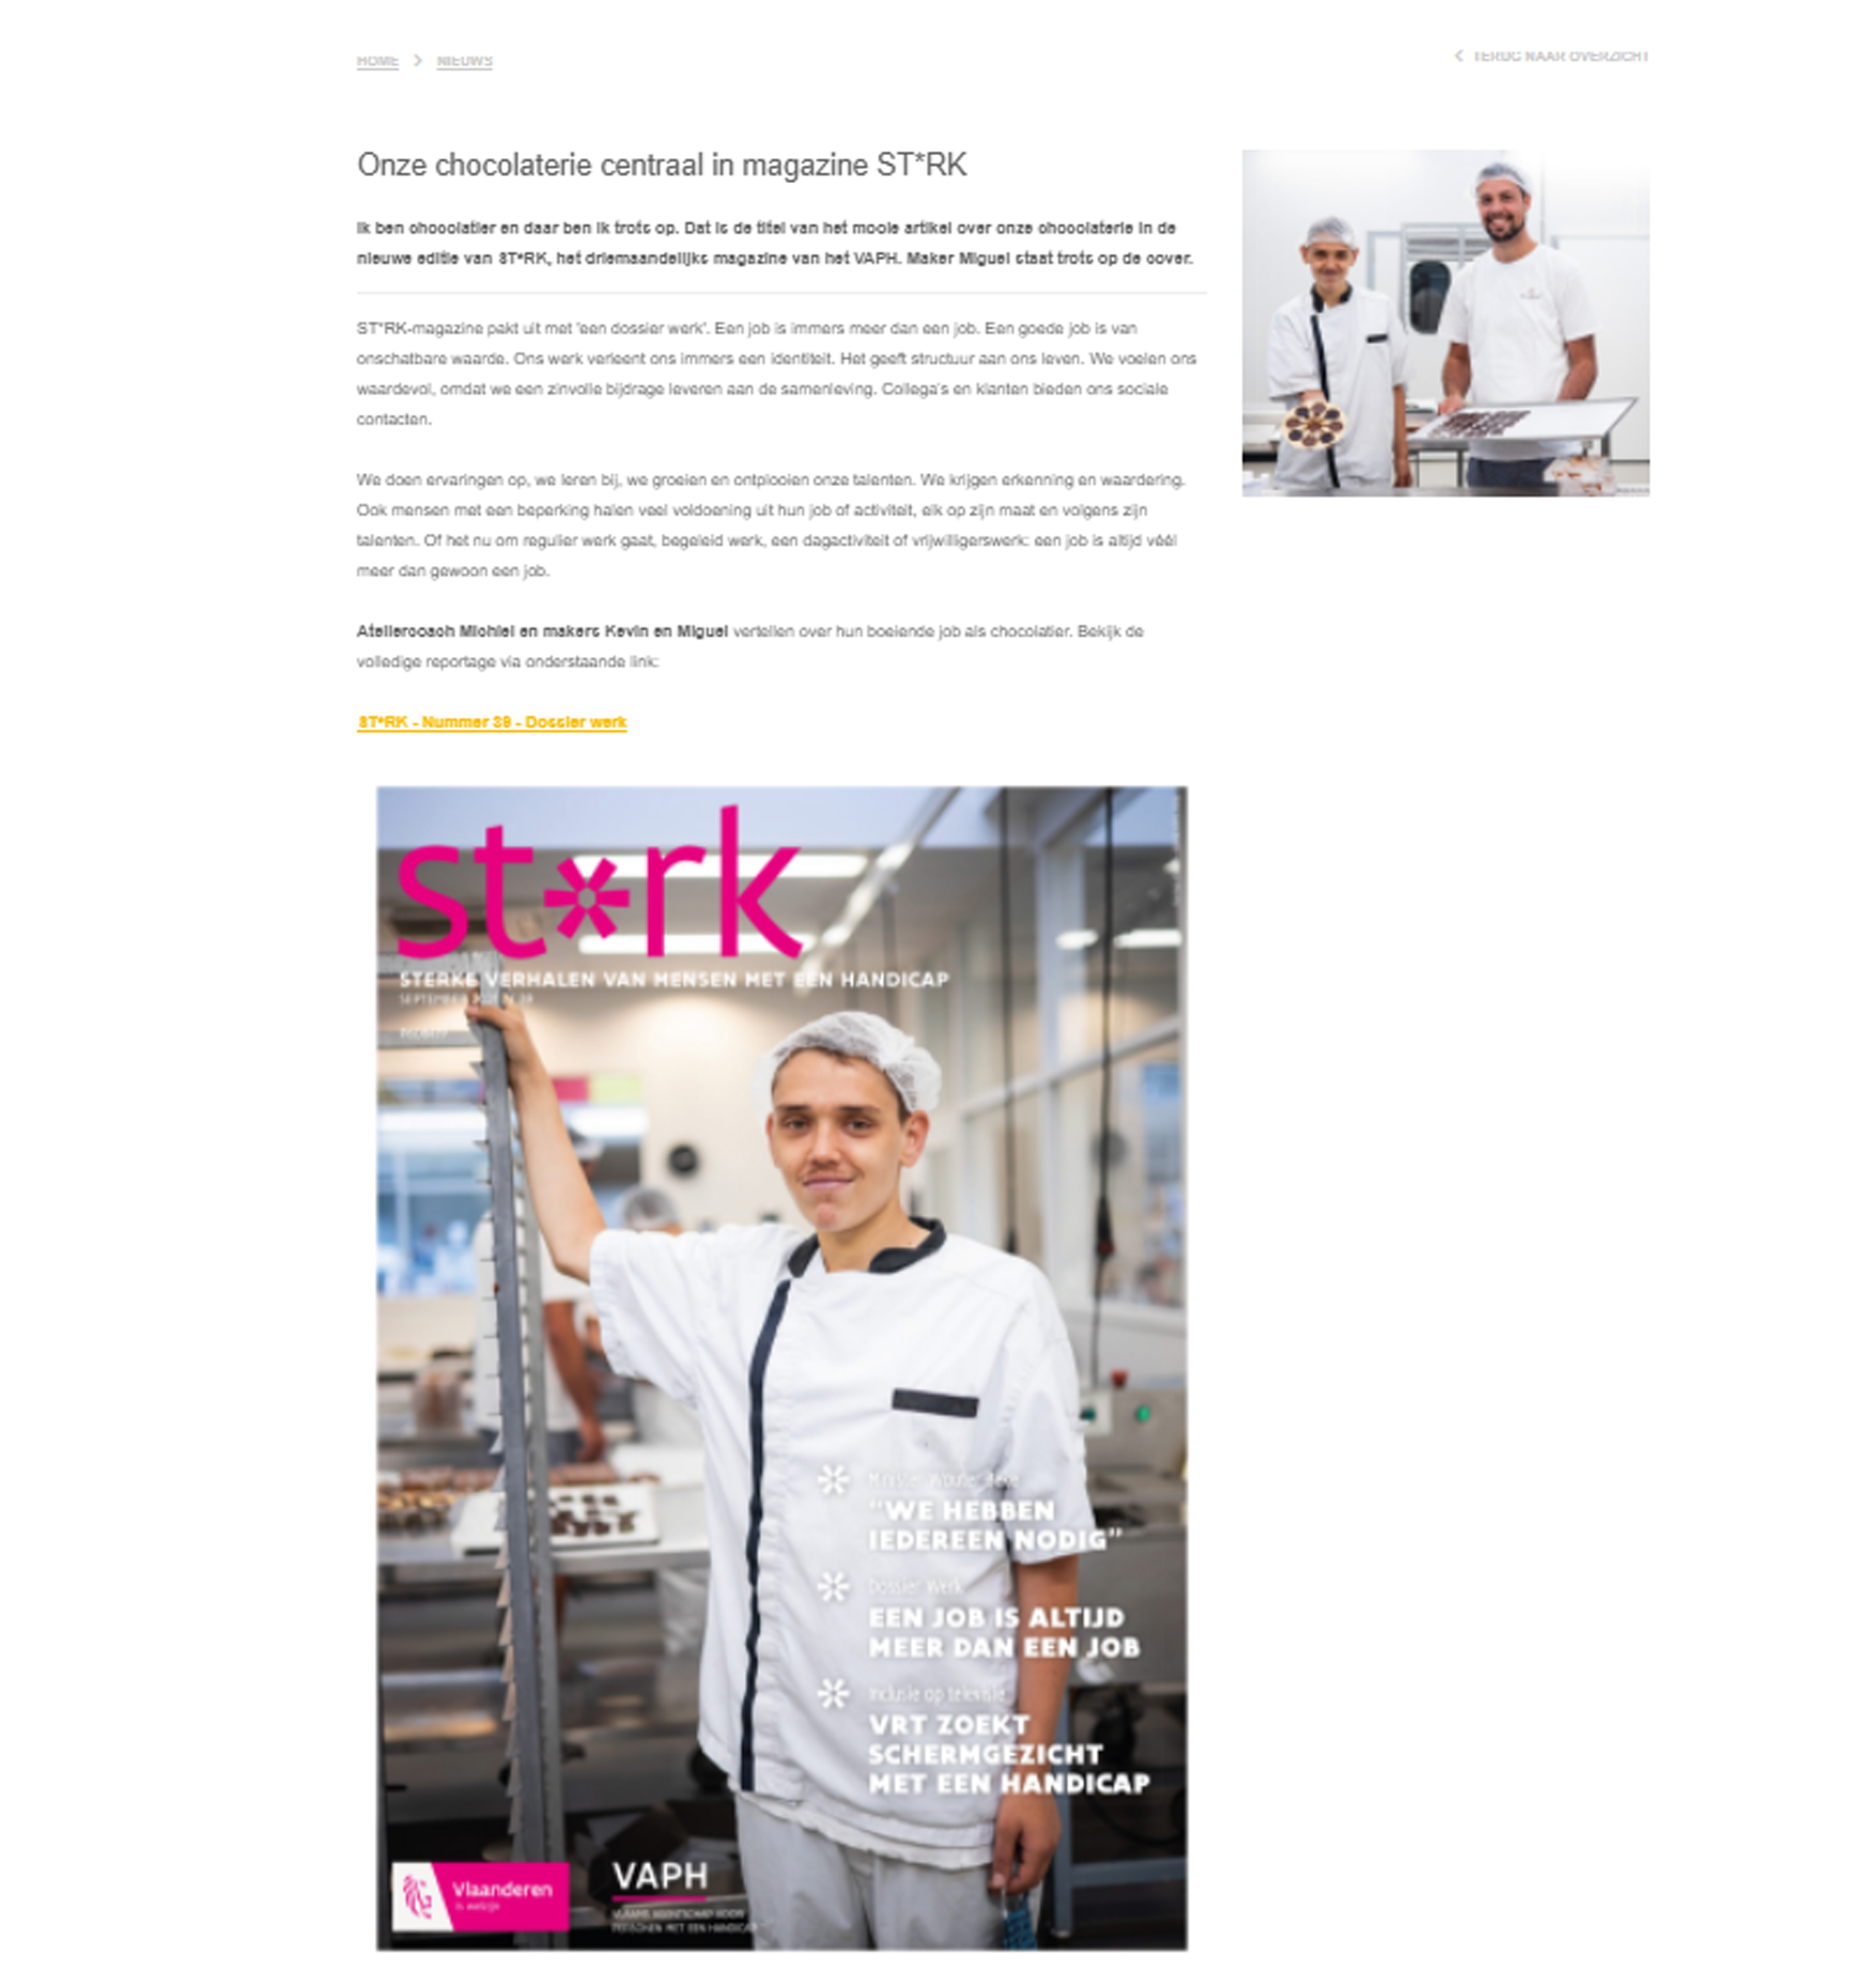
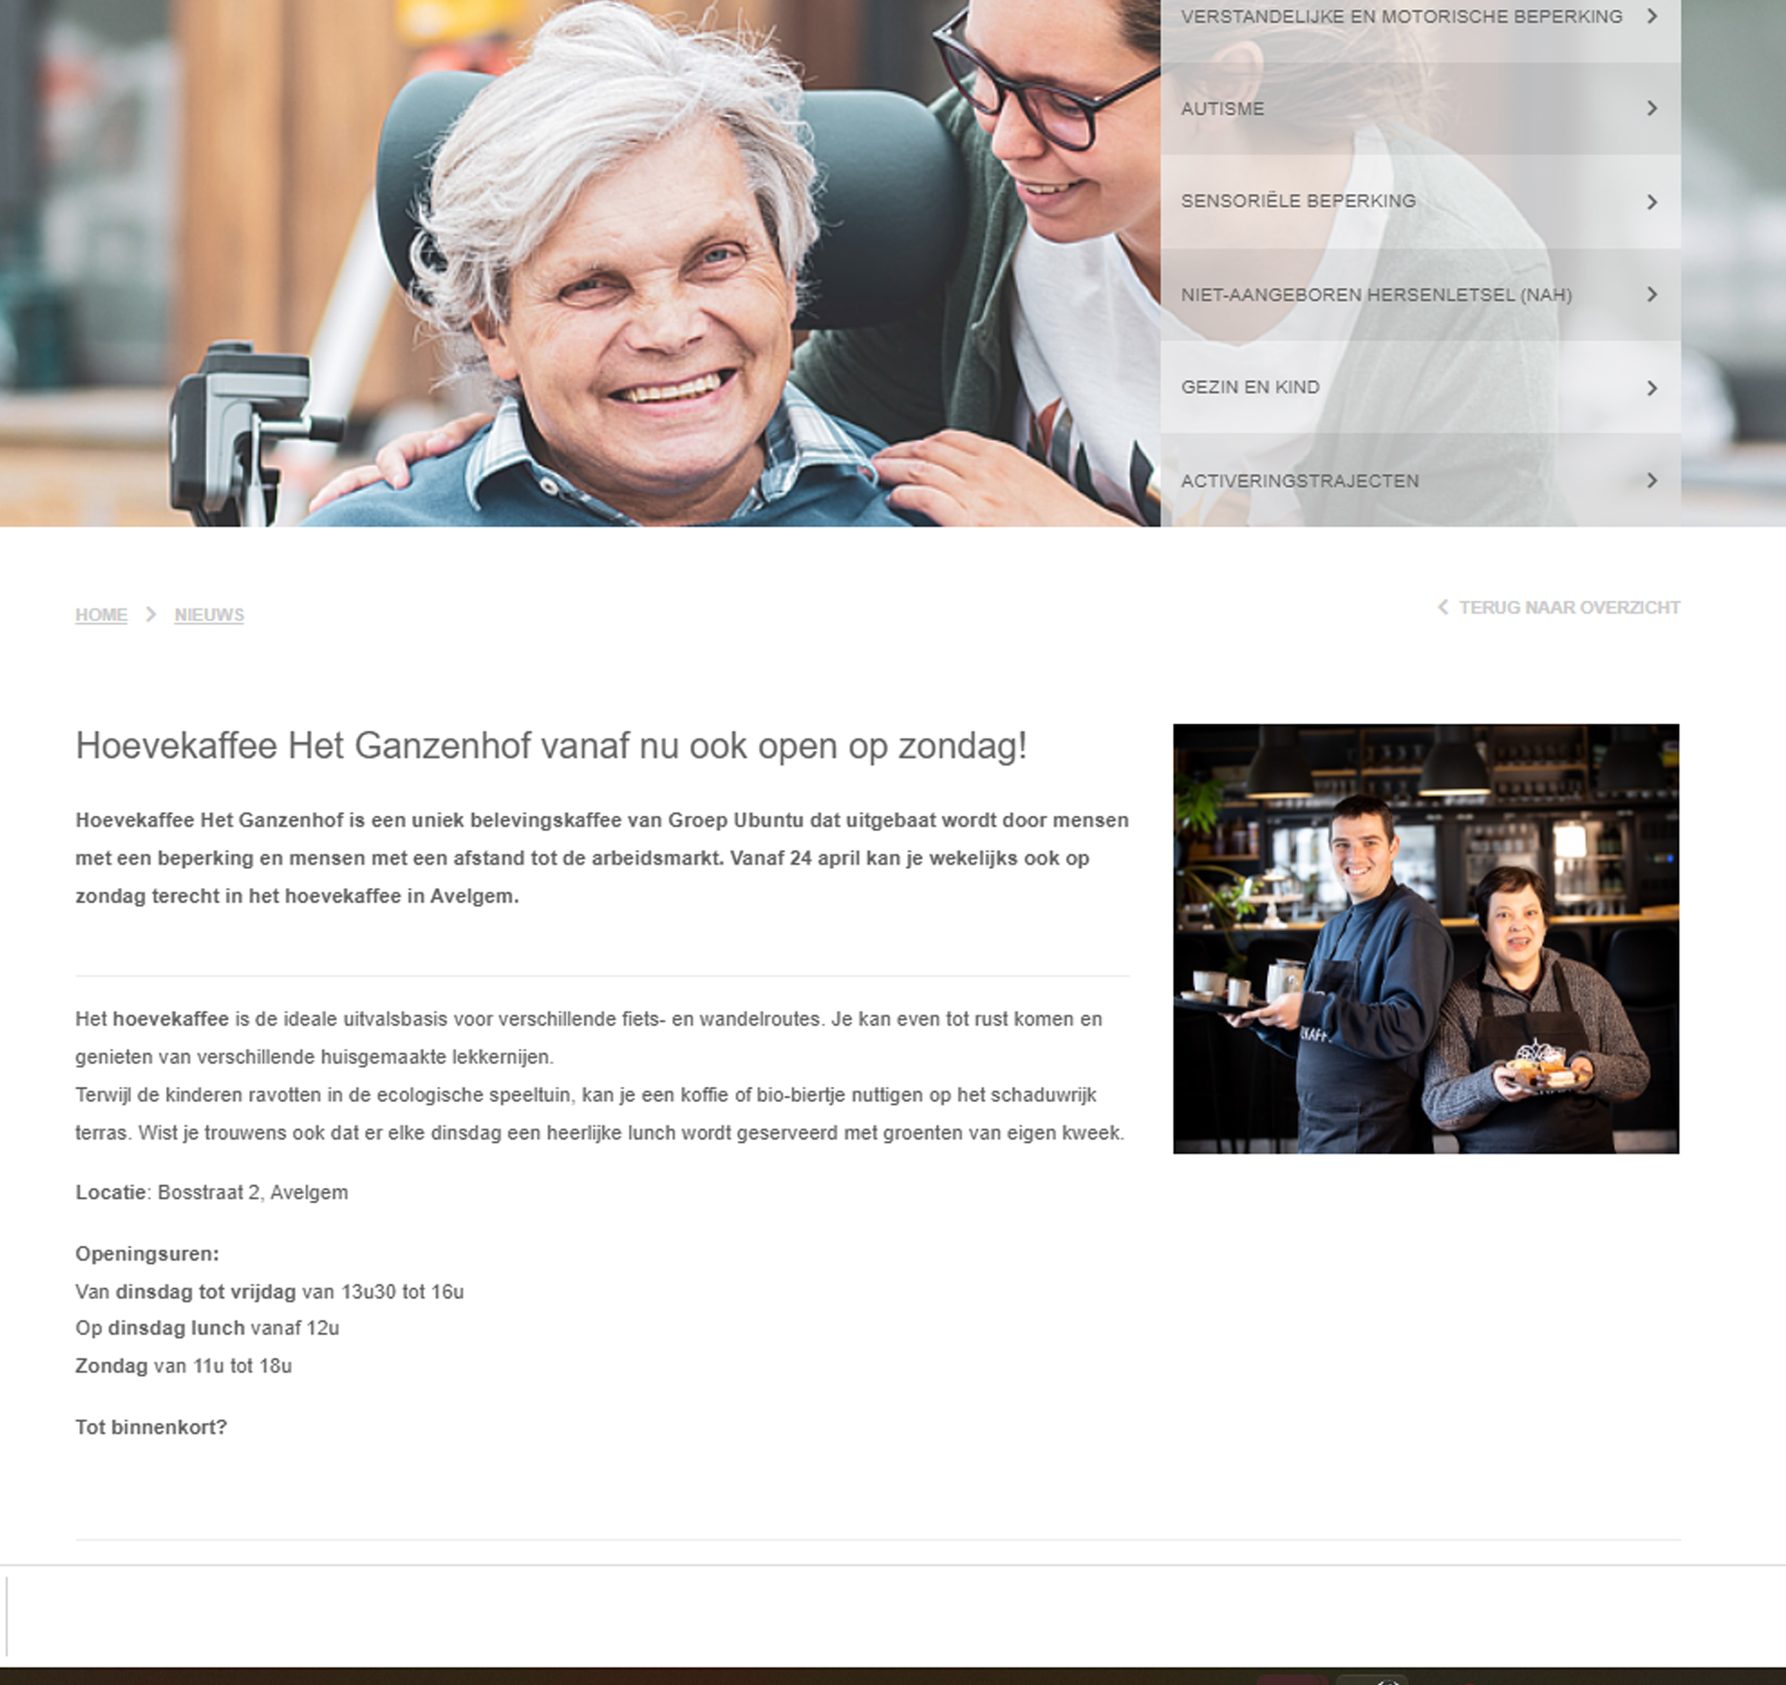
NEWS ITEMS (WEBSITE/INTRANET)

Slide 63
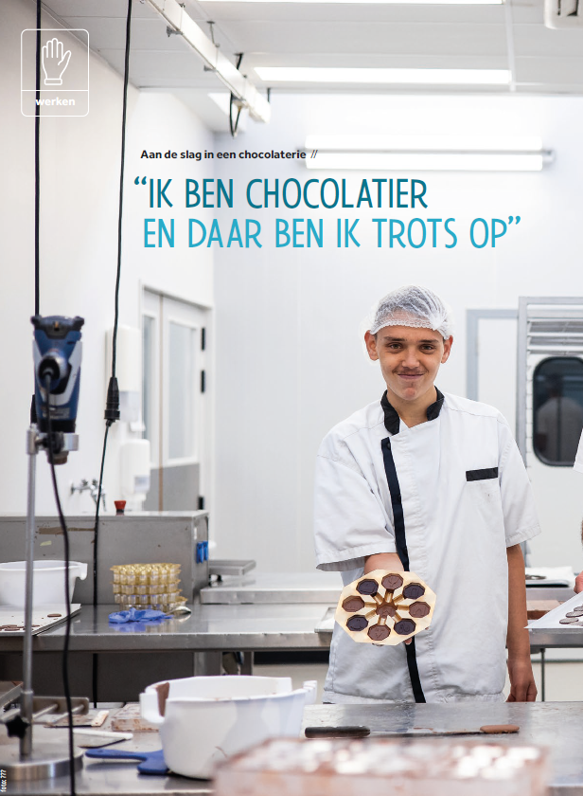
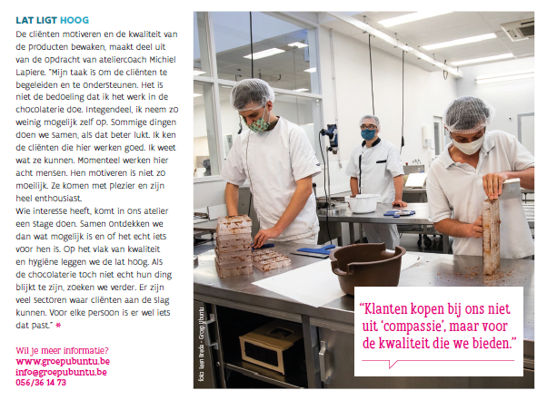
ST*RK MAGAZINE
EXTERNAL PUBLICATIONS
Chocolate makers
'I'm proud to be a
chocolate maker'
'Clients buy our products because of the quality and not out of compassion.'
Notes:
ST*RK Magazine is a magazine that is printed 4 times a year by the Flemish Association for dissabled people. They bring stories about inclusion. The emphasis is on the PI, the job is important and the satisfaction they get out of it.

Slide 64
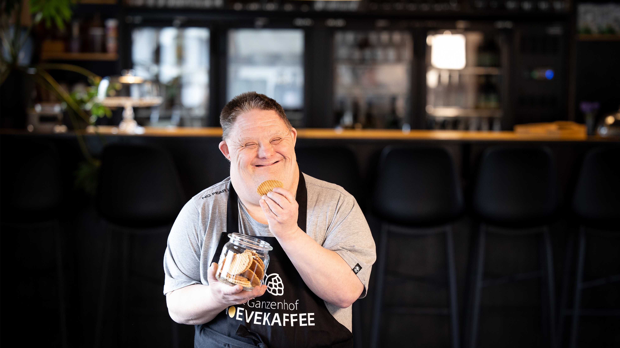
IMAGES SAY MORE THAN WORDS
Notes:
This is a beautiful image that is very inviting. The smile says it all.

Slide 65
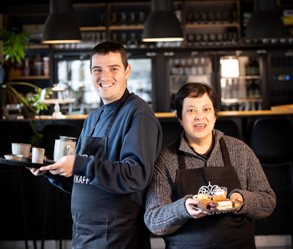
CLIPS/REELS ARE ALWAYS A GOOD IDEA
REOPENING HOEVEKAFFEE
Reels and clips trigger people to watch
Likes and visibility
Notes:
Moving images make people want to watch. It isn’t necessary to have spoken clips. Make sure the quality of the footage is good and use matching music. Add some features and key words to deliver the right message. Make sure not to forget the essential information and CTA in the end.

Slide 66
ASSIGNMENT IN OUR WORKSHOPS
Use digital communication tools
Storytelling of a creator: write the story of a creator working in the workshop you will visit for web
Make one or more pictures that support your story (choose at least 1 good image)
Choose one quote from your story. Why do you choose that particular one?
Write on the base of this story one message for social media

