Slide 2
Disclaimer
"The European Commission support for the production of this publication does not constitute an endorsement of the contents which reflects the views only of the authors, and the Commission cannot be held responsible for any use which may be made of the information contained therein."

Slide 3
BELONGING – BECOMING – BEING
Contribute to the quality of life
Create conditions, opportunities, space to BELONG, to BECOME en to BE.
Everybody is part of a larger whole
Everybody has vulnerabilities AND strengths, skills
Holistic view

Slide 5
COMMUNICATION DEPARTMENT
As a support service for our organisation and central in our strategic policy
Marketing strategy: ifo prospective cliënt – employer branding - potential customer
Structurally internal and external information transfers and information flow
Professional and attractive appearance: design, look and feel
Community building - promoting ubuntu-philosophy
Create social impact

Slide 6
CREATE SOCIAL IMPACT BY STORYTELLING
Quality Of Life
Change perception of people with disabilities / vulnerabilities within society
Raising awareness and influencing policy – Advocacy
Community Building
➔ We use different media to do this:
Internal en external publications (on paper and online)
Social media
Websites
Video and aftermovies
…

Slide 7
IMPACT ON QUALITY OF LIFE
Develop a professional identity
Through Story they get a clearer image of themselves in a certain context
➔ Increased quality of life
For example: stories in our AKTUA magazine (online and offline)

Slide 8
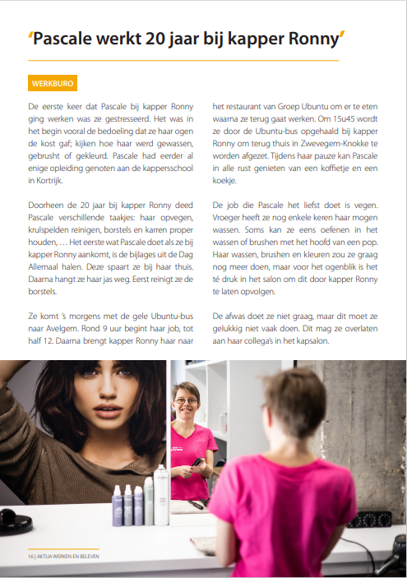
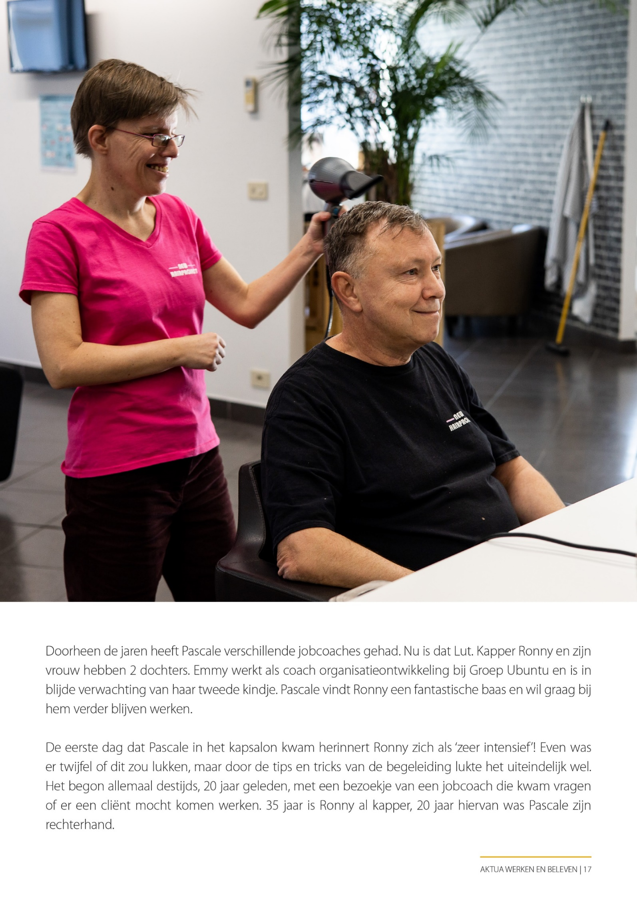

Slide 9
CHANGE PERCEPTION IN SOCIETY
Bringing real, authentic stories:
can enhace the ability to empathise with others
can lead to more respect, better understanding and tolerance.
ideally can lead to reflection and awareness and stimulates change and action.
can contribute to personal growth and social impact.
For Example: our webshop ‘het andere geschenk’ – spotlight on ‘de makers’ (creators)
‘maker’ Margot https://hetanderegeschenk.be/de-makers/maker-margot/
all makers: https://hetanderegeschenk.be/de-makers/

Slide 10
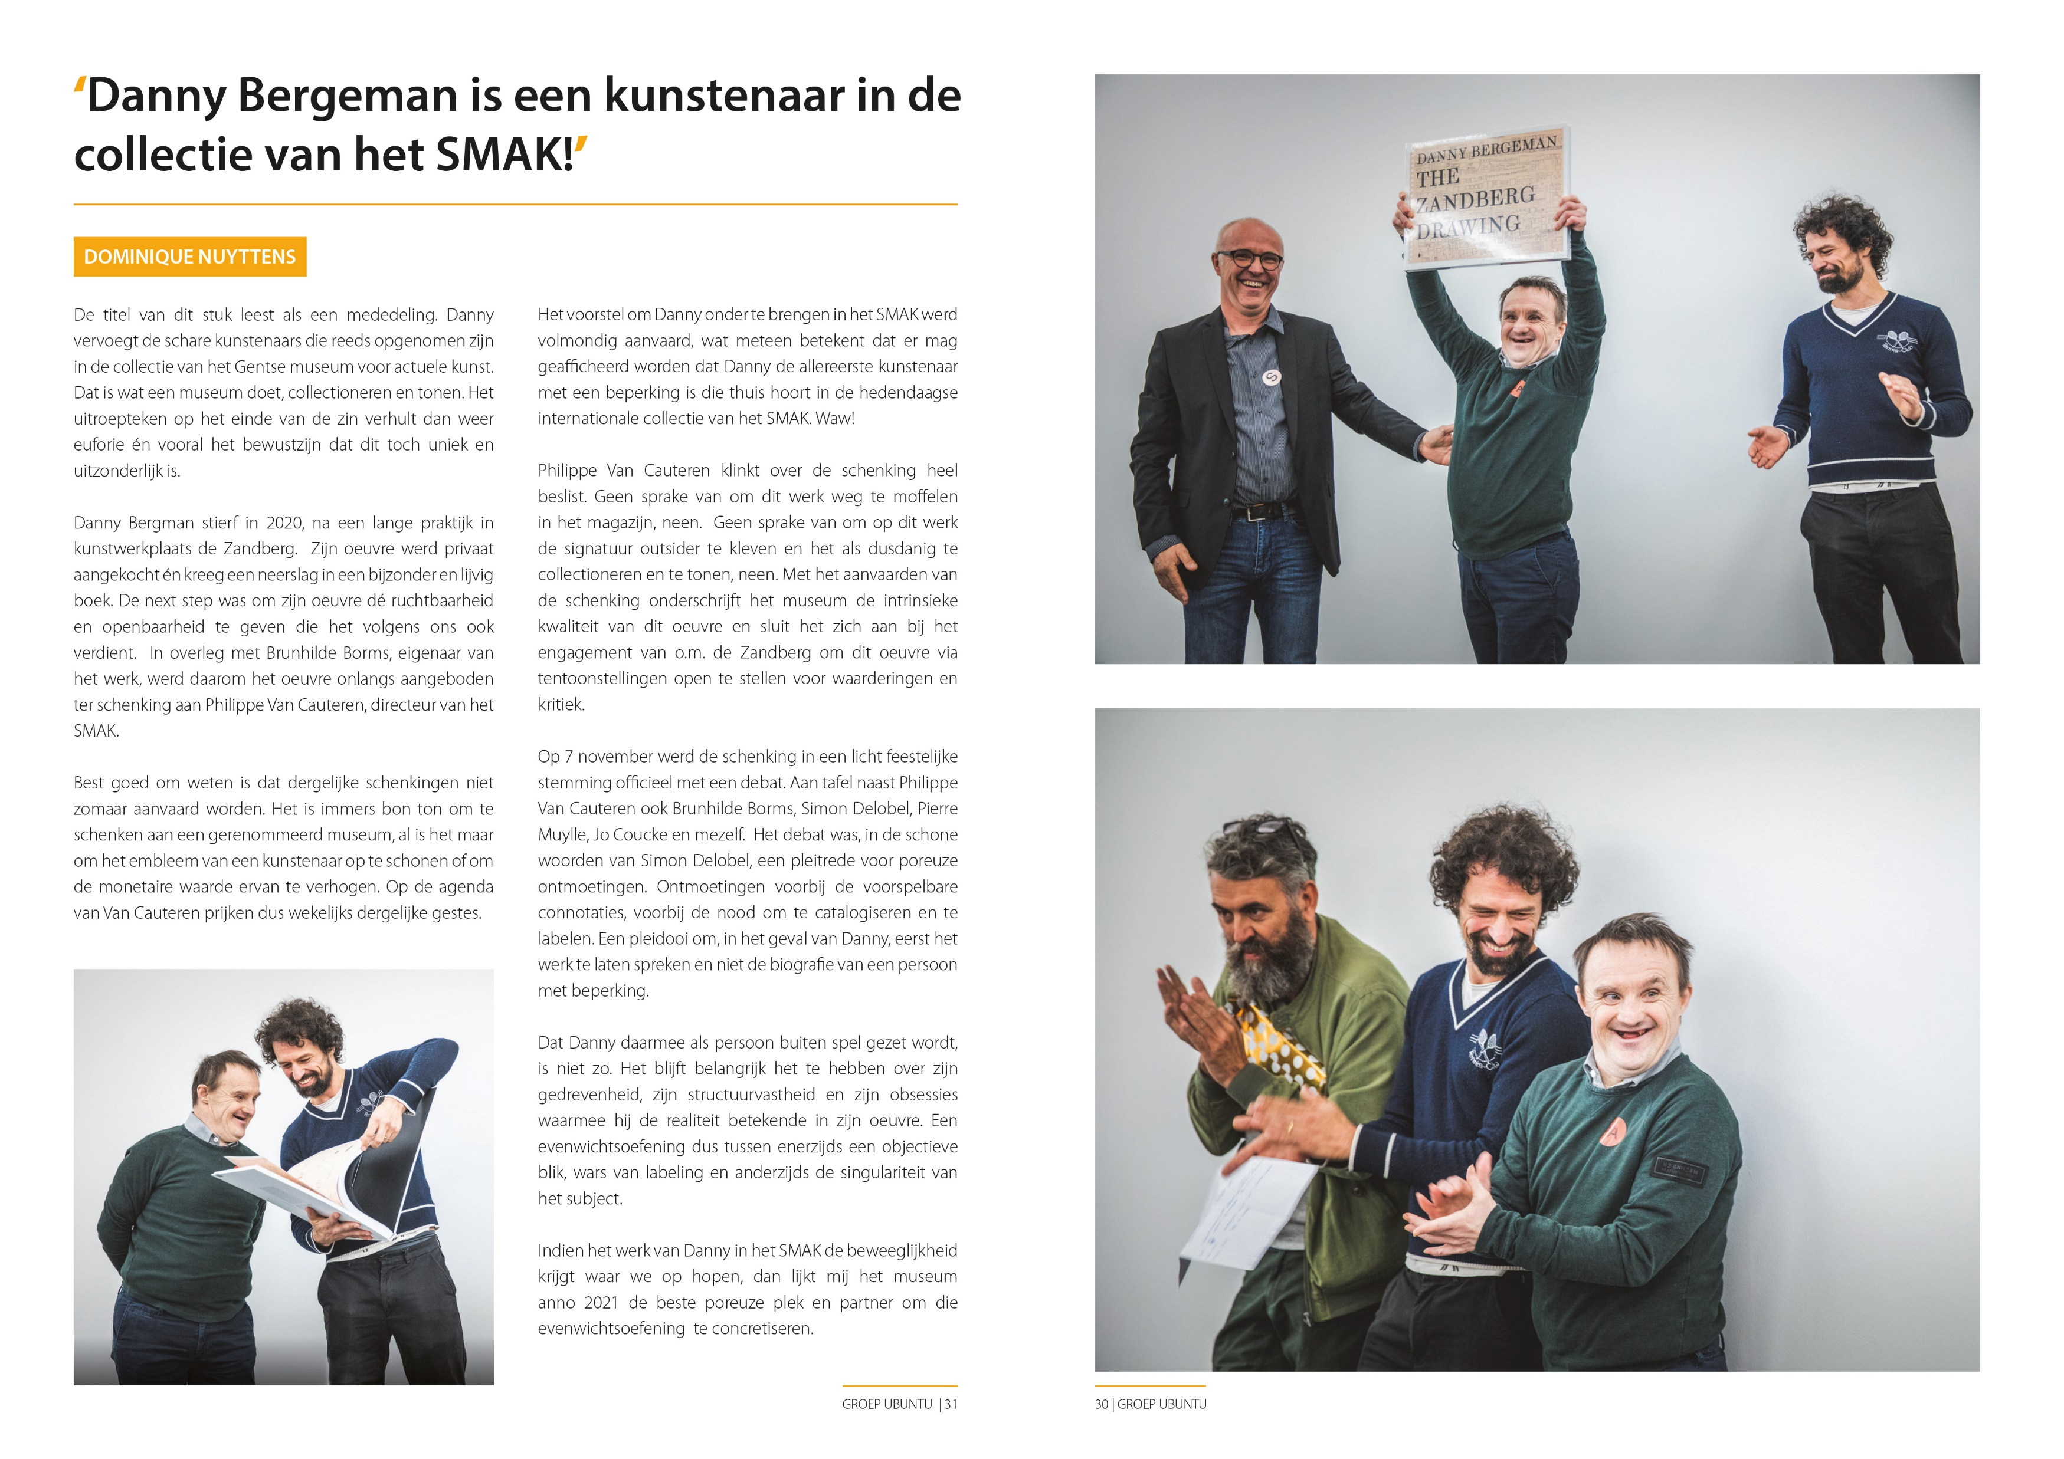

Slide 11
Storytelling in our digital newsletter: https://mailchi.mp/groepubuntu/april2022
Storytelling by video and aftermovies:
Amili Haha: fashion collection and the making of… https://www.youtube.com/watch?v=OfzyiGGvdiM&t=43s
Employer branding: https://vimeo.com/639533130?embedded=true&source=vimeo_logo&owner=98041140

Slide 12
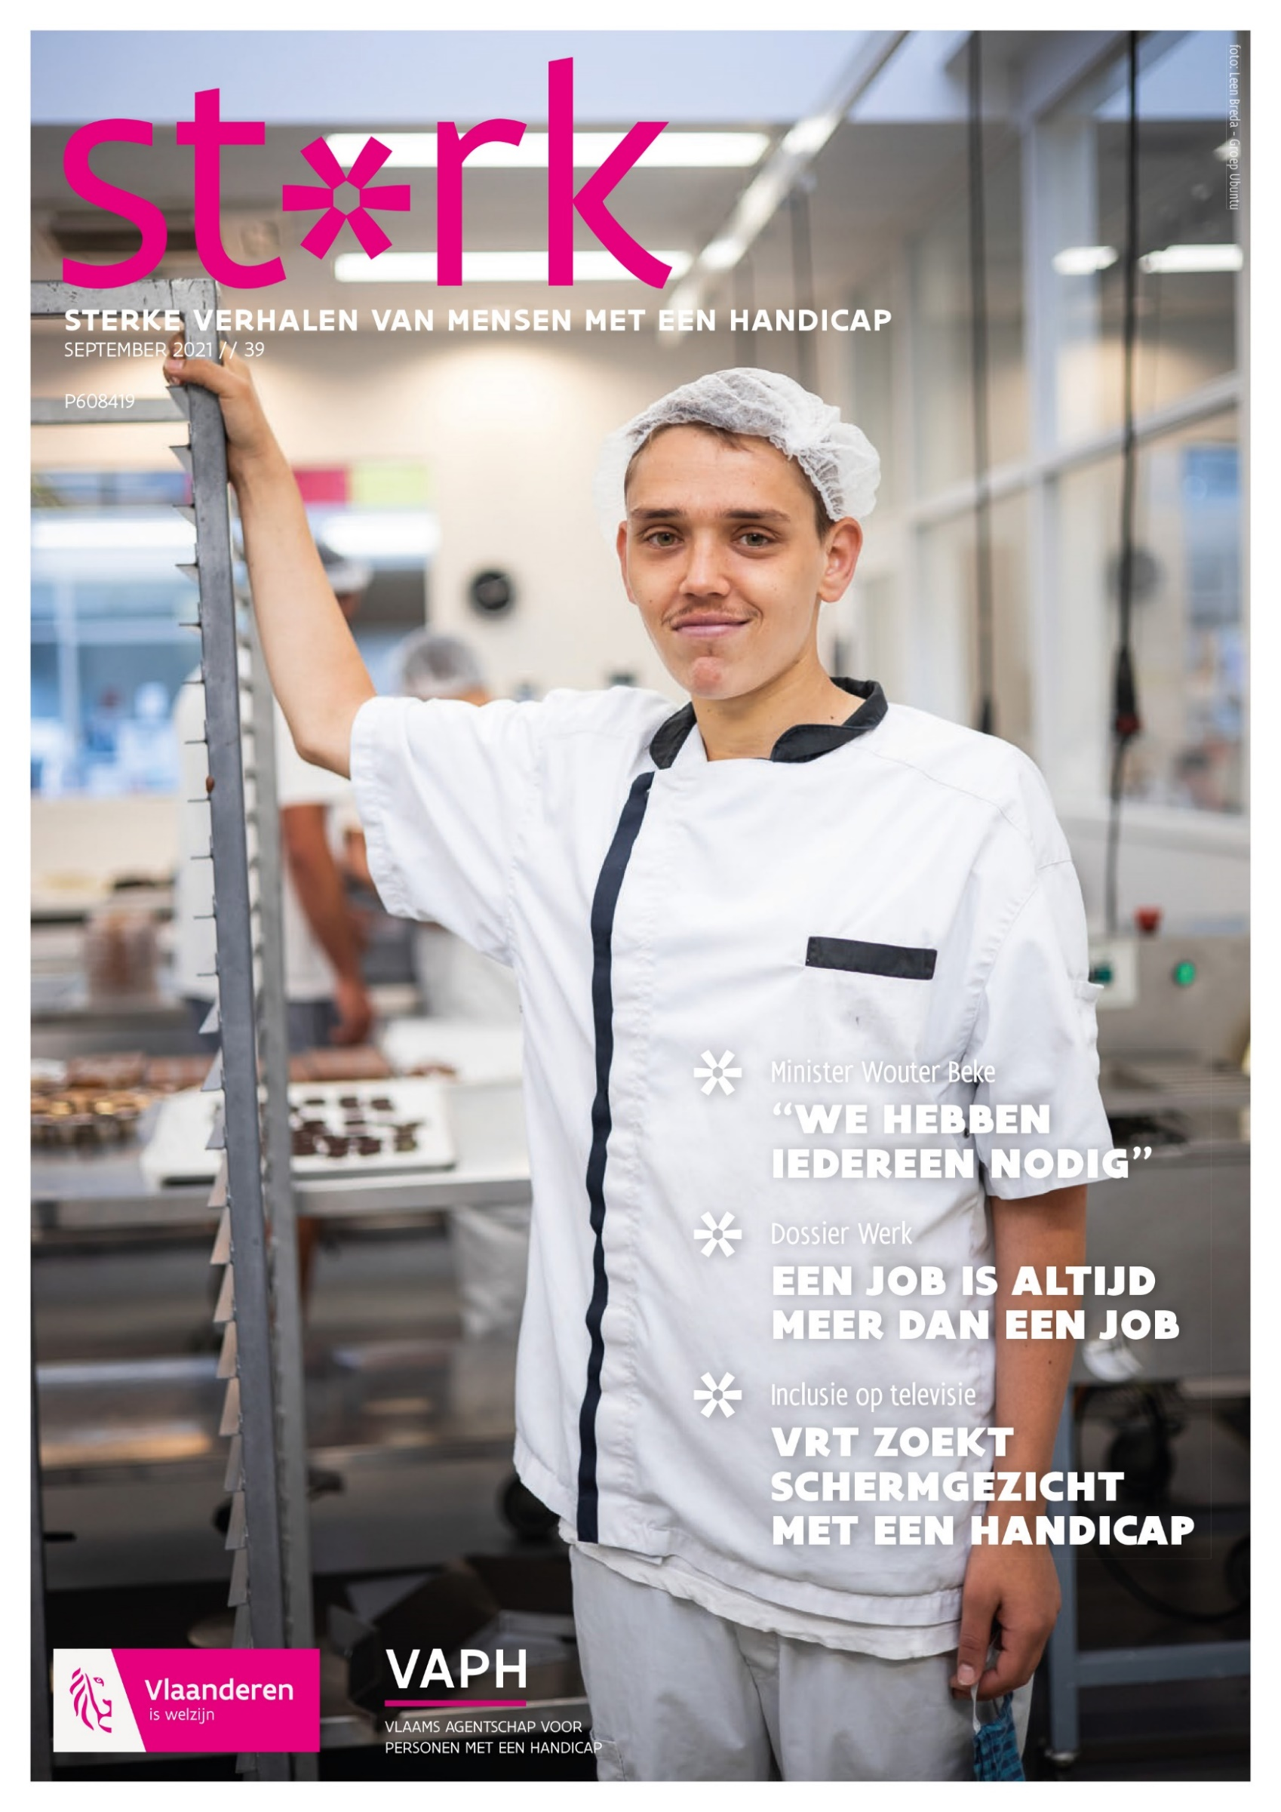
Raising awareness
and influence policy makers

Slide 13
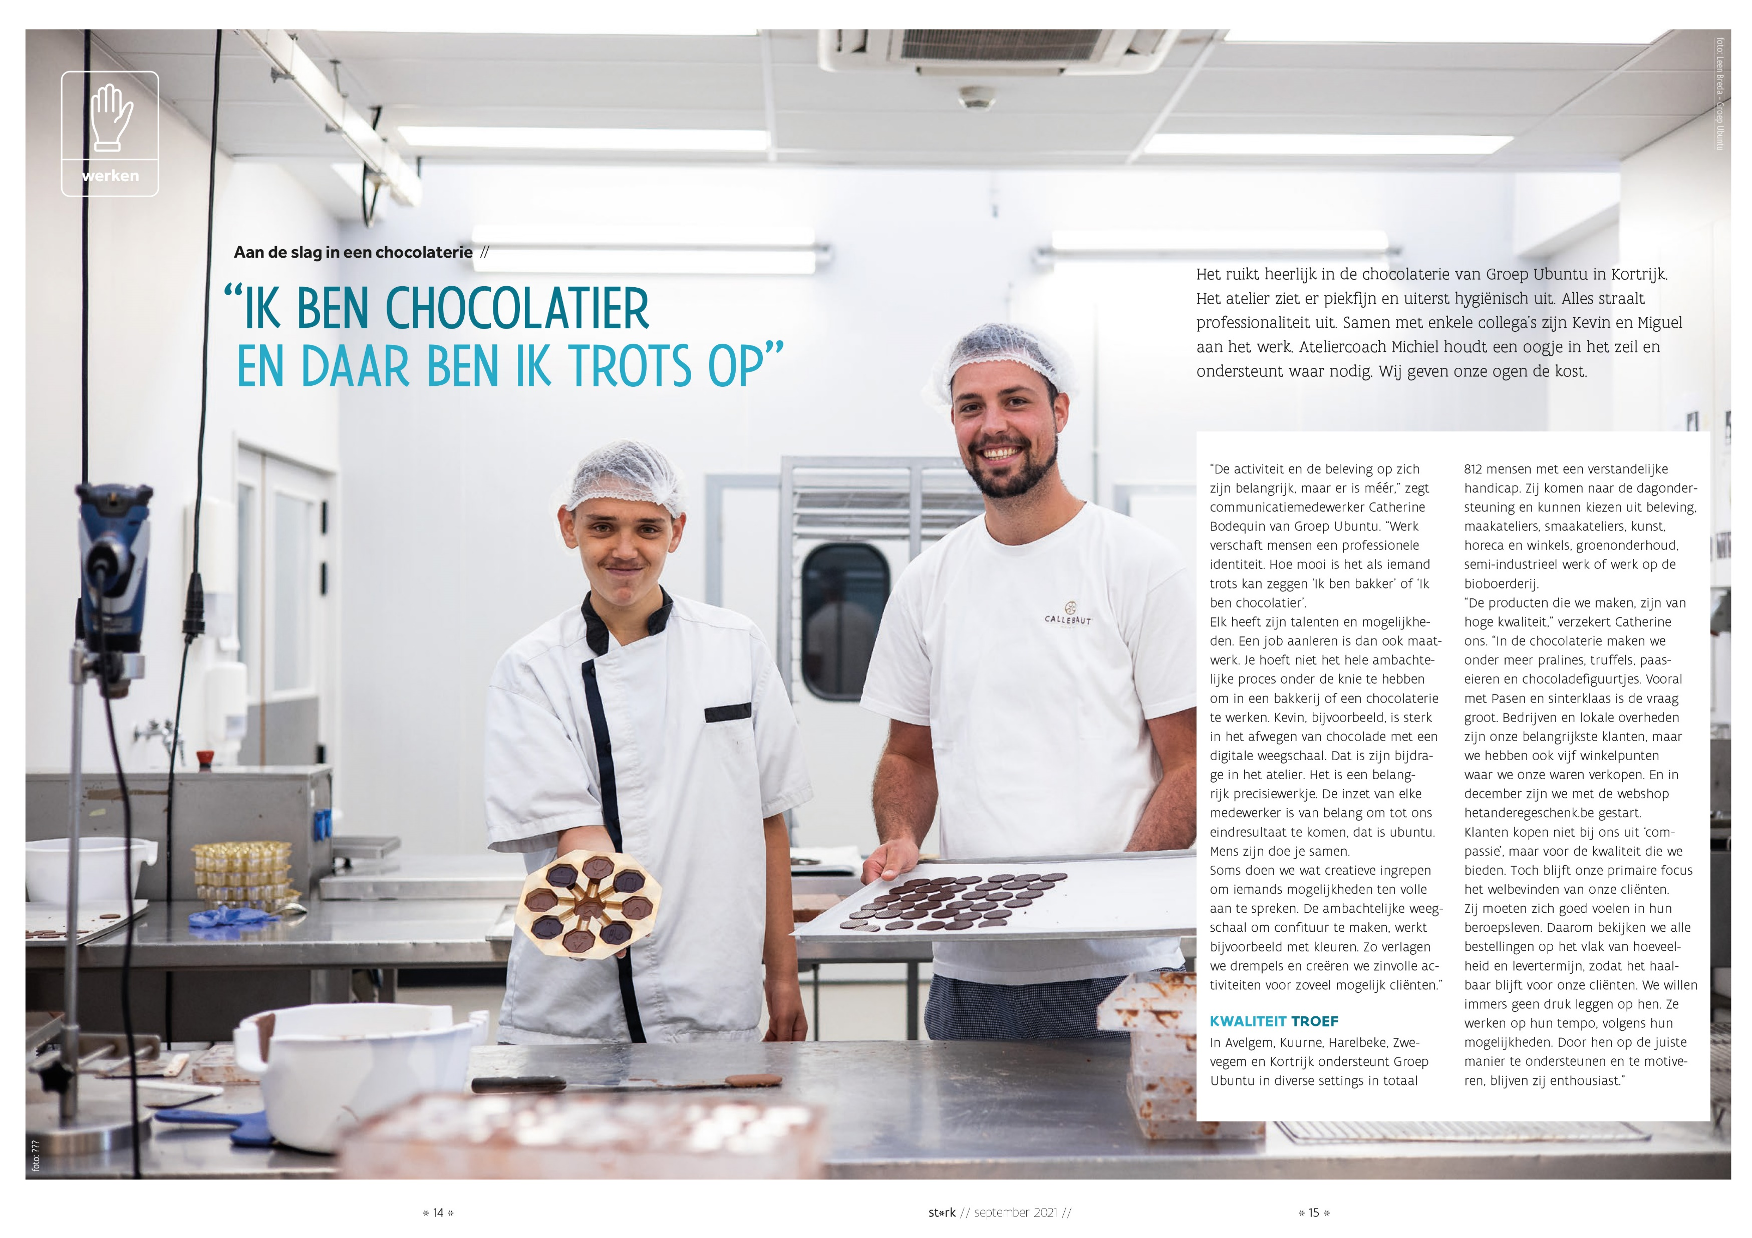

Slide 14
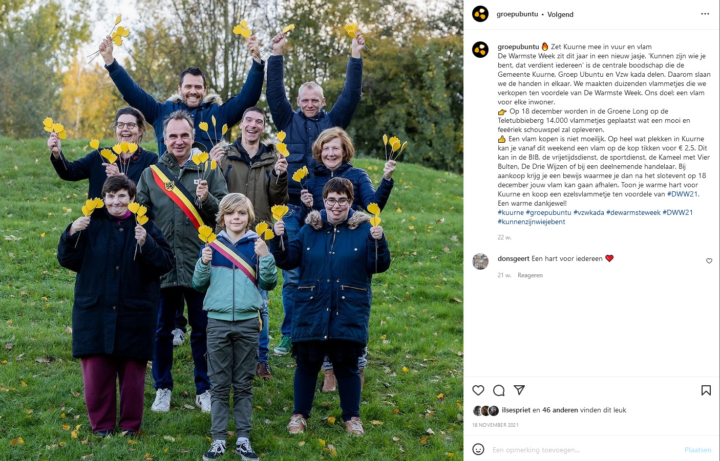

Slide 15
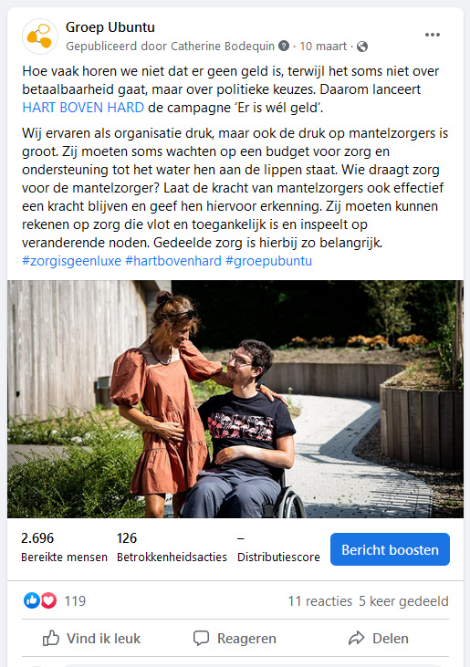

Slide 16
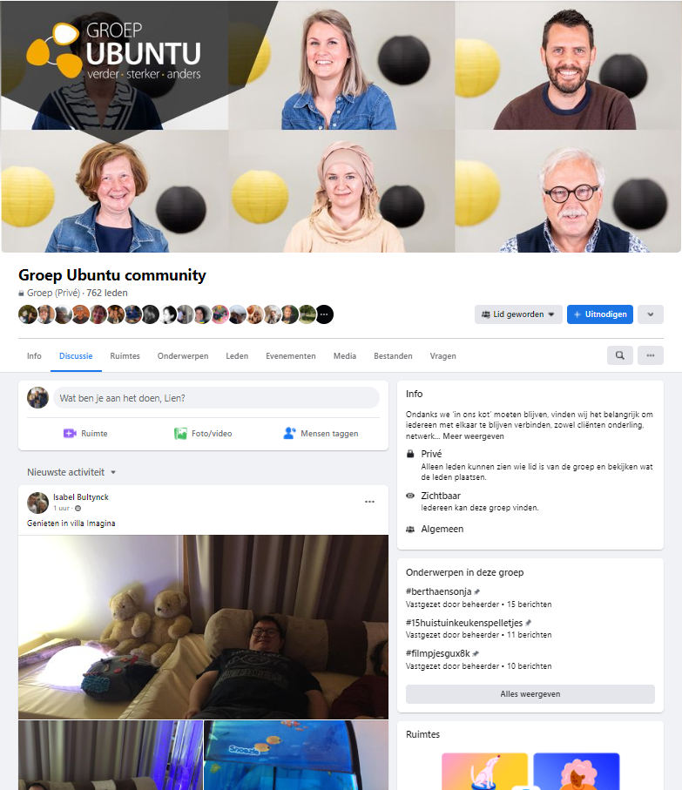
COMMUNITY BUILDING
Ambassadorship - Ubuntu philosophy
Groep Ubuntu Community

